Slide 1
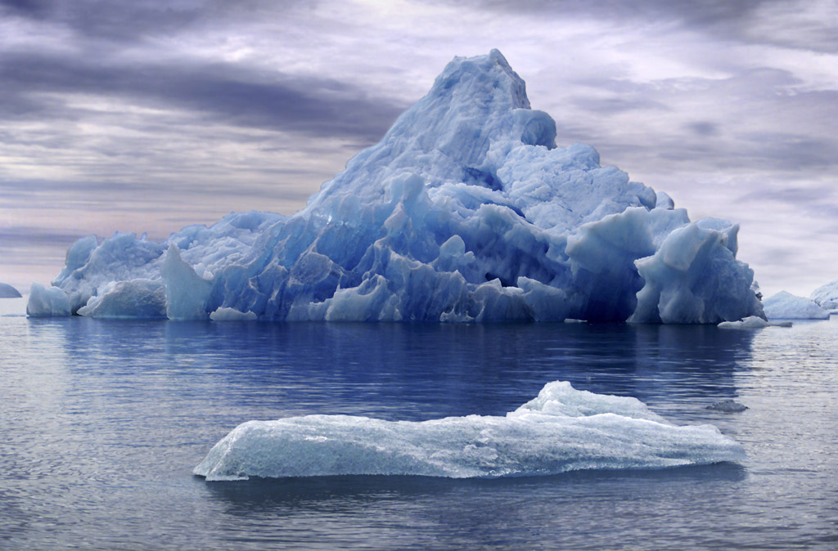
Forensic Physics

Slide 2
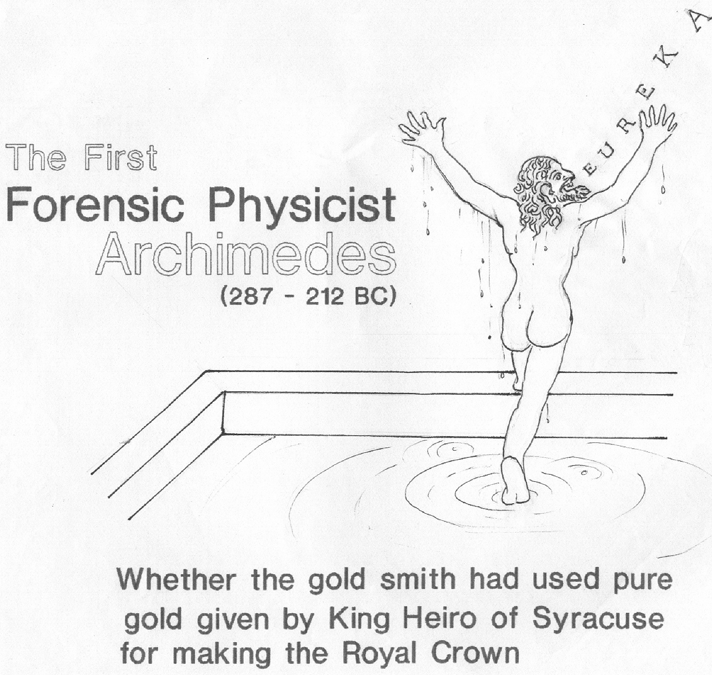

Slide 3
Physics
the study of the physical properties of matter
that is
the study how the matter behave under different circumstances
Forensic Physics
the application of the methods and techniques of physics
  to produce evidence - objective and
  circumstantial
  to elucidate pertinent questions/doubts
  for the judicial and social justice
  to convert suspicion into reasonable certainty of either guilt or innocence

Slide 4
Such evidences do not suffer from the various admitted weaknesses of personal testimony
It is an endeavor to solve crimes in society and reaffirm confidence in the social system for better living
There are probably few fields in which the applications of physics are as varied as in the scientific investigation of crime
The applications of forensic physics, as all other branches of forensic science, may conveniently be divided into comparative and definitive (absolute) ones

Slide 5
Forensic Physics
“If the Medical Jurisprudence cannot
enlighten us,
if the Microscopist and Chemical Analysts
are incapable of elucidating the matter,
recourse must be had to the expert in Physics”
– Dr. Hans Gross, John Adam, and J. Collyer Adam

Slide 6
Information Obtained from
Examination of Physical Evidence
Victim
Suspect
Physical Evidence
Object
Crime Scene

Slide 7
any objects and materials from a scene of crime, suspect , or victim that may shed light on an investigation/judicial decision making, are
physical evidence (clue)/exhibit (brought in court)
Evidence Recognition
Human initiated events produce a record of it self
Changes in the immediate environment
* Objects get moved
* Objects get broken
* Marks are made
* Materials change
* Materials are transferred
et cetera

Slide 8
Trace Evidence
Size : small amount that can only just
be detected
Vestige : surviving trace of what has
almost disappeared
Pattern : an impression/mark/sign that
some person, animal, or thing
has been in a particular place
Trace something back: to discover origin of it

Slide 9
Trace evidence may be in the form of
◙ transferred material ◙ a pattern ◙ or both
Transferred material
  Contact transfer of material (two-way transfer)
  Contactless transfer of material (one-way transfer)
Pattern evidence
  from contact transfer of material
  from contactless transfer of material
  from contact, independent of transfer of material
  from physical separations of material/object

Slide 10
Pattern evidence from contact less transfer of material
Gun shot discharge residue patterns
Air borne blood droplet stain pattern
Pattern evidence from contact transfer of material
material present on a donor surface may be transferred
to a receptor surface in a manner that preserves some characteristic geometric features of donor surface
  inked rubber stamp
  inked (bloody) fingerprint
Pattern evidence from contact
(independent of transfers of materials)
marks resulting from contact between two surfaces where one surface distorts, deforms or reshapes the other

Slide 11
Pattern evidence from contact
(independent of transfer of material)
Static contact deformation
Imprints : two dimensional static contact physical pattern
Indentations : three dimensional static physical pattern
Dynamic contact deformation
Striations and wipes : dynamic contact pattern

Slide 12
Use of trace evidence
Investigative aids : helping to develop
suspect
Associative Evidence : establishing the link
Aid to reconstruction : understanding how an
event of concern took
place

Slide 13
most of the examinations conducted in the Physics division are comparative in nature
These are aimed at providing a physical evidence of the presence of a suspect at the scene of crime, or
showing that an object which can be linked with him in some other way, was used in the commission of the crime.
that is, these examinations establish a relation between the crime and the perpetrator

Slide 14
Association based on material comparisons
Comparison of materials using
Morphological criteria
Physical properties
Compositional analysis
(materials composed of complex physical mixtures)
failure to exclude
after a series of independent tests which have utilized
discriminating criteria have been applied
Physical evidence occurs in a context

Slide 15
Objectives of
Forensic Analysis
Identification
Comparison
Reconstruction
Skilful examination and knowledgeable interpretation

Slide 16
Impact of
Forensic Science
Associative
Dissociative
Speculative

Slide 17
When there is a suspect
Conclusive evidence to associate
Strong evidence to associate a suspect
Some evidence to associate a suspect
Inconclusive evidence to associate
Some evidence to eliminate a suspect
Strong evidence to eliminate a suspect
Conclusive evidence to eliminate
a suspect
a suspect
a suspect

Slide 18
When there is no suspect
Speculative cases
Good intelligence
Slight intelligence
No intelligence
High level of inconclusive evidences
indicate inappropriate type of
physical evidences

Slide 19
Investigation
Forensics
end users
Judgment
(INVESTIGATIVE SCIENCE)
(FORENSIC SCIENCE)
Probability of guilt
Presumption of innocence
Associative Potential
Discriminative Potential
Testing hypothesis of crime
Proof of crime
Collection of physical clues
Analysis of physical clues
Suggestive opinion
Definitive opinion
Proactive Approach
Reactive Approach

Slide 20
criminal cases
beyond reasonable doubt
civil cases
preponderance of the evidence
more likely than not

Slide 21
In an investigation of crime, there are two important issues
1st
what do we need to know to solve the case; and
2nd
what evidence is useful to us in court
questions of admissibility shouldn’t discourage us from whatever legally obtainable information will help us solve the case
collect information and follow up anything that offers the hope of a lead

Slide 22
Physical clues examined in the
Physics division of a Forensic Science Laboratory
Paint (chips, flakes, smears or dust)
Soil, Dust, and Dirt
Glass (broken panes/articles; small fragments)
Fractured Surfaces (mechanical fit/contour matching)
Erased identification marks
Tool marks
Wires/cables/strings/ropes
Fabrics
Foot prints
Building materials
Voice
Hard disks (and other storage media for digital data)
Miscellaneous (Railway seals, electric meter seals, arson
debris, physical examination of documents, etc)

Slide 23
Objects (material)
Natural
* major and minor constituents
controlled by nature (within specific range)
* trace constituents vary at random
* change with time (environment, source etc.)
Manufactured
* major and minor constituents
controlled by manufacturer (within specific range)
* trace constituents vary at random
* bulk production and wide distribution

Slide 24
Instrumental Analysis
Instrument
Method
Analyte
Matrix
Reagents
(sample)
(standards)
Analyst

Slide 25
Forensic application of methods sand techniques
of Physics may be classified as:
Gross Macroscopic and General Studies
Microscopic Studies
Molecular (gross) Analysis
Trace Element Analysis
Analysis of voice
Analysis of digital data

Slide 26
Gross Macroscopic
General Studies
Physical properties
dimensions  density  refractive index
electrical properties  et cetera
Reconstruction of fractured surfaces
mechanical fit  glass-fracture (radial, spiral, cone)
rib marks, and hackle marks
Interaction of electromagnetic radiations
with matter
reflection  selective/differential absorption
transmission
photoluminescence (UV/IR florescence and phosphorescence)
Internal interrogation of opaque objects
x-rays (hard and soft)  electronography
γ- rays (Cobalt-60)  neutron radiography (Californium-250)
Betagraphy (methyl c-14 methacrylate sheets)
autoradiography (35-sulfur dioxide exposed paper sheets)
Others
electrostatic imaging  image enhancement (DIP)
chemical etching
(restoration of erased marks)

Slide 27
Morphological and Other Methods
Optical Microscopy
(stereo, comparison, and projection)
Scanning Electron Microscopy
Infrared Image Converter
Eectrostatic Imaging
Digital Image Processing
Radiography
Electronography
Voice Spectrograph
Lasers and Other Narrow Beam Sources

Slide 28
Methods of Molecular (gross) Analysis
Ultra-violet/Visible Spectrophotometry
Infrared Spectrophotometry
Thin Layer Chromatography
Gas Liquid Chromatography
High Performance Liquid Chromatography
Gel Permeation Chromatography
X-Ray Diffraction
Raman Spectroscopy
Mass Spectrometry
Photo Acoustic Spectroscopy
Electron Spin Resonance
Electrophoresis
Differential Thermal Analysis
Thermoluminescence

Slide 29
Spectrophotometry
Ultraviolet-visible
classification and provisional identification
of various chemical compounds
Derivative spectra
: shoulders and inflection points
are transformed into new peaks, which provide
more points of comparison
Infrared
identification and comparison of chemical compounds
Dispersive (transmission)
relatively slow, less sensitive
Fourier transform
greater energy through put, higher resolution
better wavelength calibration, higher noise to
signal ratio
Micro
for minute (micron sized) samples

Slide 30
X - Ray Diffraction
Advantage
the non-crystalline impurities
do not interfere with the identification
non-destructive method; reexamination possible
-supplement to spectrochemical methods
used for the identification
and comparison of
■ minerals  explosives  corrosion products
■ fillers in plastics and papers  mica
■ crystallinity of cellulose constituents of paper
■ clay fraction of soil  mortar  dust
■ drugs  narcotics  diluents for drugs
■ paints  pigments  synthetic textile fibers

Slide 31
Methods of Elemental Analysis
Atomic Emission Spectroscopy
Atomic Absorption Spectroscopy
Neutron Activation Analysis
Electron Beam Probe
X-Ray Fluorescence
Proton Induced X-ray Emission
Electron Spectroscopy for Chemical Analysis
(X-ray Photoelectron Spectroscopy)
Auger Electron Spectroscopy
Spark Source Mass Spectrometry

Slide 32
Instead of qualitative or semi quantitative analyses of a
large number of elements a smaller number of elements
suitable for quantitative analyses should be selected for
meaningful databases
Suitable statistical methods to meet
the judicial requirement should be chosen
probability of guilt
- association potential of the attribute
probability of innocence
- discriminative potential of the attribute
ratio of the probability of guilt / probability of innocence

Slide 33
The personnel responsible for the opinions and interpretation should, in addition to the appropriate qualifications, training, and experience, also have:
relevant knowledge of the technology used for the manufacturing of the items, materials, products, etc. tested,
the way they are used or intended to be used, and of the defects or degradations which may occur during or in service;
knowledge of the general requirements expressed in the legislation and standards; and
an understanding of the significance of deviations found with regard to the normal use of the items, materials, products, etc. concerned.

Slide 34
beyond reasonable doubt
…….‘reasonable’ is not
quantifiable concept
what does reasonable doubt
mean in terms of probability
that the hypothesis of guilt is true

Slide 35
State of U. P. v Krishna Gopal(1988) 4 SCC 302:
1988 SCC (Cri) 928: AIR 1988 SC 2154.
Proof beyond reasonable doubt
Reasonable doubt
To constitute reasonable doubt, it must
be free from an over-emotional response. Doubts must be actual
and substantial doubt as to the guilt of the accused person arising
from the evidence, or from the lack of it, as opposed to mere vague
apprehensions. A reasonable doubt is not imaginary, trivial or
merely possible doubt, but a fair doubt based upon reason
and common sense. It must grow out of the evidence in the case.
There is subjective element in the evaluation of the degrees of
probability and the quantum of proof. Forensic probability must
rest on a robust common sense, and ultimately, on the trained
intuitions of the judge. While the protection given by the criminal
process to the accused persons is not to be eroded, at the same time,
uninformed legitimization of trivialities would make a mockery
of administration of criminal justice.

Slide 36
The Bayesian approach to interpretation of forensic science evidences has been advocated by many forensic scientists in the recent years
Bayes propounded that the probabilities should
be revised when new information is available
The need to revise probabilities arises from a
need to make better use of available information
and thereby reduce the risk involved in decision
making
Posterior Probability
P(A/B) = P(A)P(B/A) / [P(A)P(B/A)+P(not A)P(B/not A)]

Slide 37
Trace evidence is one of the most valuable, misused
misunderstood, and underutilizes physical evidence.
Unfortunately, scientific work on trace evidence in
criminal cases has been peripheral to investigation
rather than being integral with it. It is evident from
the relative frequencies with which they are
encountered in case work in fsls.
The analysis and the interpretation of trace evidences
in resolving the issues in a criminal investigation is
challenging and demands an experienced scientist and
sizeable database on various attributes of physical trace
evidences of different types.

Slide 38

Thank You

