Slide 1
Examination of
wires and cables
ranbsingh

Slide 2
Objects (material)
Natural
* major and minor constituents
controlled by nature (within specific range)
* trace constituents vary at random
* change with time (environment, source etc.)
Manufactured
* major and minor constituents
controlled by manufacturer (within specific range)
* trace constituents vary at random
* bulk production and wide distribution
ranbsingh

Slide 3

Ingot
Wire bars
Rolled wire rods
Hard drawn wire
Rod A
Rod B
known
obscure
known

Slide 4
Examination of wires
Measurement of gauge(diameter)
physical match of cut ends
die marks on the surface
material
electrical resistance
trace element profile
(class characteristics)
(individual characteristics)
(class/individual characteristics)
(class characteristics)
(class characteristics)
(individual characteristics)
ranbsingh

Slide 5
Measurement of diameter
Diameter should be measured in mutually perpendicular directions at a place
Readings should be taken at least, at
three places on a sample
Average of the above six readings should be
taken for comparison
Telegraph wires
2.43 - 2.53 mm
2.77 - 2.87 mm
3.42 - 3.52 mm
ranbsingh

Slide 6
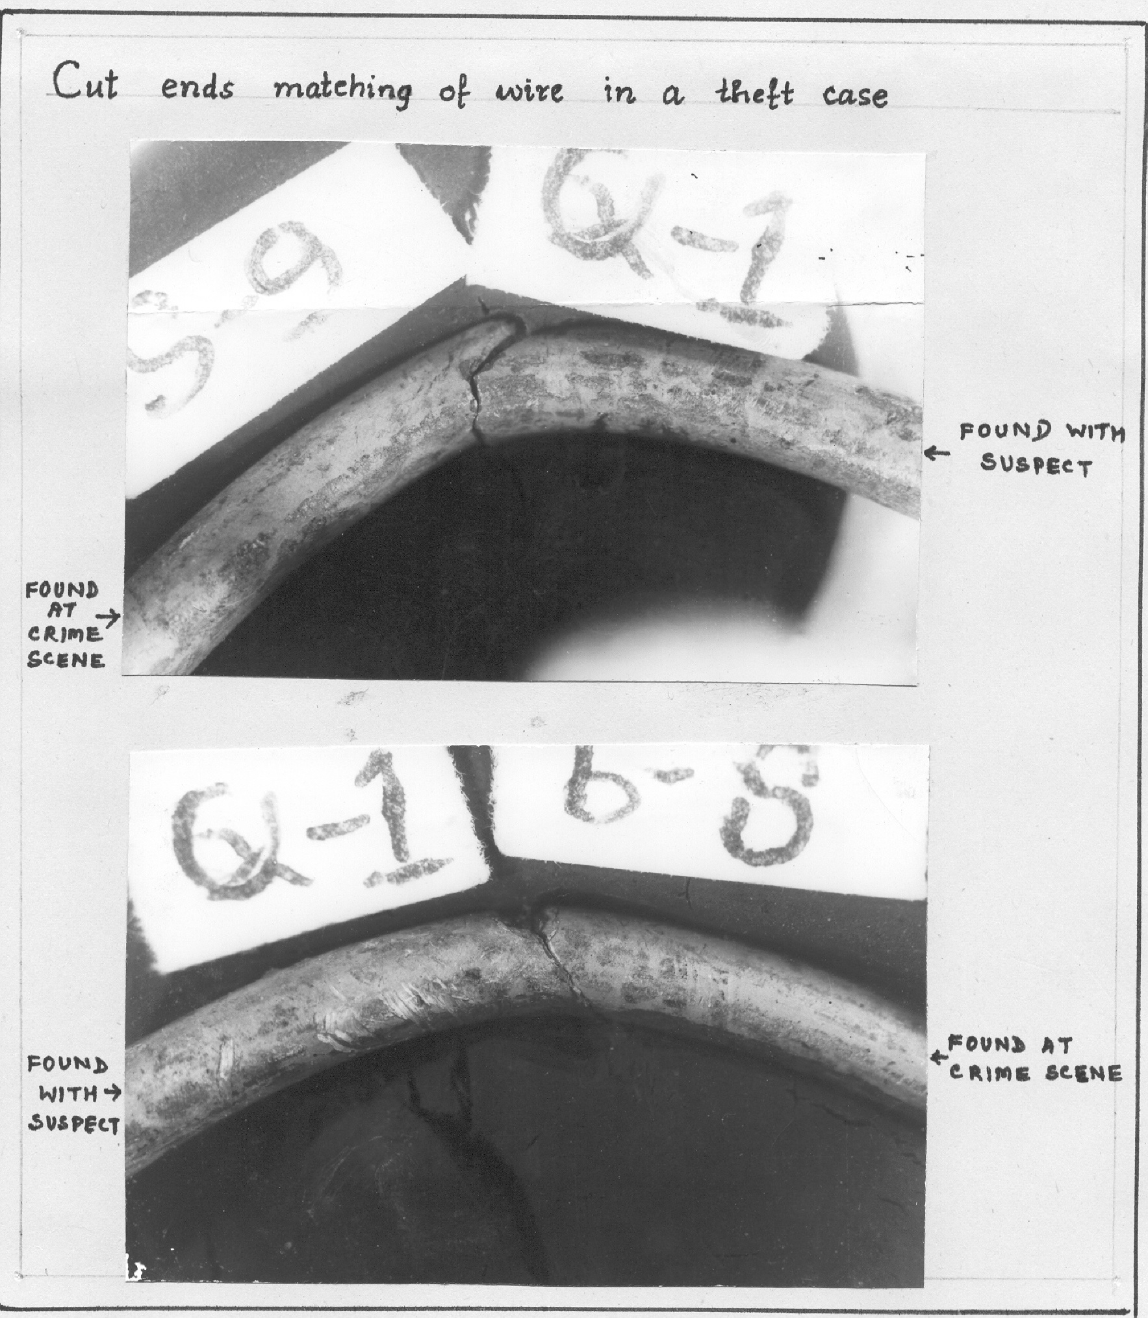
physical match of cut ends

Slide 7
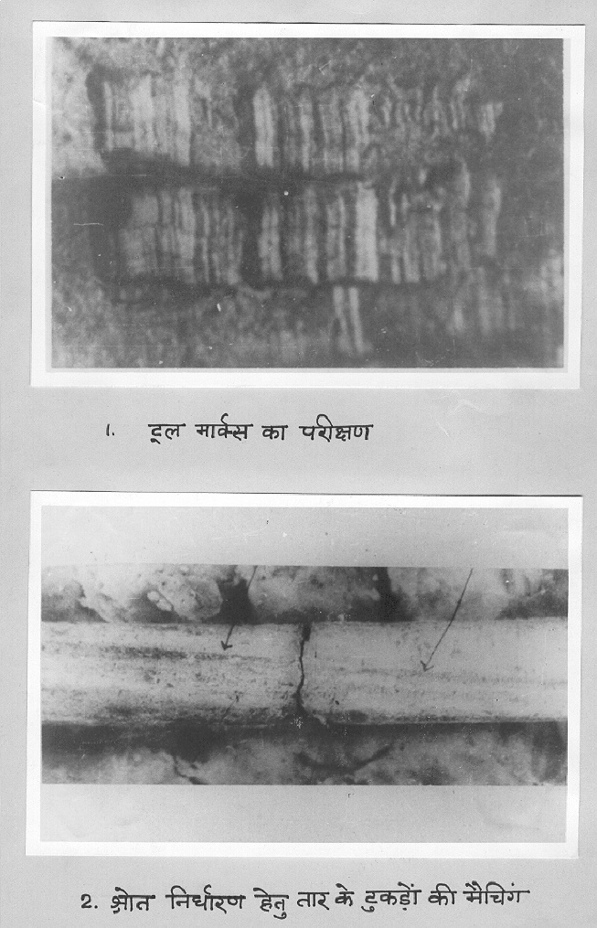
Comparison of striations (die marks) on the surface of wires

Slide 8
Forensic
Trace element analysis
 Determination of a specific element
(for example, Contact transfers)
 Determination of a group of elements
(for example, gun shot residue)
 Trace element profiling for characterization
(for example: metallic wire, opium)
 Common contaminants in known and
questioned samples
Levels of constituents
major constituents 10 - 100 percent
trace constituents 1 - 100 ppm
minor constituents .1 - 10 percent
ultra trace constituents .001 - 1 ppm
ultra-ultra trace constituents less than .001 ppm

Slide 9
Composition Of Bauxite
Moisture
1.0
Cr O
2
3
0.07
L O I
22.3
MgO
0.03
Al O
51.3
MnO
0.02
2
3
2
Fe O
14.1
ZrO
2
0.10
2
3
TiO
8.0
ZnO
0.01
2
SiO
3.0
Ga O
0.008
2
2
3
V O
0.2
BeO
0.001
2
5
P O
0.19
Specific
2
5
gravity
2.8
CaO
0.08
ranbsingh

Slide 10
Impurities detected in aluminum
Antimony
Calcium
Gallium
Lutetium
Potassium
Tin
Arsenic
Cerium
Hafnium
Magnesium
Samarium
Titanium
Beryllium
Chromium
Iron
Manganese
Scandium
Vanadium
Boron
Cobalt
Lanthanum
Nickel
Silicon
Ytterbium
Bismuth
Copper
Lead
Phosphorous
Zinc
Sodium
Zirconium
spectrographic analysis
elements
coefficient of variation(%)
analyzed
B
Cr
Cu
Fe
Mg
Mn
Ni
Pb
Ti
V
5
7
22
7
21
7
7
14
12
15
elements
recommended for
characterization
Ni, Cr, B, Mn, Fe
in order of discrimination potential
neutron activation analysis
elements
analyzed
Cu
Cr
Fe
Ga
Hf
La
Mn
Sc
Sm
coefficient of variation(%)
6.5
1.8
3.5
4.5
10
11
2.5
6.5
12.5
elements
recommended for
in order of discrimination potential
characterization
Mn, Cr, Hf, Sc, Fe
ranbsingh
Tagging: silver

Slide 11
Trace element profile of copper
Impurities detected
(NAA OES)
and
Antimony
Cobalt
Iridium
Nickel
Tellurium
Arsenic
Gold
Lead
Silver
Tin
Bismuth
Iron
Manganese
Selenium
Zinc
Neutron activation analysis
Ag, Se, Sb, Au
elements recommended for
characterization
ranbsingh

Slide 12
Fifty six samples
from a hundred meter copper wire
Elements Ag Se Sb Au
Mean concentration 12.7 4.3 4.0 0.6
(value in ppm)
Coefficient of 3.5 4.2 2.2 3.8
variation(%)
ranbsingh

Slide 13
Comparison of copper wires
Case A
concentration in ppm
Ag Au Sb Se
questioned
could not be
14.0 0.51 7.0 2.7
known
distinguished
0.2 0.03 2.2 0.7
known
on the basis
0.3 0.03 2.1 0.7
Case B
of physical,
questioned
chemical,
14.0 0.52 7.0 2.7
known
*
and electrical
7.9 0.06 0.5 4.5
known
properties
14.0 0.52 7.0 2.7
*
*

Slide 14
Strands of different Cables having
similar impurity levels
Ag
Au
Sb
Se
B2
10.4
0.074
4.4
0.8
C17
10.1
0.074
4.0
0.8
Average values of impurity levels
in three different multi-stranded cables
Ag
Au
Sb
Se
A
10.25
0.0628
0.302
1.47
B
11.76
0.0464
2.413
0.65
C
11.97
0.0458
2.237
0.68

Slide 15
Different Strands of the same Cable having
indistinguishable impurity levels
Ag
Au
Sb
Se
A2
12.5
0.018
0.20
0.6
A3
12.3
0.017
0.22
0.6
A9
10.9
0.017
0.18
0.5
A10
11.0
0.019
0.19
0.5
B3
7.6
0.005
0.10
0.4
B9
7.6
0.004
0.08
0.3
B19
7.8
0.006
0.08
0.3
C14
12.1
0.011
0.13
0.5
C15
12.1
0.012
0.13
0.4

Slide 16

Physical correspondence of strands

Slide 17
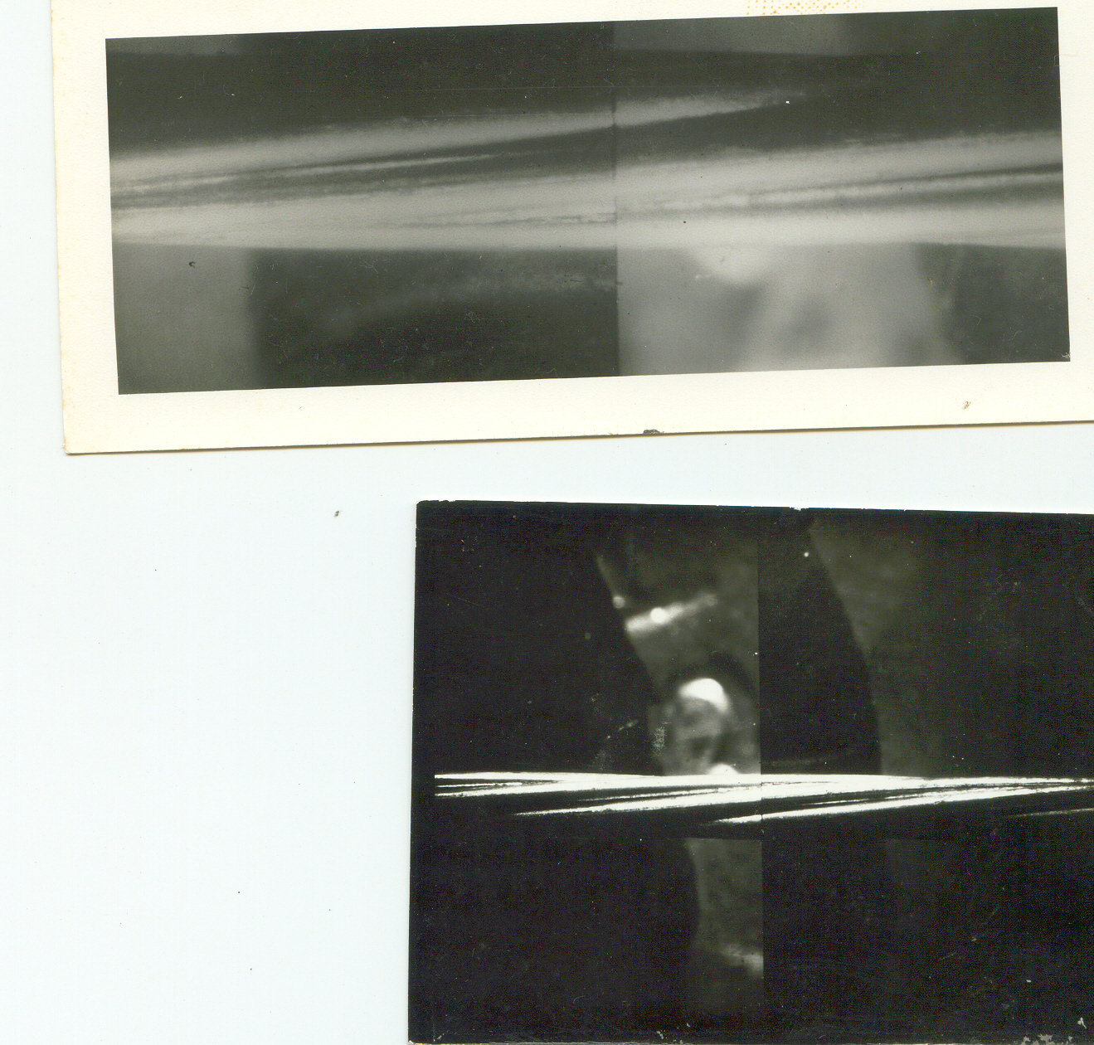
Wire links transmitter with suspect terrorist
two pairs of flex from the transmitter A1, A2 & B1, B2
two pairs of flex from the suspect C1, C2 & D1, D2
Each had seven strands; 3-iron strands & 4-copper strands
Diameter of each strand was 0.27 mm
All the strands were marked sequentially and analyzed
Neutron Activation Analysis technique was used
Flexes could be grouped into; (1) A1, B1, C2, D2 and (2) A2, B2, C1, D1
The suspect was associated with the transmitter

Slide 18
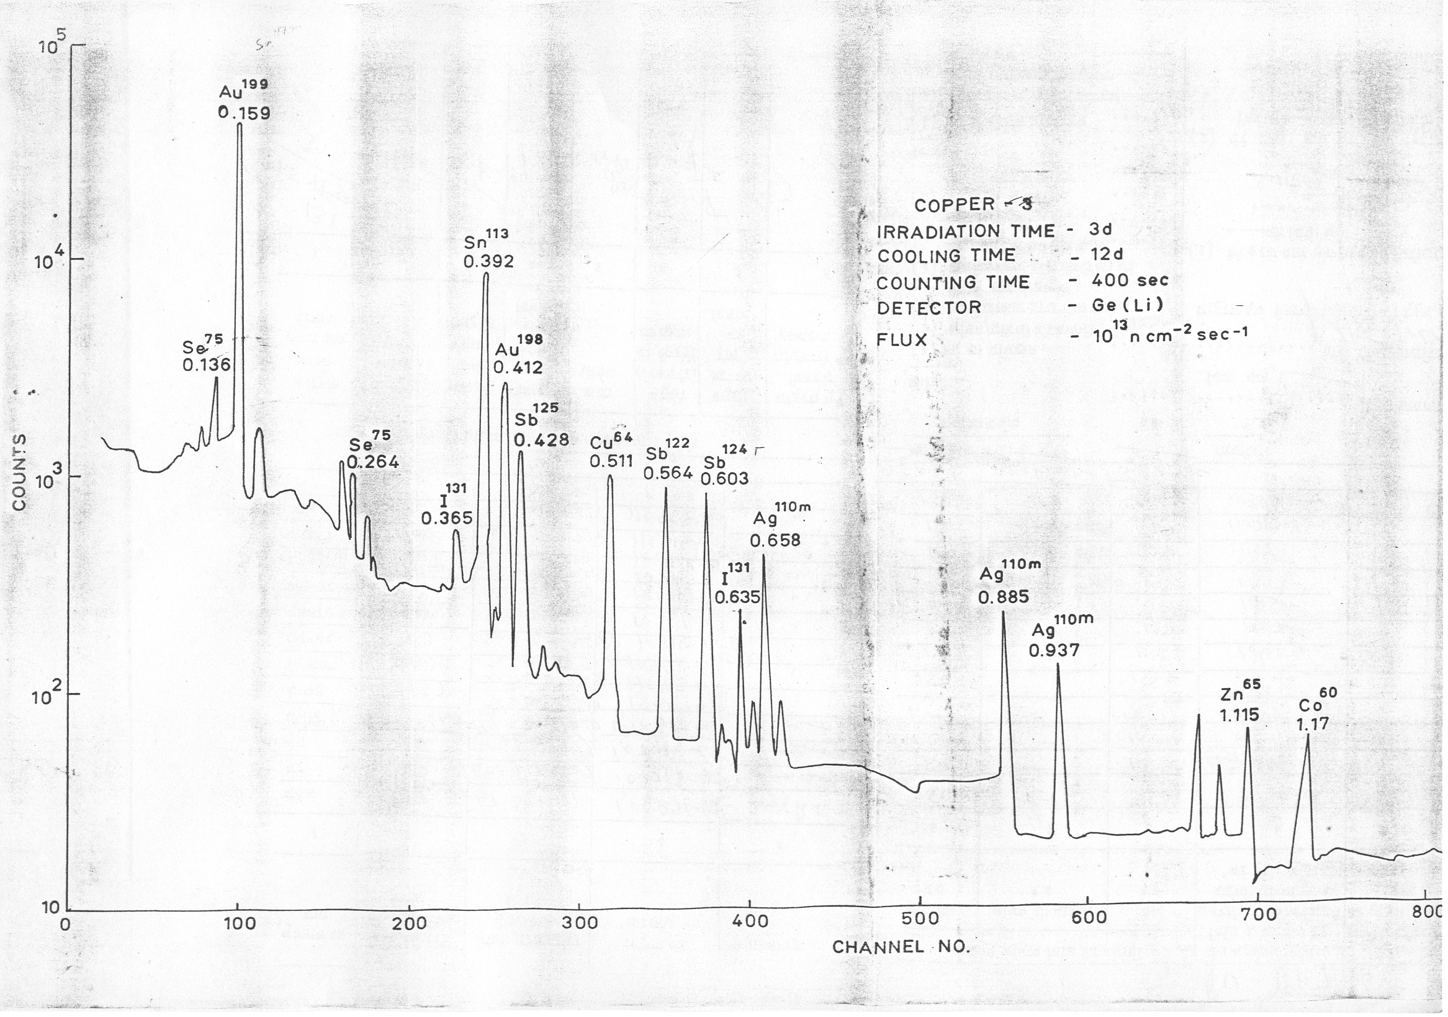

Slide 19
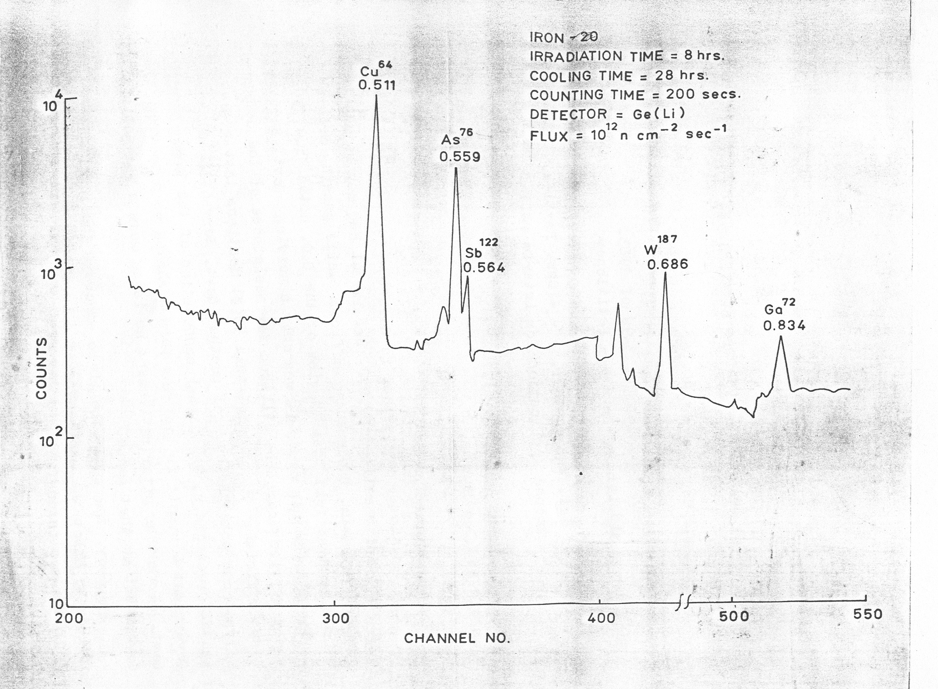

Slide 20
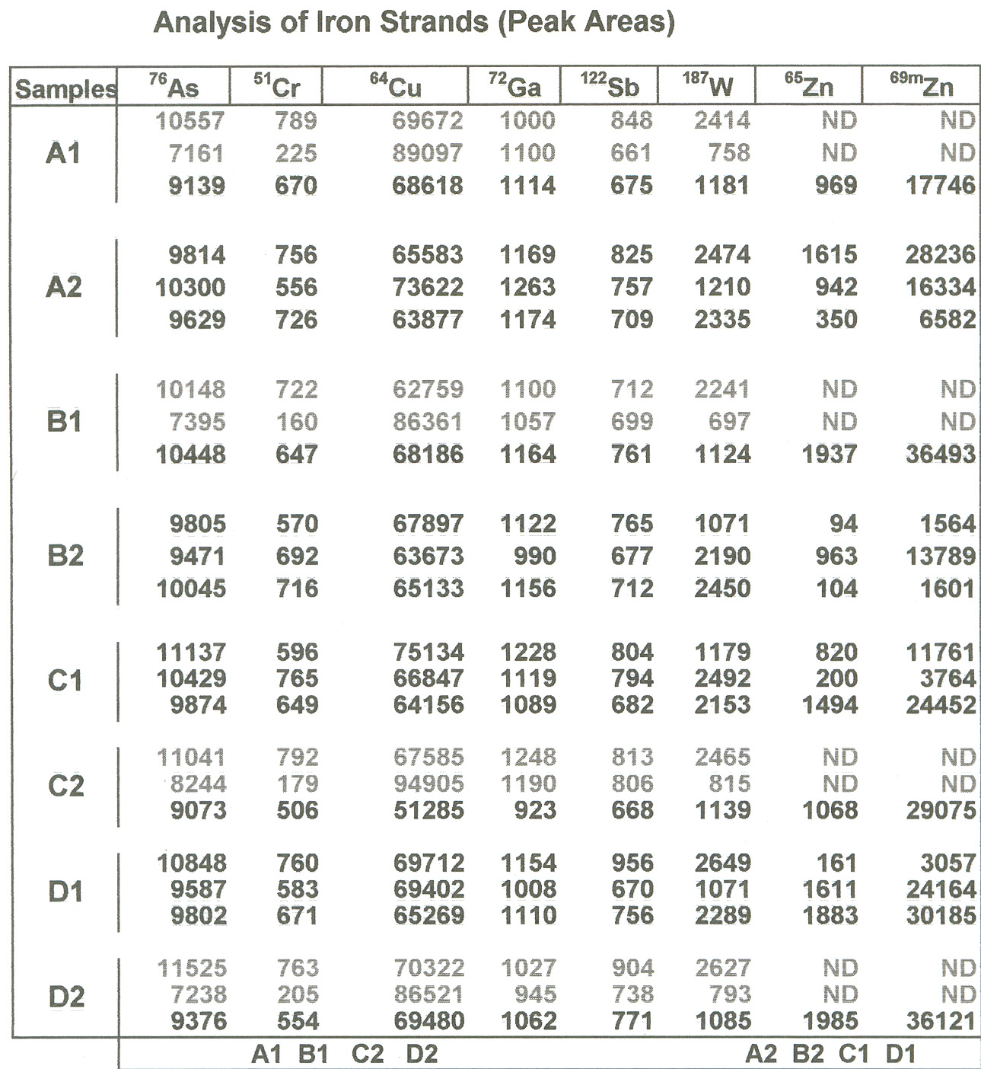

Slide 21
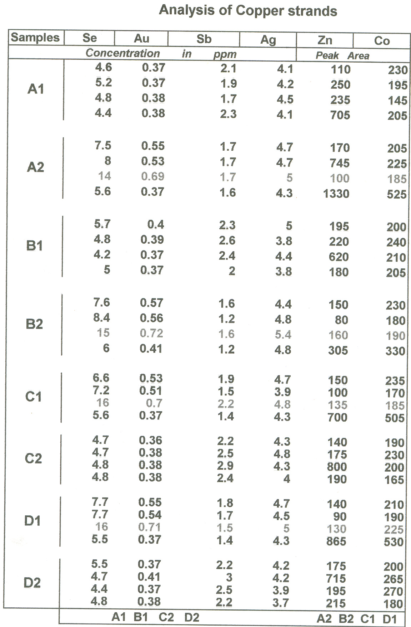

Slide 22
Characterization of
Copper Wires by Trace Element profile
(Neutron Activation Analysis)
1977
1997
A priori assumptions
-within agreement,
-between variations
were verified
Trace element profile of
one hundred and eleven
copper wires from actual cases were compiled
Forty five inter-comparisons
were made, and it was shown
that the levels of the elements:
Ag, Au, Se, and Sb could
differentiate all the wires
Six thousand one hundred
and five inter-comparisons
were made. The wires could
be grouped into one hundred
different sources only
The above method was used
to analyze and report on case
samples with confidence
If indistinguishable samples were not
duplicates, the confidence in forming
opinion is affected. Determination of
a few more elements may be essential
ranbsingh

Slide 23
Characterization of Wires by their
Trace Element Profile
is it a
Definitive Identification Technique
Multi-stranded Cables
comparison of trace element concentration in
corresponding strands yields conclusive results
(beyond reasonable doubts)
Wire (single strand)
- indistinguishable (highly consistent with)
- distinguishable (mismatch)

Slide 24
Characterization of Metals by their
Trace Element Profile
Whether
Different Databases on Trace Impurities
can be Shared
Accuracy
- closeness of the measured value
to the true value
Systematic error in
- difference between measured
measurements (bias)
and true values
Standard deviation
- an index of precision
Generation of Analytical data of Known Quality
* Validation of analytical technique
* Quality Assurance Measures

