Slide 1
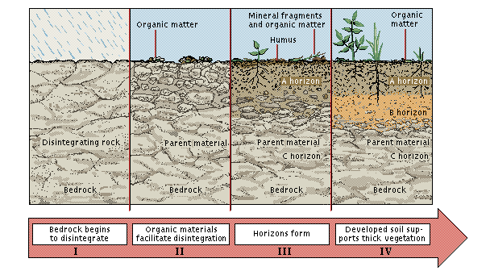
Soil: rock in its final stage of decay
Formation of soil – weathering
Physical weathering
effect of temperature
abrasion –wind, flowing water
plant roots
Chemical weathering
oxidation and reduction
carbonation
hydrolysis
hydration
Development of Soil
Climate
Relief (topography)
Organisms
Parent material
Time

Slide 2
Soil Soil particles vary enormously in size
Gravel over 2 mm
Sand coarse .2 - 2 mm
fine .02 - .2 mm
Silt .002 - .02 mm
Clay under .002 mm
Dimensions of some sieves
14 mesh 1.20 mm; 25 mesh 0.60 mm
52 mesh 0.30 mm; 72 mesh 0.21 mm
100 mesh 0.15 mm; 200 mesh 0.075mm
ranbsingh

Slide 3
Soil, dust, and debris
Usually found on shoes, clothing, tires, mud guards
persons, rugs, floor, digging implements, vehicles, occupational /environmental dust on different objects, etc
Soil is very heterogeneous: control sample should
be collected from almost the exact spot from which
Crime sample is thought to have come; otherwise
from different places in a definite geometrical
pattern in the questioned area
Sample size: spoonful - handful
Collect in
Plastic vials, paper bags , paper wrappers
ranbsingh

Slide 4
Trace (transfer) Evidence --Soil
The presence of soil at most of the crime scenes and its transferability between the scene and the criminal, makes it a valuable physical clue in the investigation of crime.
Soil or dried mud found adhering to a suspect's shoe, pant cuffs, or vehicle when compared with soil sample collected from the place of occurrence of the crime, may provide associative evidence that can link the suspect or object to the scene of crime.

Slide 5
The soil at different points varies in some detectable manner. It varies so much from point to point as compared with its variation from region to region that it is useless to attempt its comparison unless the control (known) sample is collected at almost the exact spot from which the questioned (unknown) sample is thought to have come.
Thus, mud on a shoe should be compared with mud from the shoe print, if possible.
If the approximate location is known but not the exact spot, it is necessary to collect samples in a definite geometric pattern throughout the small region in question and compare all of them with the questioned sample.

Slide 6
In general, airborne particles, which are macroscopic, microscopic or sub-microscopic
in size, are known as dust.
It may be very characteristic of a particular place. This applies specially to places such as flourmills, building sites, workshops, coal cellars and the like.
A person who has worked at or visited such places carries on his clothes dust characteristic of that place and a close examination of the dust will reveal his occupation or his visit to that place.

Slide 7
He may also leave traces in the form of dust from shoes or clothes which are characteristic of him and the same can act as a guide in tracing him. In dust, there could be such particles whose occurrence can be connected directly with a crime.
Laboratory examination of the dust, which is sometimes very tedious and comprehensive, is
done first under the microscope. Thereafter, any characteristic particles, if located and separated
are examined further by suitable chemical or physical analytical methods. For example, filings and other metallic particles can be easily identified by spectrochemical methods, and the clay minerals can be identified by x-ray diffraction technique.

Slide 8
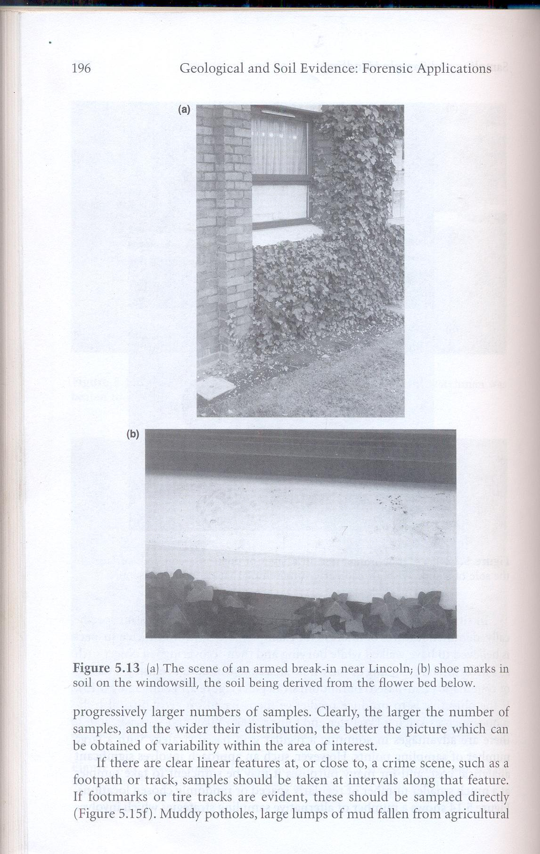
in an armed break in
Shoe mark on the windowsill , soil derived from the flower bed
ranbsingh

Slide 9
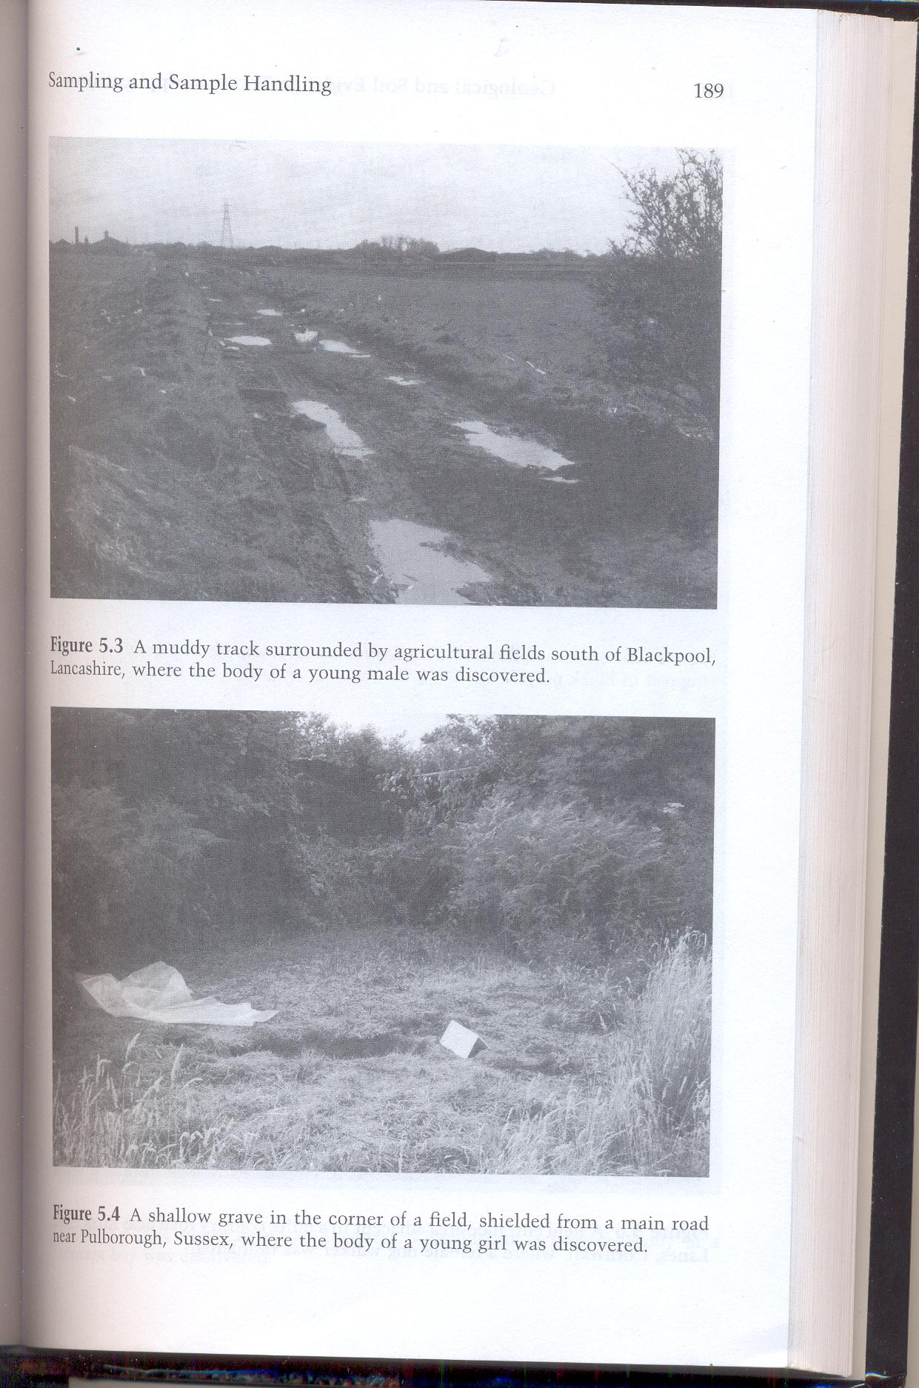
Muddy track surrounded by
agricultural field, where a body
of a young male was discovered
Shallow grave in the corner
of a field, where a body of a
young girl was discovered
ranbsingh

Slide 10
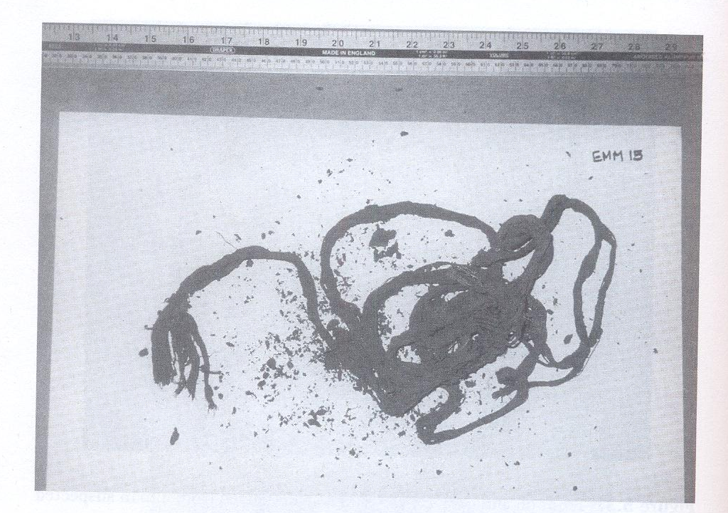
Heavily mud stained rope recovered
during investigation of a murder
The victim’s body was dismembered
and parts buried in different places
ranbsingh

Slide 11
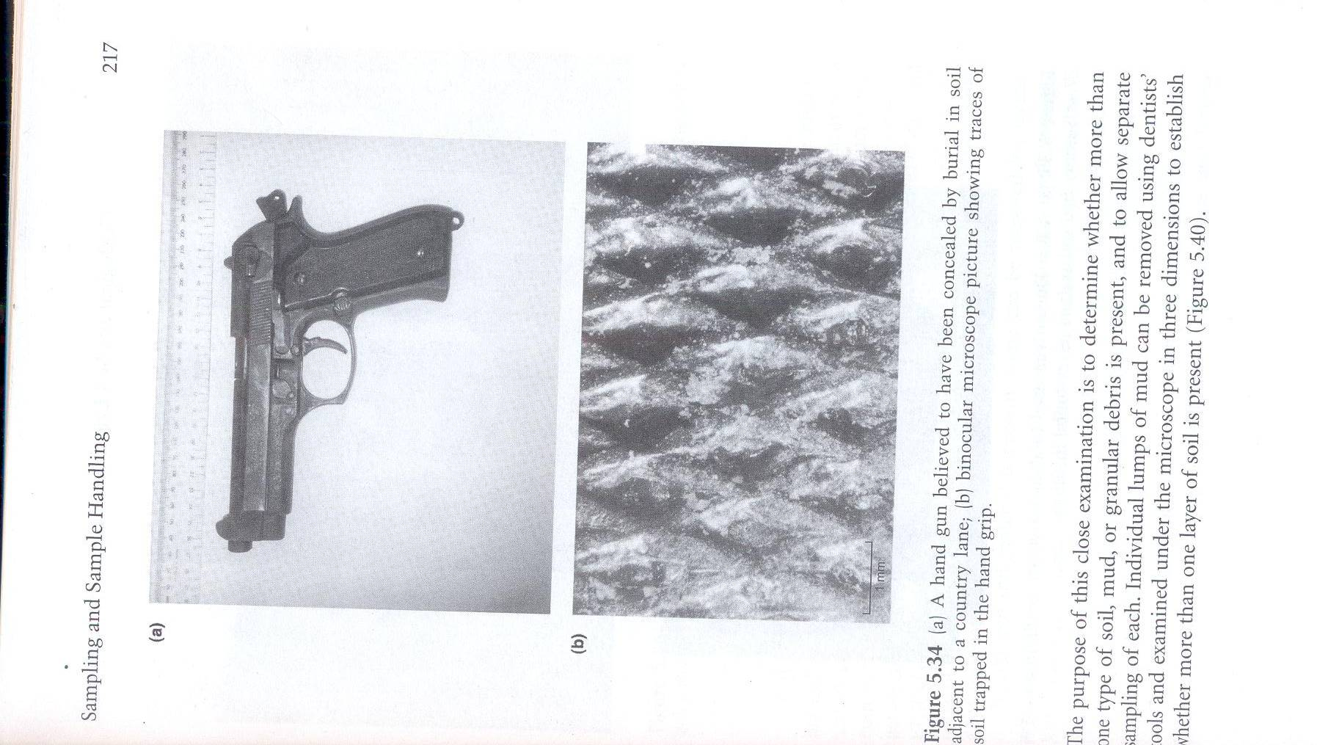
A hand gun believed to have been
concealed by burial in soil
Microscopic picture showing traces
of soil trapped in the hand grip
ranbsingh

Slide 12
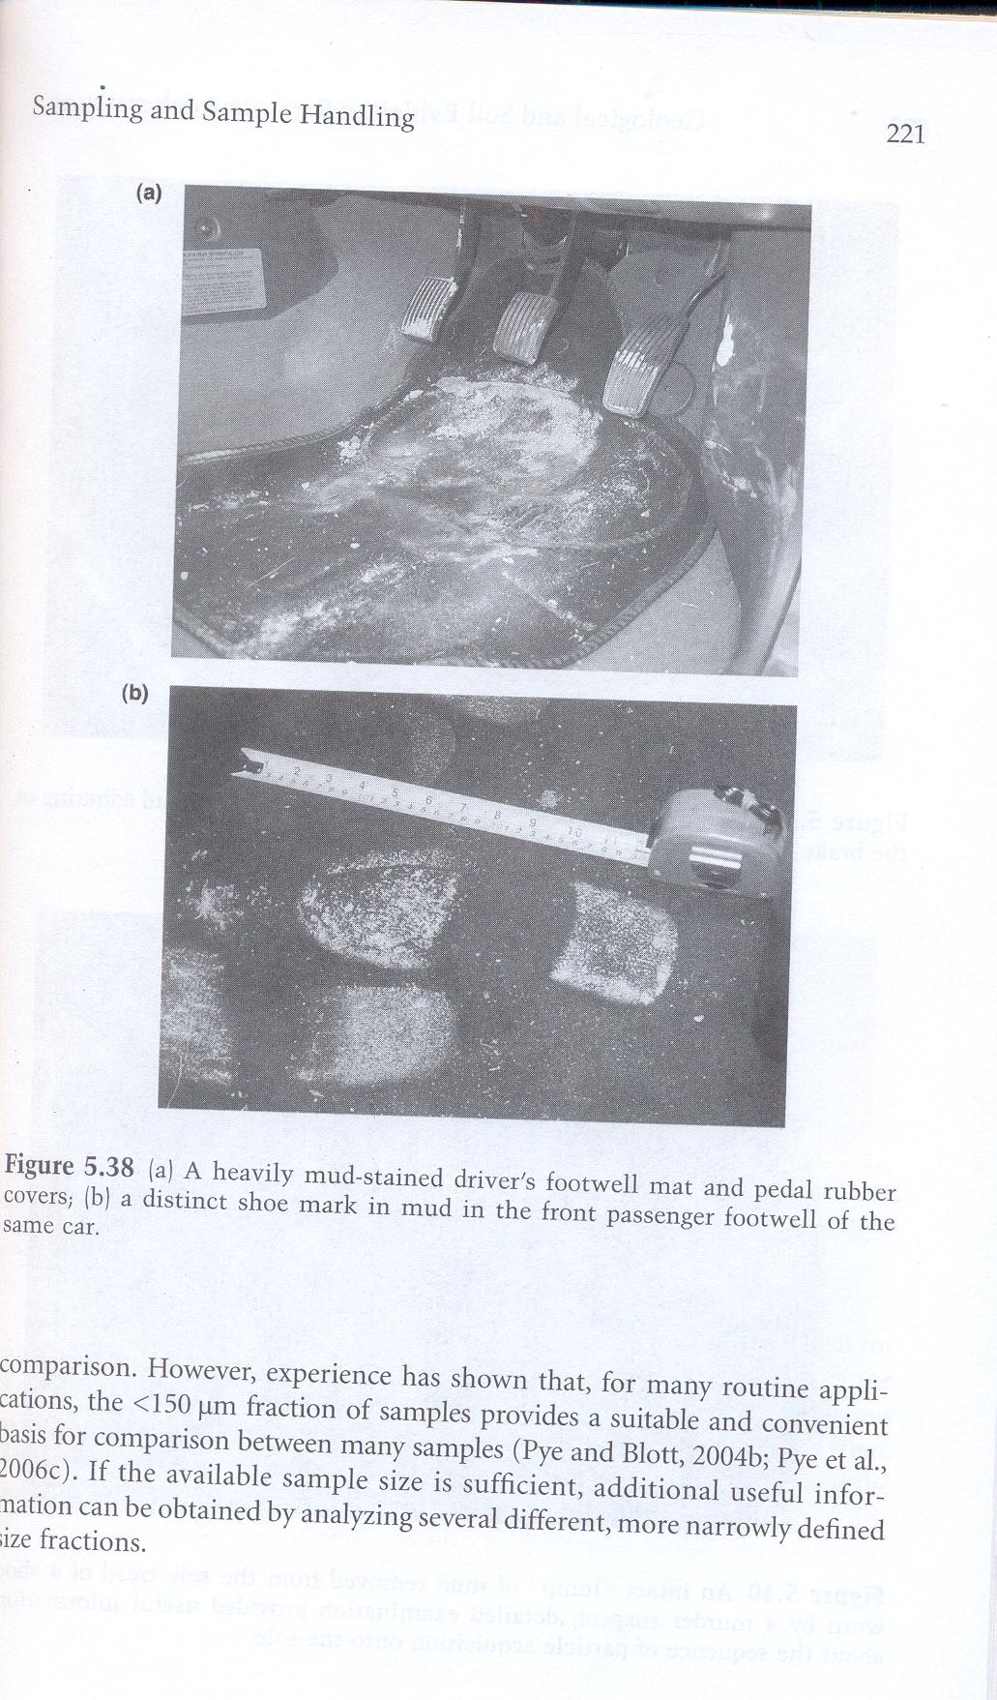
A distinct shoe mark in mud in
the front passenger foot well
of the same car
A heavily mud-stained driver’s
foot well mat and pedal rubber
covers
ranbsingh

Slide 13
13
8
9
B
4
12
1
A
5
10
3
2
6
7
A = 10 ft
B = 50 ft
C =100 ft
C
11
Systematic method for collection of soil samples in open field

Slide 14
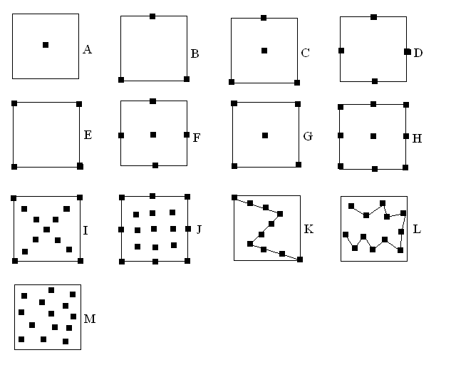
Some soil sampling strategies for a discrete area such as a small field

Slide 15
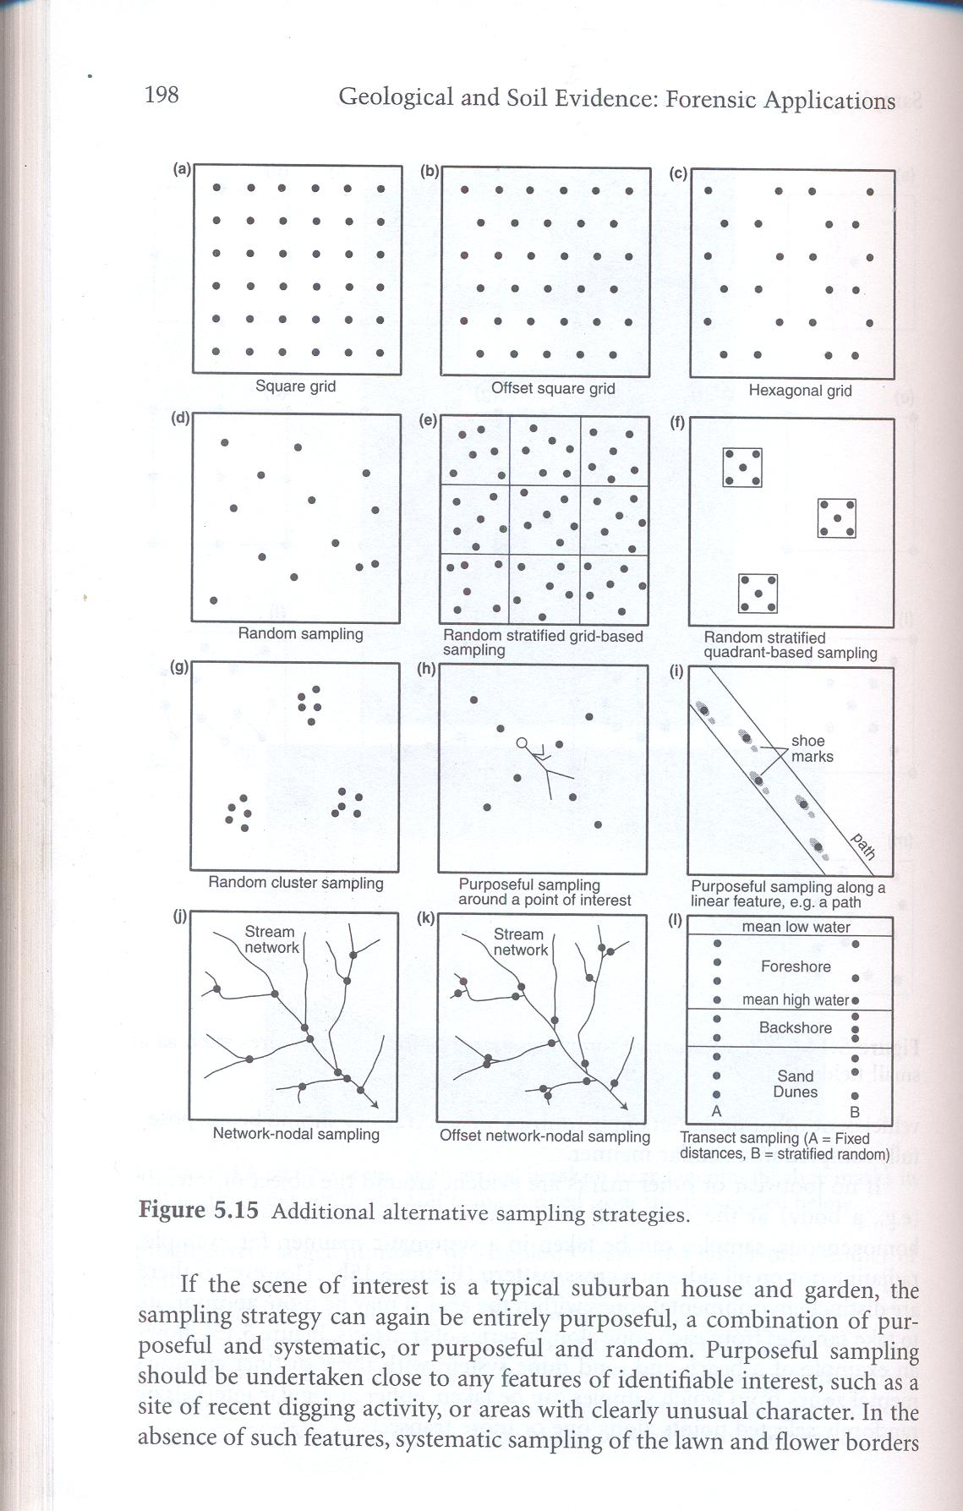
Some sampling strategies
ranbsingh

Slide 16
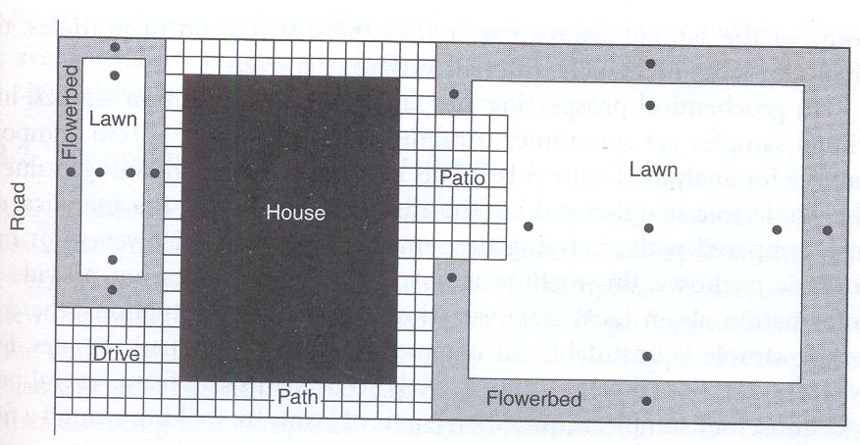
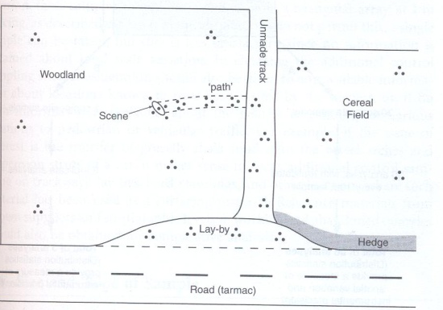
Suggested sampling strategy
for the garden of a small house
Suggested sampling strategy
for a crime scene in a rural area
ranbsingh

Slide 17
Examination of Soil
Visual Examination
Color of soil and ash
Loss on Ignition
Particle size distribution
macroscopic/microscopic
Dry sieving
Wet sieving
Sedimentation (turbidity test)
Coulter counter
Automated image analysis
Laser diffraction
ranbsingh

Slide 18
Examination of Soil - contd.
Particle density distribution
Mineralogical identity of
constituent particles
Clay minerals (sub-microscopic particles)
(density gradient analysis)
microscopy/polarizing microscope
X-ray diffraction (XRD)
Infrared absorption
Differential thermal analysis
X-ray diffraction
ranbsingh

Slide 19
Examination of Soil - contd.
Chemical analysis
Miscellaneous (presence of foreign particles)
Spot tests (for chalk iron etc.)
Acidity/alkalinity (pH measurements)
HPLC (for organic compounds)
Trace element characterization
Thermoluminescence
Plant chips
Pollen/spore/diatom
Paint/coal/cement
ranbsingh

Slide 20
Microscopic examination
Types of constituents: coal dust, brick ash, cement
dust, quartz grains, mineral fragments(colorless,
colored), grass, seeds, etc.
Polarized light is used for differentiating between
various mineral constituents
a small drop of concentrated hydrochloric acid : bubbles
surrounding particles of carbonate minerals (chalk,
dolomite etc) ; yellowing of solution – presence
of soluble iron
Color of soil and ash
color of soil is darker when it is wet; samples must always
be dried before observing color; there are hundreds of
distinguishable soil colors:white, grays, browns, reds, black.
Ash: weighed amount of soil ashed at 500 –900 degree
centigrade; white through yellow to deep red depending
on their iron and manganese constituents, also on
temperature of ashing.
ranbsingh

Slide 21
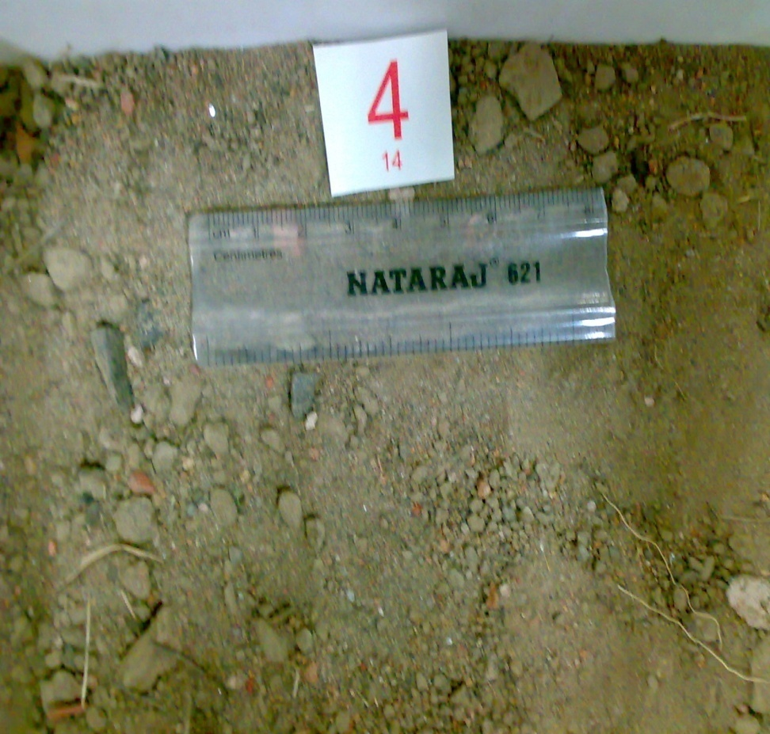
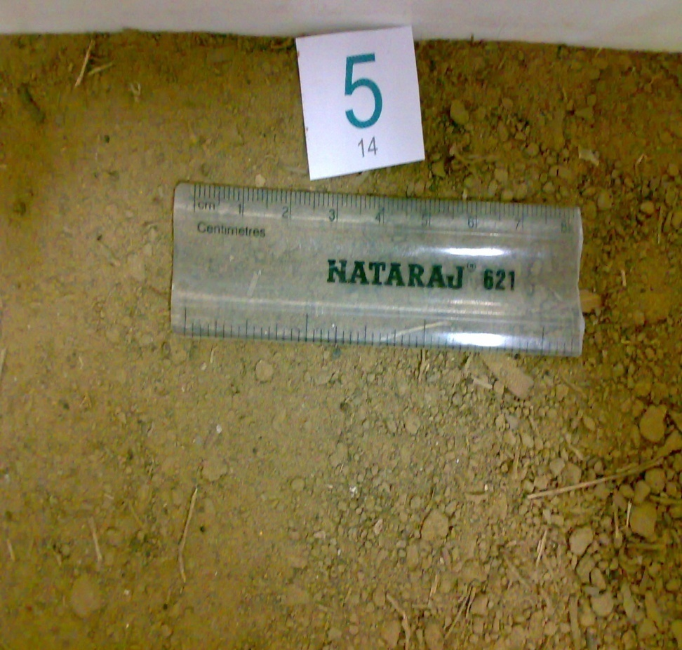
Soil sample from Rohini sector 3
Soil sample from Vikaspuri

Slide 22
Sample number | Red particles | Black particles | Glass particles | Plant roots | Metal | Fibers | Particle of vegetation (grass)
1 | ++++ | +++++ | +++ | - | - | - | -
2 | +++ | - | +++ | - | - | - | -
3 | ++++++ | +++++ | +++++ | - | - | - | -
4 | +++ | +++ | +++ | - | - | - | ++
5 | ++ | +++ | ++ | - | - | - | -
6 | + | ++++ | + | - | - | - | -
7 | - | ++ | - | ++++ | ++ | - | -
8 | ++ | - | ++ | - | - | ++ | -
9 | ++++ | ++ | +++ | - | - | - | -
10 | + | + | ++ | ++ | - | - | ++
11 | ++ | ++ | +++ | ++ | +++ | + | +++
12 | + | + | - | - | ++ | + | -
13 | +++ | ++ | ++ | - | +++ | - | ++
Microscopic examination

Slide 23
Loss on Ignition
Combustion of organic matter (humus), loss of combined
water and a portion of carbonate present
Sandy soil : 2 – 5 percent
Ordinary soil : 20 – 25 percent
Forest or ditch : ~ 50 percent
Soil (humus)
Two samples of identical soils should agree within a
few tenths of one percent or even better
In a case two representative fractions were examined:
Soil sample percent loss on ignition
sample control
Fraction 1 20.4 20.6
Fraction 2 22.5 22.4

Slide 24
Turbidity Test (particle size distribution)
complementary to the sieving test
A cuvette of absorptiometer filled with water and
0.5 to 1 g. of the fine fraction of the soil.Cuvette is
well shaken and the light transmittance is read
immediately and at ½ minute intervals.
Sandy soil – transmission rapidly reaches 100 percent
Clays and chalk – take considerably longer time to settle
Peaty soil or soils containing soluble iron or manganese
give persistent yellow to brown color – permanently
reduce the transmission
Density gradient analysis
highly diagnostic single characteristics
Nitrobenzene 1.1987; Bromoform 2.890
tubes: 35 -45 cm; 5 - 10 mm diameter;
25-75mg sample (passed through 100 mesh)
particle – density distribution
ranbsingh

Slide 25
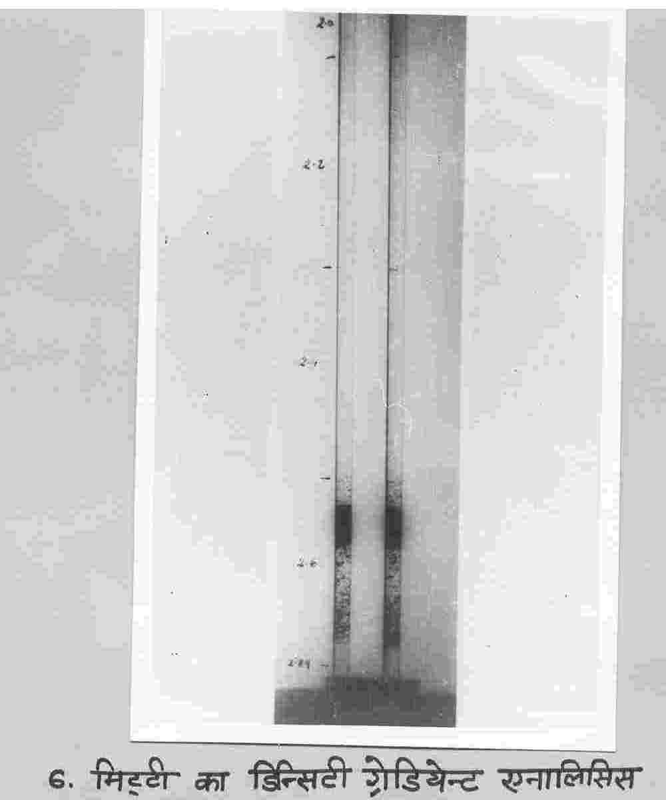
Density gradient analysis of soil

Slide 26
Differential thermal analysis
Physical or chemical changes (phase transitions) are
accompanied by absorption or emission of heat. The
temperature at which the changes take place is constant
for any given compound. The sample and an inert
reference material are heated, and their temperature
is recorded, when phase transitions occur, temperature
differences are observed. The technique may be used for
comparison of highly complex substances such as clay.
Elemental analysis
Sodium, potassium, aluminum, calcium, magnesium,
silicon, iron, manganese, strontium, barium, cerium,
zinc,chromium, gold, lanthanum, copper, antimony,
selenium, samarium etc.
In general, major elements arte of little value in the
determination of source correspondence. The presence of
highly characteristic trace elements yield valuable evidence
ranbsingh

Slide 27
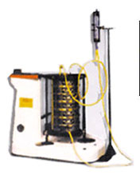
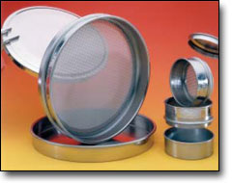
Wet Sieving
Micro-Mesh Standard Sieves
Rim Diameter | Rim Height/SS | Mesh Size | Mesh Tolerance | Standards
3" | 1" or 3" | 3um - 200um Square, Round, Slotted & Custom | +/- 2um | ASTM E-161 ISO 3310-3
6" | 1" or 3" |  | +/- 2um
8" | 1" or 2" |  | +/- 2um
12" | 2" |  | +/- 2um
75mm | 25mm |  | +/- 2um
100mm | 25mm |  | +/- 2um
200mm | 50mm |  | +/- 2um
3" (Acrylic) | 1" or 3" |  | +/- 2um
Micro-Mesh Ultra Sieves
Rim Diameter | Rim Height/SS | Mesh Size | Mesh Tolerance | Standards
3" | 1" or 3" | 2um - 500um Square, Round, Slotted & Custom | +/- 1.5um | ASTM E-161 ISO 3310-1
8" | 1" or 3" |  | +/- 1.5um
75mm | 25mm |  | +/- 1.5um
100mm | 25mm |  | +/- 1.5um
200mm | 50mm |  | +/- 1.5um
3" (Acrylic) | 1" or 3" |  | +/- 1.5um

Slide 28

Stokes’ Law
If the particles are falling in the viscous fluid by their own weight, then a terminal velocity, also known as the settling velocity, is reached when this frictional force combined with the buoyant force exactly balance the gravitational force. The resulting settling velocity is given by:
Stokes’ Law
the drag force F on a sphere of radius a moving through a fluid of viscosity η at speed v is given by:
F = 6πaηv
note that this drag force is directly proportional to the radius
where:
V_{s} is the particles' settling velocity (cm/sec) (vertically downwards if
ρ_{p} > ρ_{f}, upwards if ρ_{p} < ρ_{f}),
r is the Stokes radius of the particle (cm),
g is the standard gravity (cm/sec²),
ρ_{p} is the density of the particles (g/cm³),
ρ_{f} is the density of the fluid (g/cm³), and
η is the fluid viscosity (dyne sec/cm²).
arrows show the fluid flow as seen by the ball. This smooth flow only takes place for fairly slow motion

Slide 29
Thank You

Slide 30
