Slide 1
Paint
Paint
Paint
Paint
Paint
Paint
Paint
Paint
Paint

Slide 2
Pigments
coloring matter
pigments/dyes
Binders
oils, resin etc.
binds the pigments together
Solvent/Thinner
to adjust paint consistency
Additives
pigment stability, antifreeze, control foaming/skinning
Fillers
color neutral, opaque
Putty
achieving smoothness
ranbsingh

Slide 3
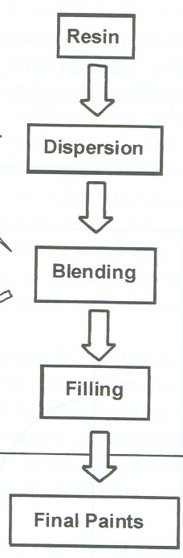
Paint manufacturing process (schematic)

Slide 4
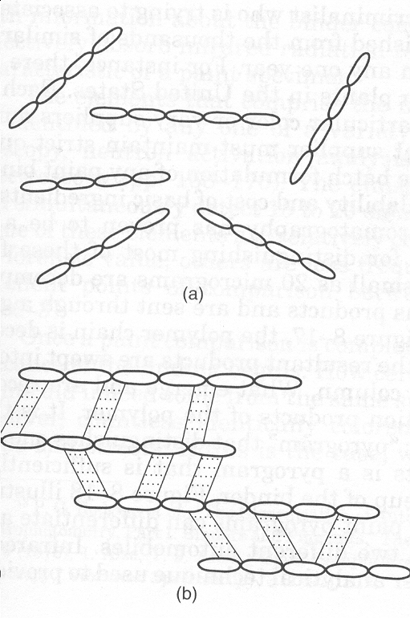
Automobile paint
formulations
an
un-cross-linked
polymer
Acrylic Lacquers : have
long chains with few, if any,
chemical bond acting as
cross links. When heated
become soft and more
or less fluid
soluble in acetone
Acrylic Enamels : when heated
form an extensively cross-linked
network that becomes extremely
hard and resistant to solvents
Alkyd Enamels : also produce
an extensively cross-linked
surface when heated
a highly
cross-linked
polymer

Slide 5
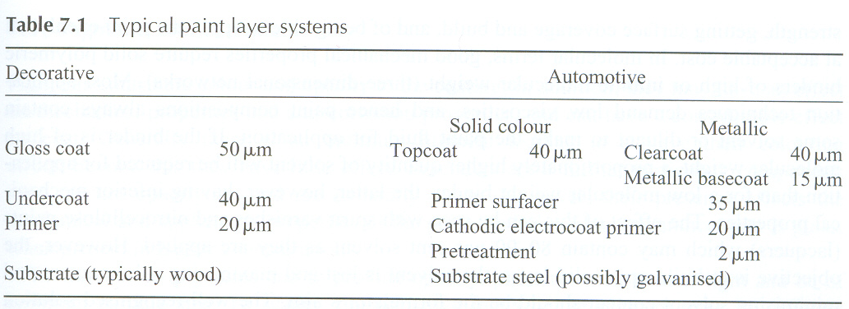

Slide 6
Collection, preservation and packing
Paint evidence is frequently encountered in hit-and
run, burglaries, art forgeries, and occasionally in
other types of offences.
In hit-and run cases, paint may be transferred to
clothing of victims/any other object/the ground
near the point of impact
All the areas are examined, with particular attention
being paid to areas showing pressure effects (glaze
etc), tears, or other contact.

Slide 7
If paint is found on the garment, it should not be removed; the garment should be marked, carefully wrapped by rolling it in paper and sent it to the laboratory. Such paint will at least show the color of relevant part of the responsible car.
Sometimes whole chips of paint will be transferred to the clothing. If these flakes contain several layers, and in particular if they come from a repainted car then such evidence may have great value when the responsible vehicle is located.
Chips of paint may also be found on the ground near the point of impact in some cases.

Slide 8
Samples for comparison should be obtained from all areas showing fresh damage on suspected vehicles. This is very important since the paint may be different in type or composition in different areas, even if the color is the same.
If bending the metal slightly can flake off the paint, it should be removed in this manner.
If not, the paint should be scraped or chipped off, using a clean knife blade. The blade should be wiped carefully, before collecting each sample. All layers down to the metal should be collected. Each sample should be placed in a separate container.
Cross transfers of paint commonly occur in hit and-run cases of two or more vehicles.

Slide 9
Loose paint chips should be removed and
wrapped in paper.
If the transfers are smeared on the surfaces,
flake off chips or scrape paint from the vehicle,
including the transferred paint, as well as the top
layer of paint originally on the car.
All of these transfers recovered from different
areas should be kept in separate containers.
The samples should not be placed directly into
envelopes. Most envelopes have unsealed
corners.

Slide 10
In case of cross transfers, uncontaminated samples
should always be collected from each vehicle from
areas immediately adjacent to each transfer collected.
This is of great importance, since such specimens
permit the laboratory to distinguish between the
transferred paint and the paint originally present on
the vehicle.
Tools used to gain entry into building, safes, or other
places in burglary cases, often contain traces of paint,
as well as other substances, such as plastic, safe
insulation, etc.
Care must be taken that such traces are not lost.
If such transfers may be present, the end of the tool
containing the material should be wrapped in clean
paper and sealed with tape to prevent loss.

Slide 11
Attempts should never be made to set/fit the tool into marks or impressions found. If this is done, transfers of paint or material can occur and any traces found later will have no significance as evidence.
Specimens of paint should be collected from all areas that the tools may have contacted at the crime scene. These samples should include all layers present.
One should be very careful not to destroy the tool mark in collecting the paint. If possible, one should cut out around the mark, and send it to the laboratory.

Slide 12
The tool itself may contain paint or other coatings, tracings of which may be left at the crime scene. A careful search should be made for such transfers, particularly in each tool mark.
All the paint samples should be kept in separate containers.
Paint samples should never be kept directly into envelopes unless large pieces are enclosed. Most envelopes have unsealed cracks in the corners and loss or contamination can occur.

Slide 13
Examination of paint samples
Macroscopic/microscopic examination
Fluorescence/polarizing microscopy
UV-Vis Spectrophotometry
Solvent/microchemical tests
Thin layer chromatography
Pyrolysis gas chromatography (PyGC)
IR Spectrophotometry
Elemental analysis
X-ray diffraction
Physical matching, layer structure, color arrangement, weathering effect etc
for crystalline compounds
ranbsingh

Slide 14
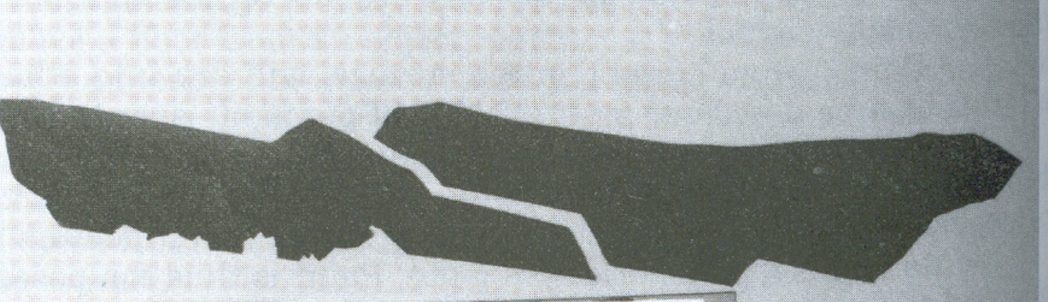

Slide 15
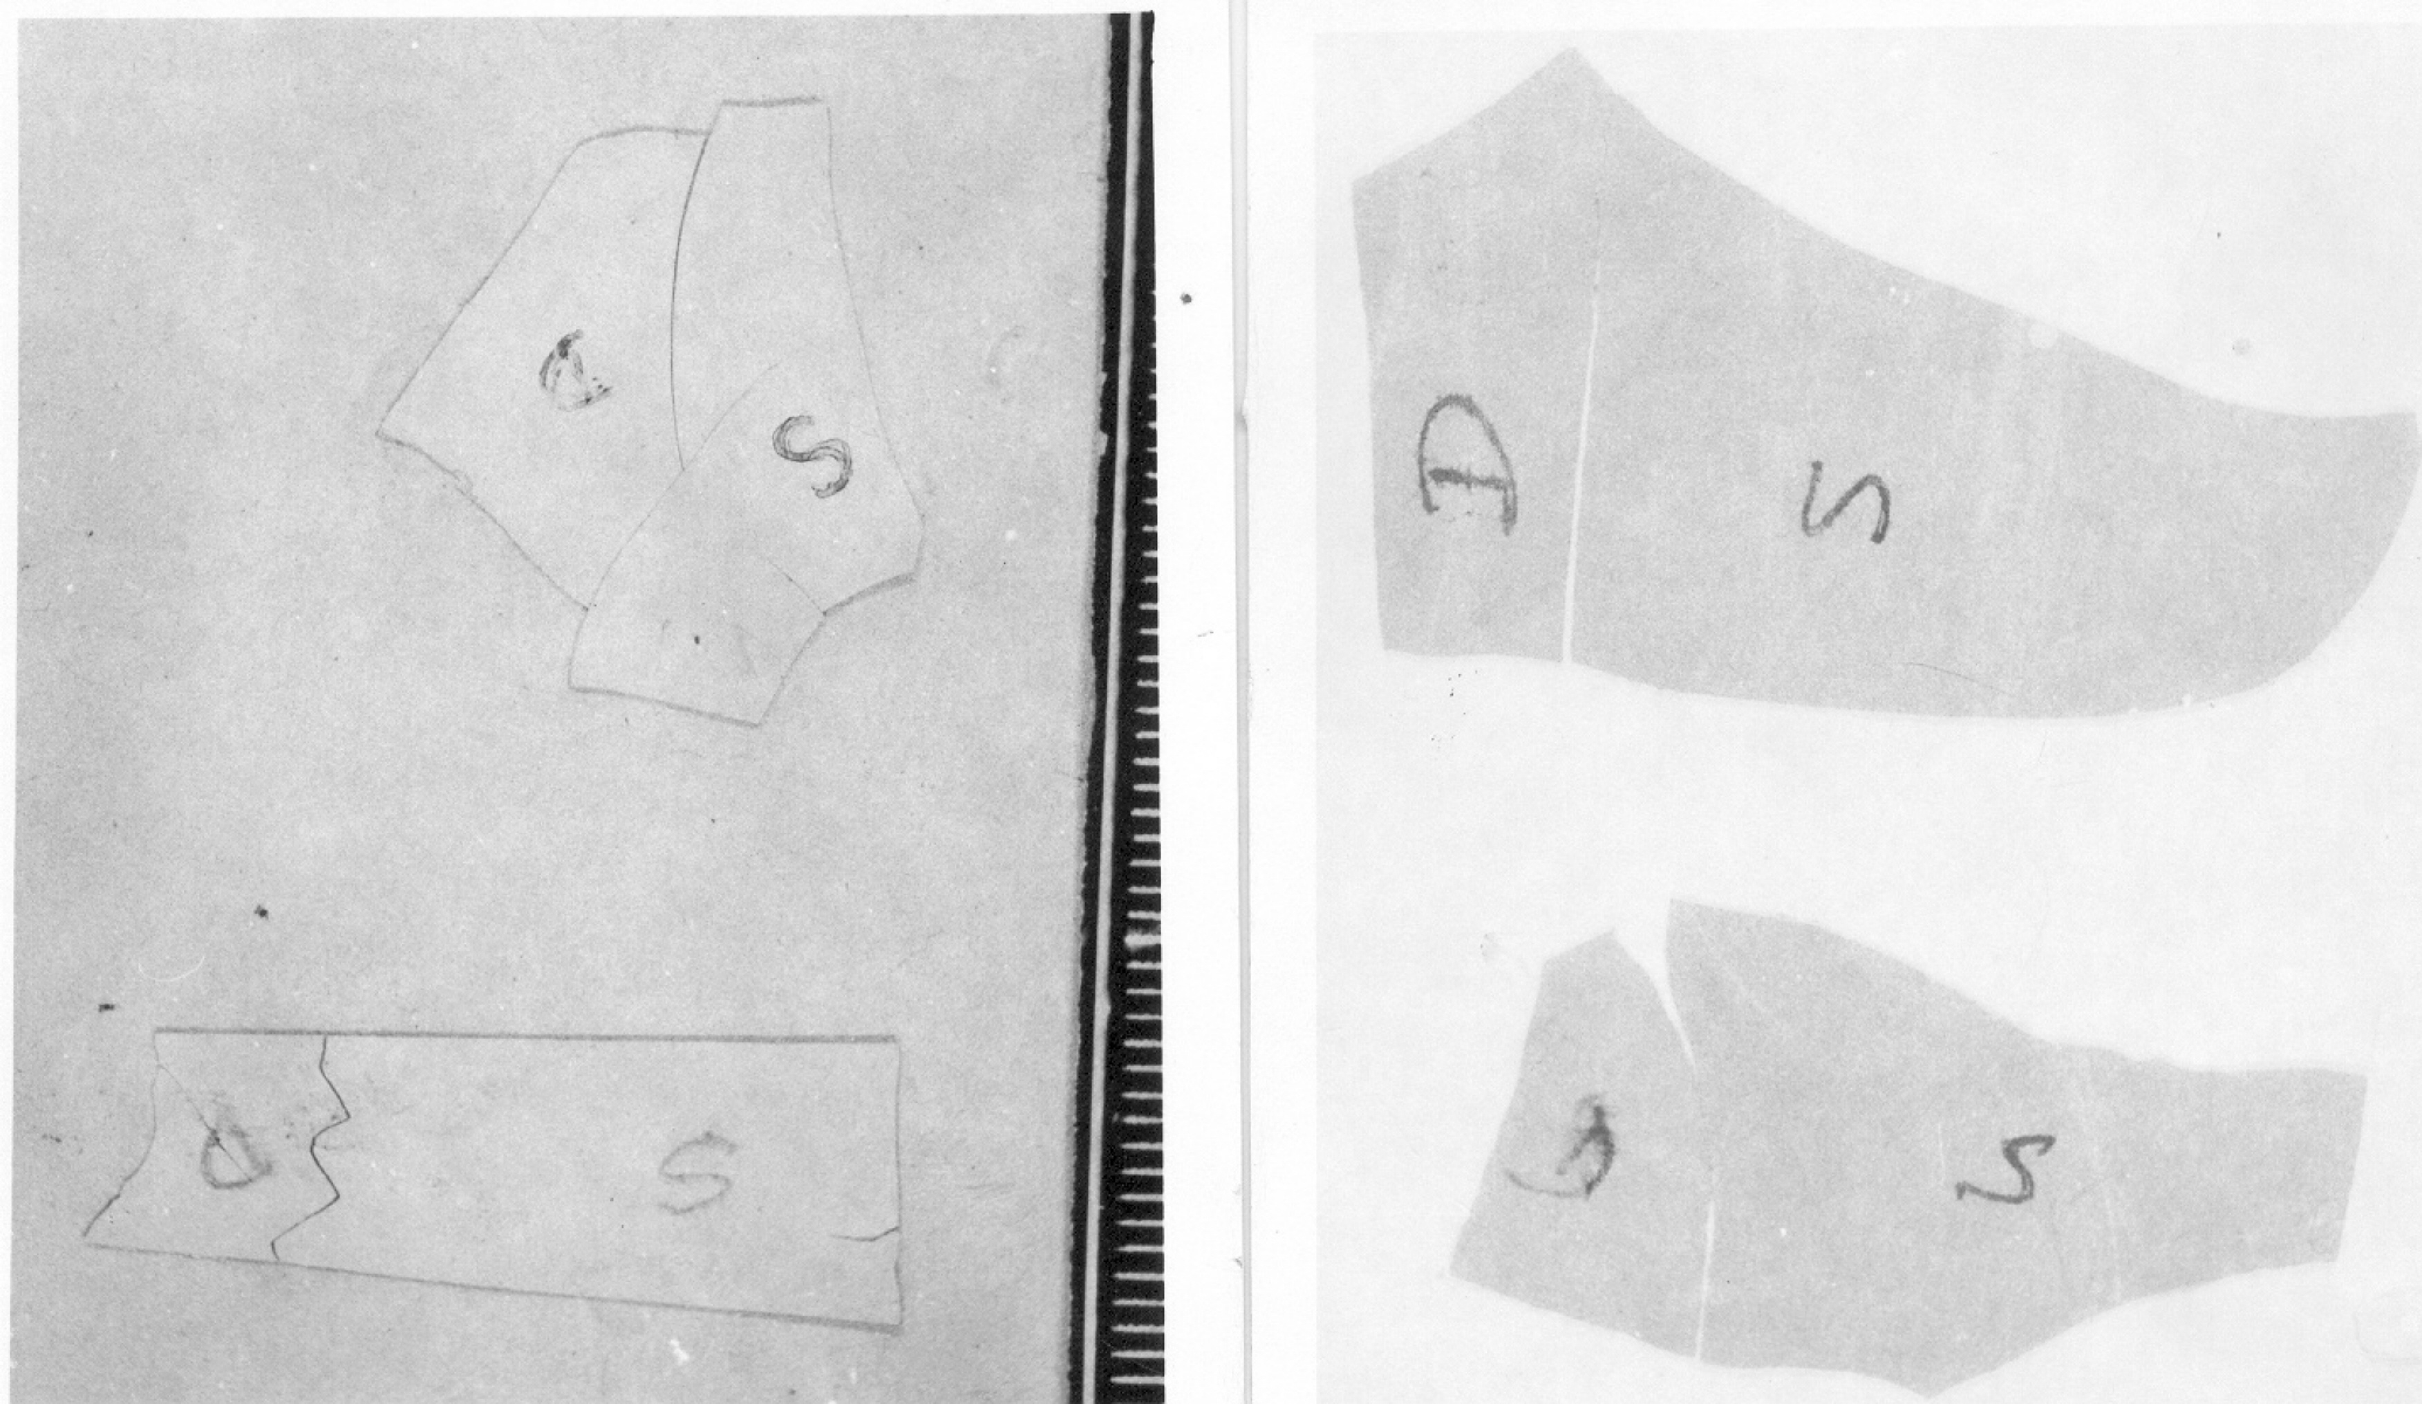

Slide 16
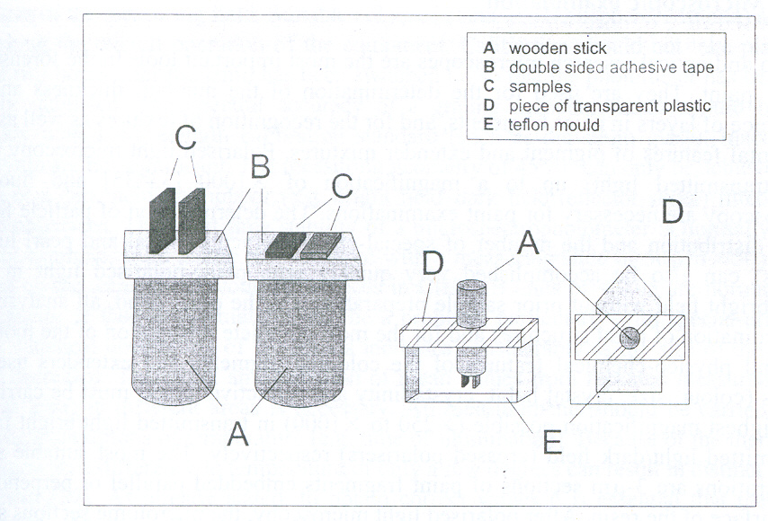
Technique for preparing thin sections

Slide 17
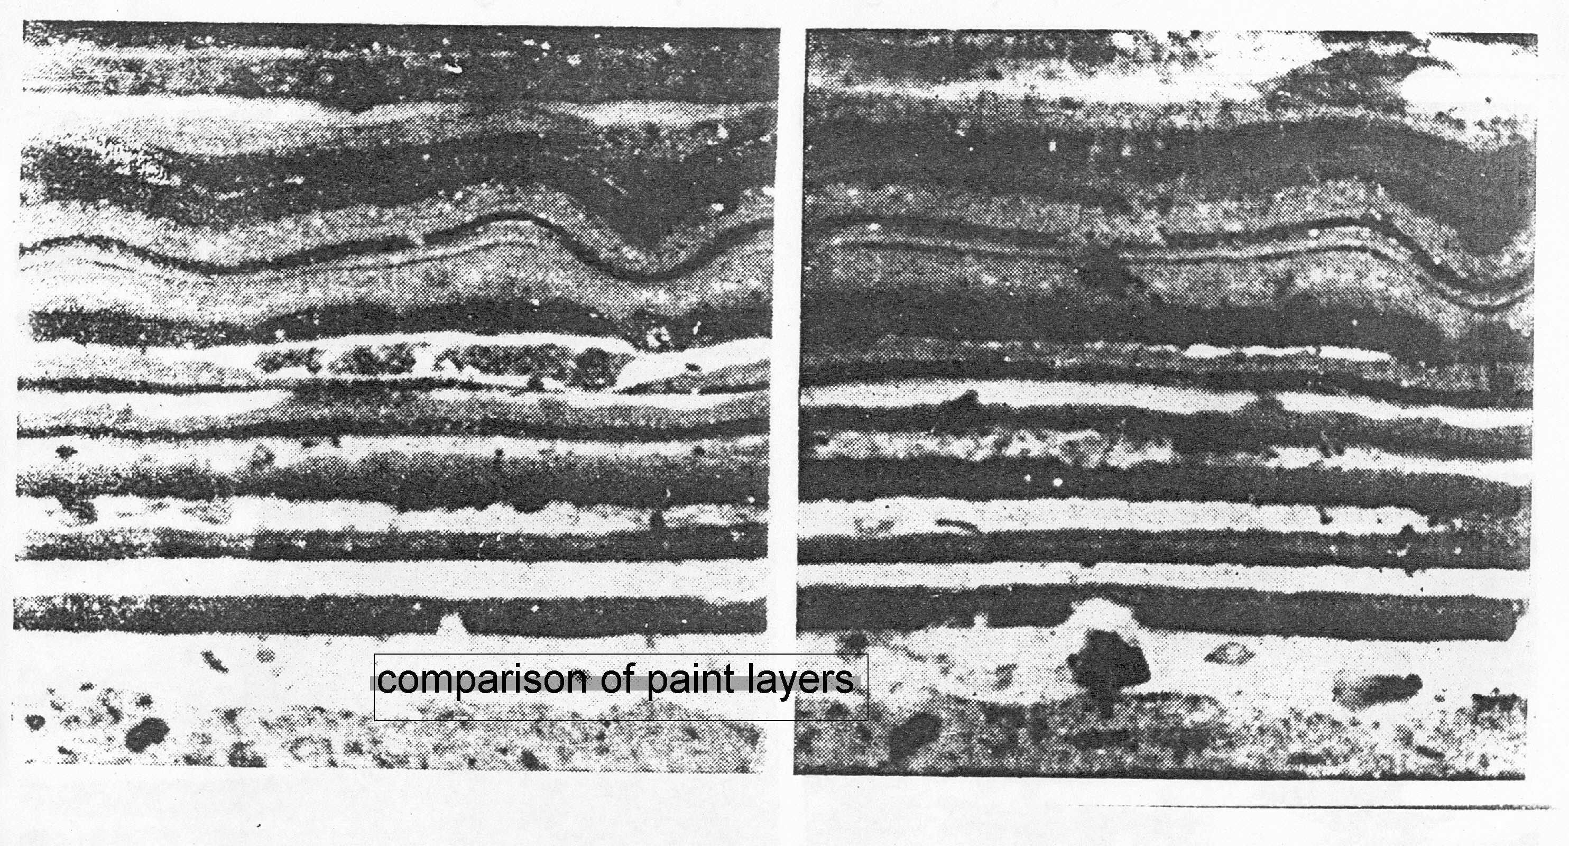
50 finishing coat, 10 under coat
5 primer (chance : 1 in 2500)
6 or more layers reveal source
correspondence
ranbsingh

Slide 18
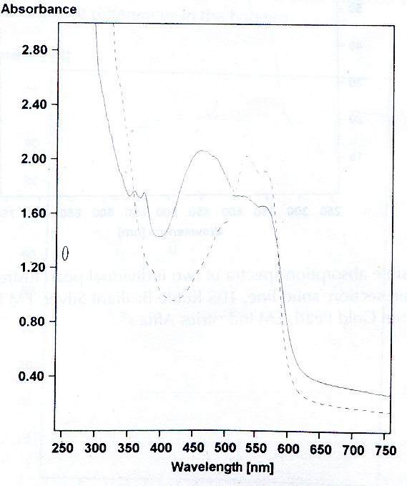
UV –visible absorption spectra
Two coat metallic
top coat (burgundy red)
3-µ thin section
Red organic pigments
Solid line – red 179
Broken line red 122

Slide 19
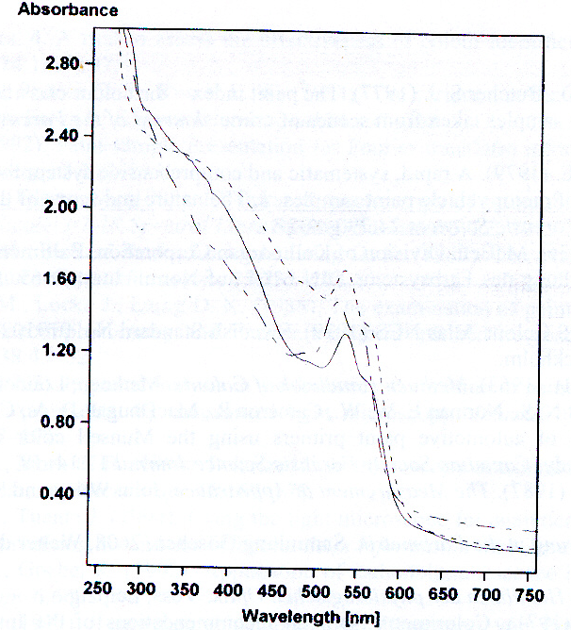
UV –visible absorption spectra
three vehicles painted with metallic paint carnelian red
all the three base coats are clearly differentiated because of pigment differences in batches

Slide 20
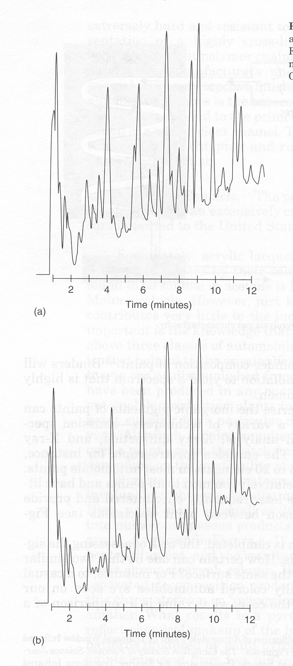
Pyrolysis gas chromatography
is an invaluable technique for
distinguishing most of the
paint formulations.
Paint chips as small as 20
micrograms are decomposed
by heat into numerous
gaseous products.
Pyrograms of acrylic enamel
paints removed from two
different vehicles

Slide 21
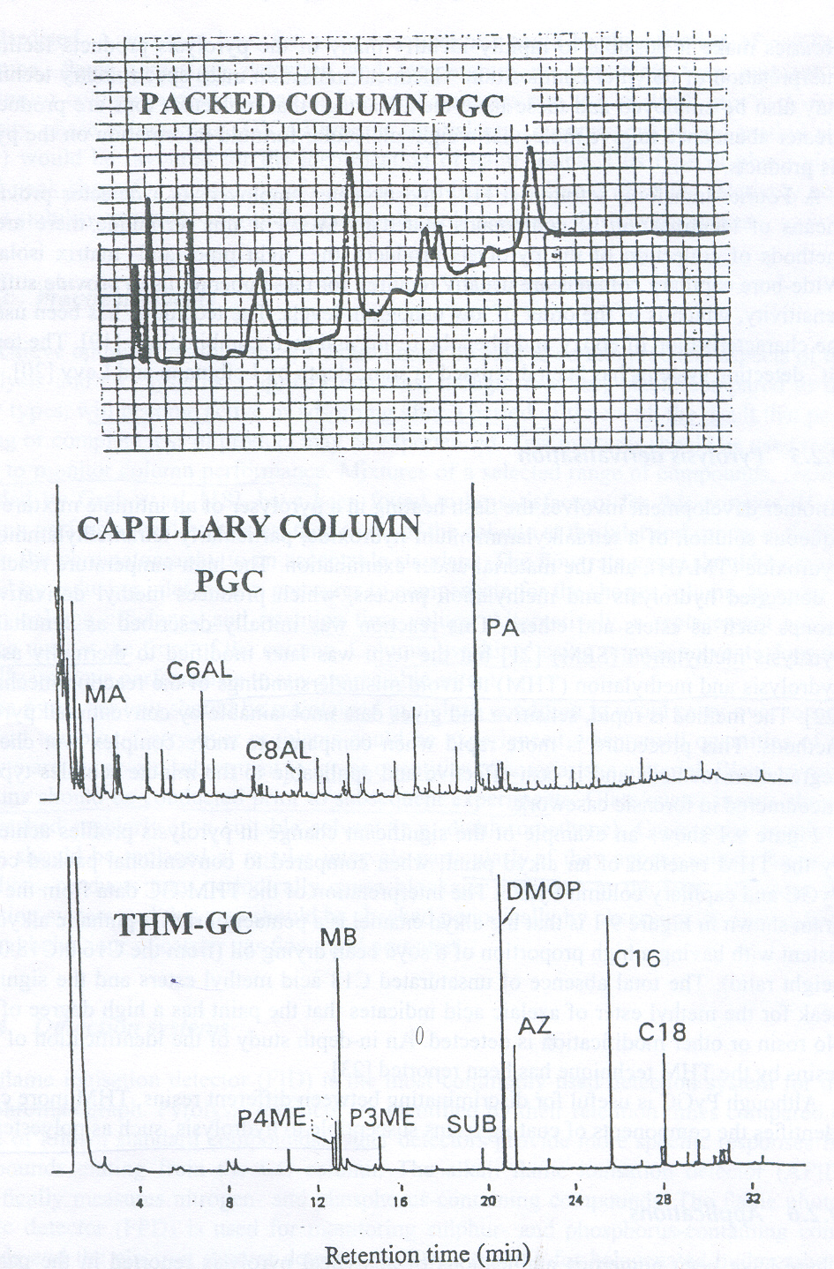
Pyrograms of pentaerythritol ortho-phthalic alkyd resin Paint
obtained by
packed column PyGC,
capillary column PyGC, and
Thermal assisted Hydrolysis
and Methylation GC
DERIVATISATION
MA methacrolein, C6LA hexanal, C8AL octanal, PA phthalic anhydride, etc. etc.

Slide 22
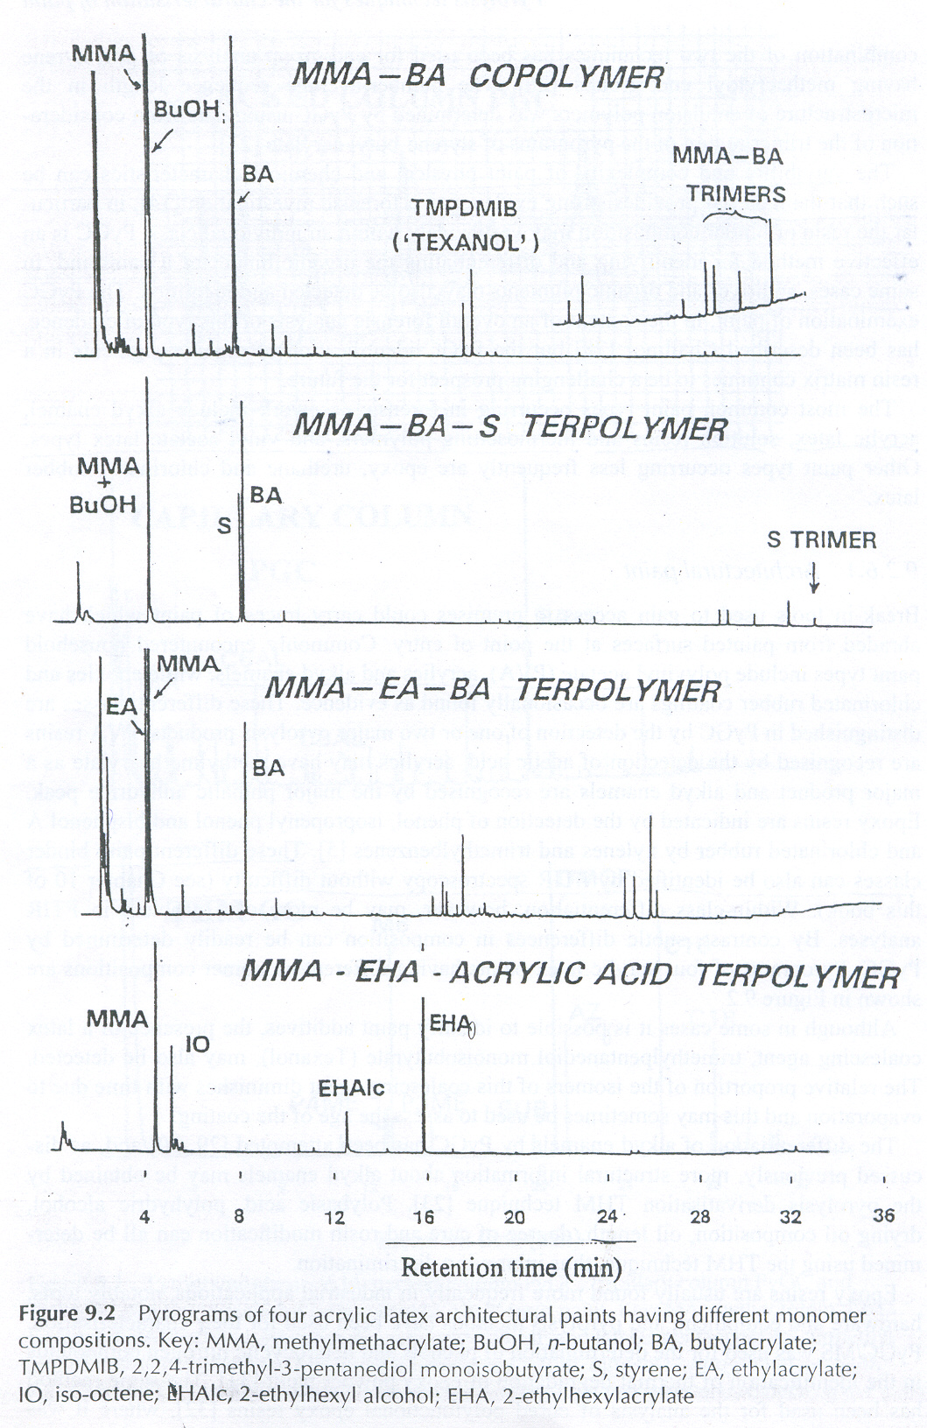
Pyrogram of four acrylic latex architectural paints having different monomer compositions
MMA methylmethacrylate
BA butylacrylate
S styrene
EA ethylacrylate
EHA 2-ethylhexylacrylate
etc. etc.

Slide 23
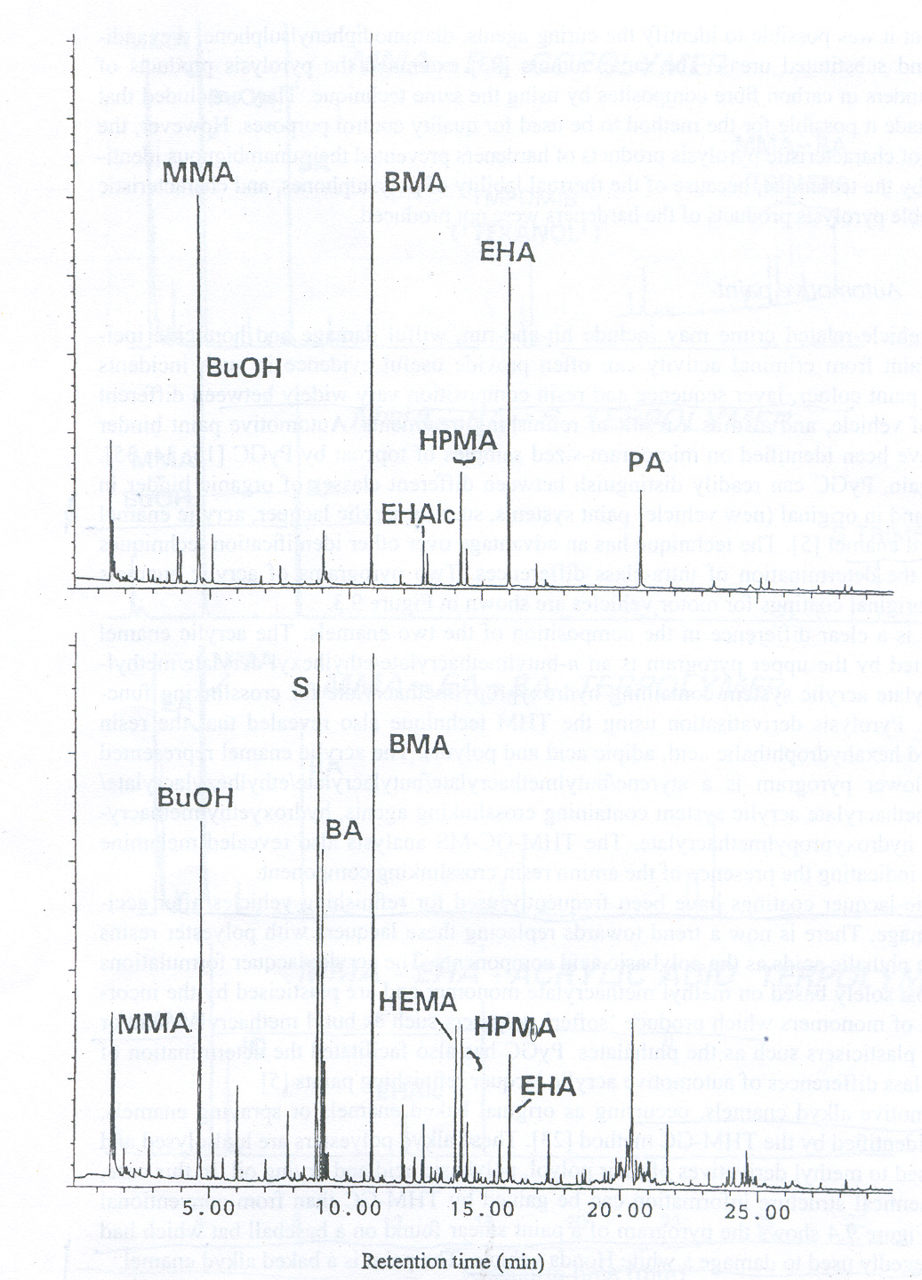
Pyrogram of two acrylic enamel automobile original topcoat finishes by PyGC/MS
MMA methylmethacrylate
BuOH n-butanol
BMA butylmethacrylate
HPMA hydroxypropylmethacrylate
etc, etc.

Slide 24
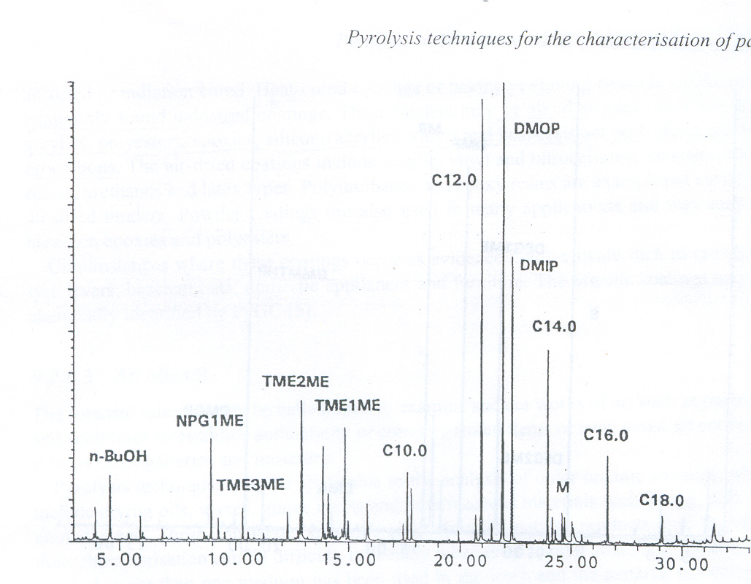
THM profile of the baked alkyd enamel
paint smear found on a baseball bat
found to be consistent with
the paint from a Honda vehicle

Slide 25
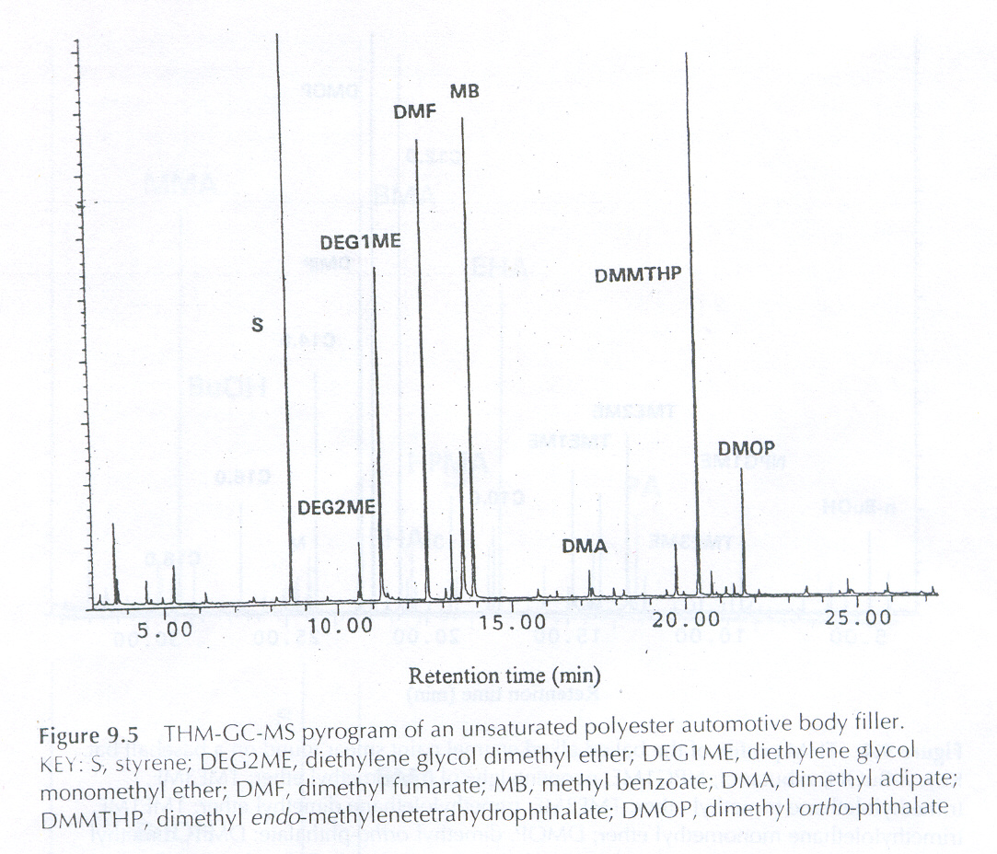
THM-GC-MS Pyrogram
polyester automotive body filler

Slide 26
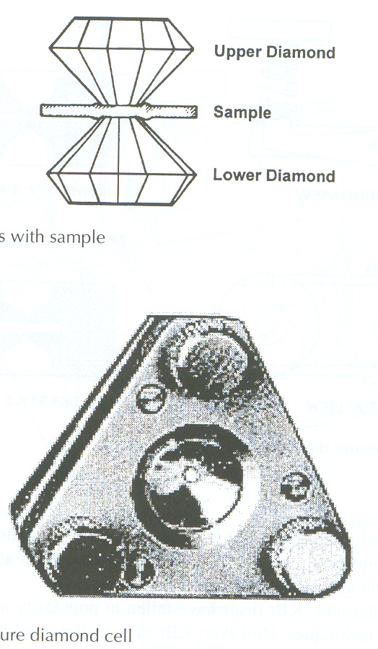
Diamonds with sample
Low-pressure diamond cell

Slide 27
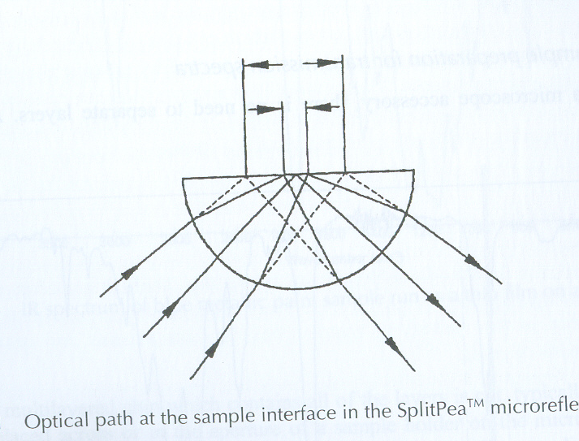

Slide 28
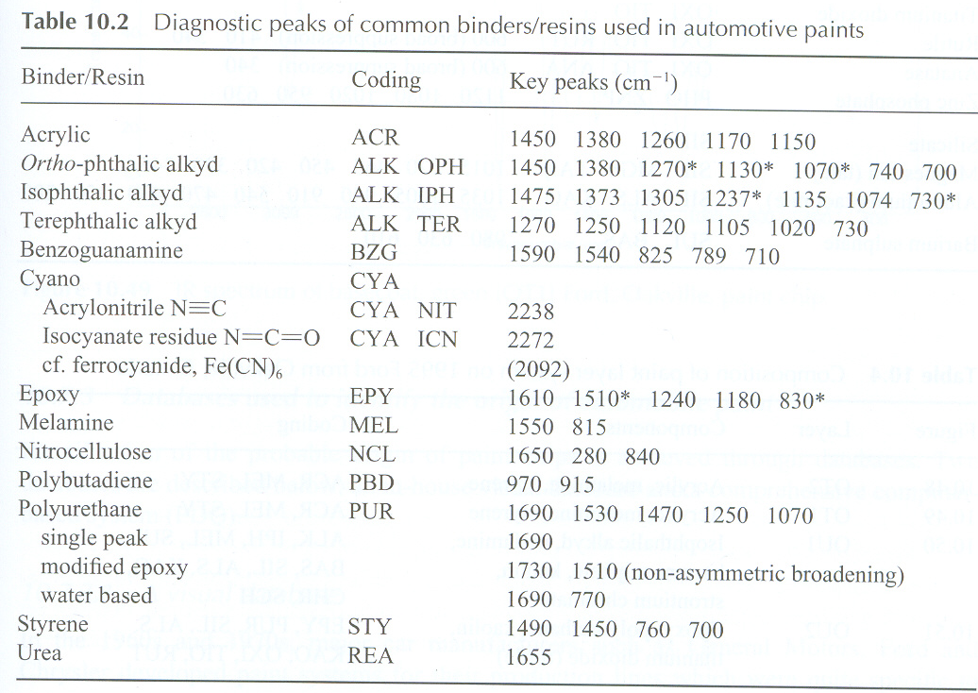

Slide 29
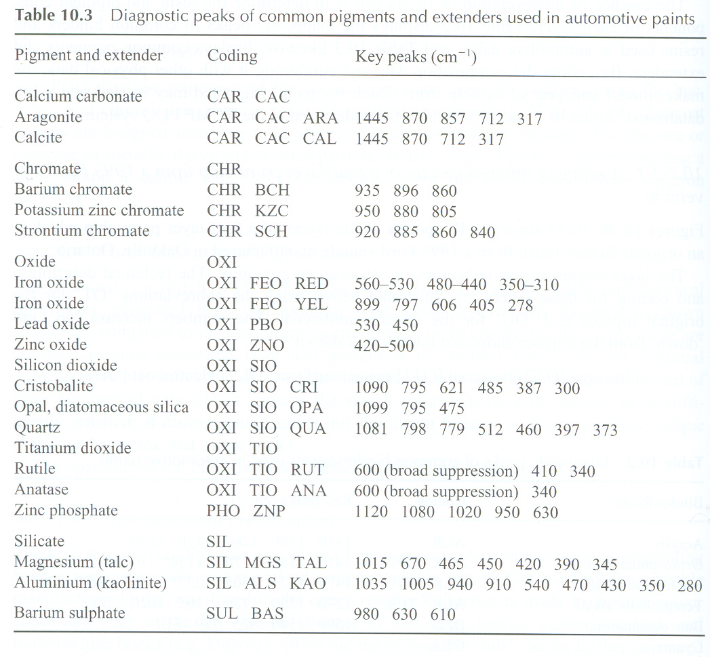

Slide 30
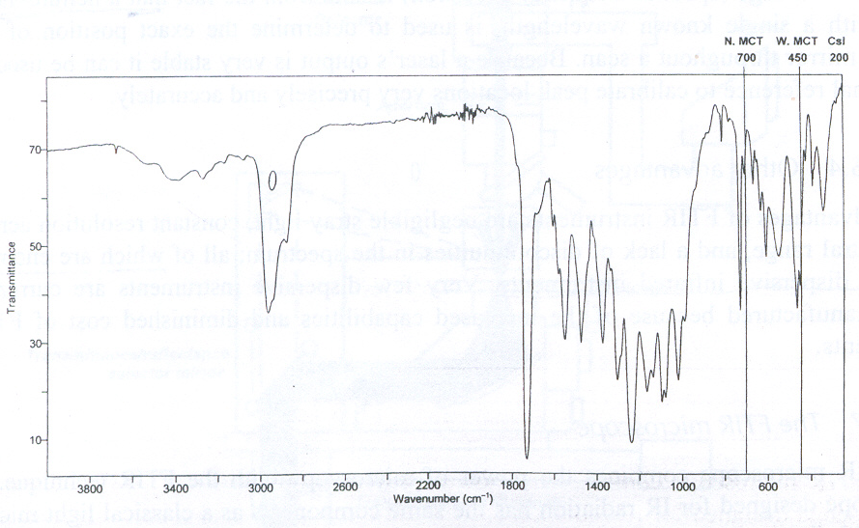
Effects of the cutoff wavelength of KBr and CsI optics on the inorganic data observed in the lower IR region

Slide 31
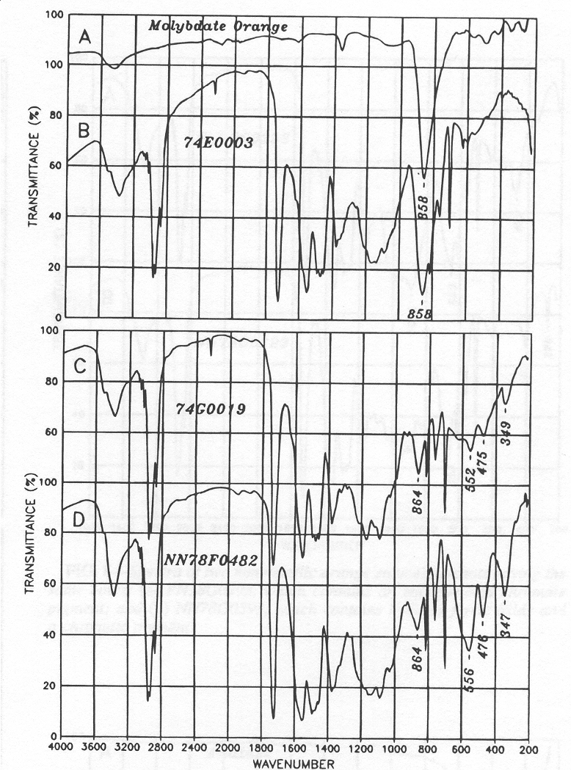
Infrared spectra of
automobile topcoats
(inorganic pigments)
A Molybdate orange
B a red enamel, which
contains Molybdate orange
C an orange-brown enamel,
which contains ferric oxide
and Molybdate orange
D a red-brown enamel,
which contains ferric oxide
and Molybdate orange

Slide 32
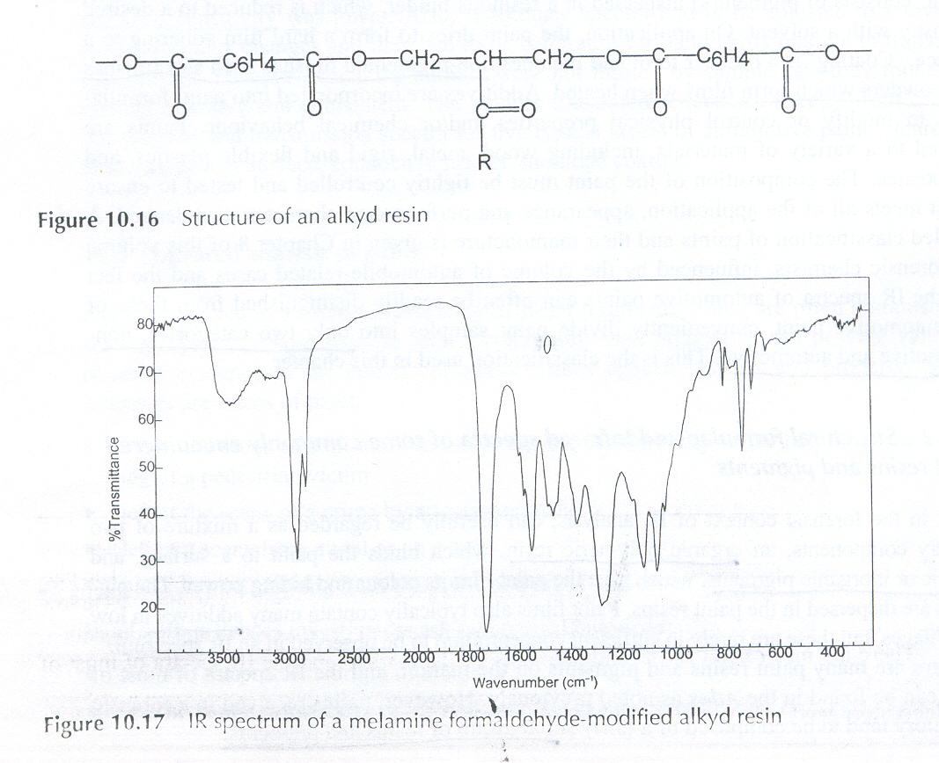
IR spectrum of a melamine formaldehyde-modified alkyd resin

Slide 33
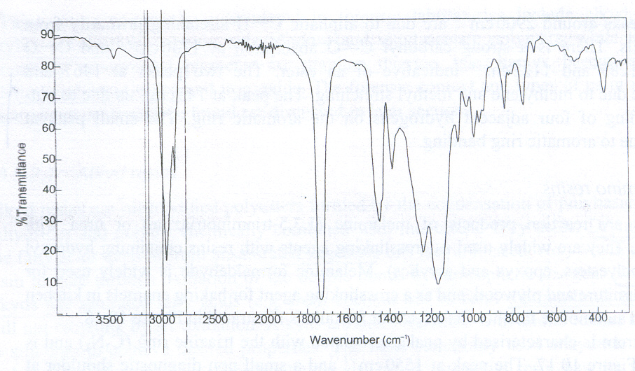
IR spectrum of an acrylic resin

Slide 34
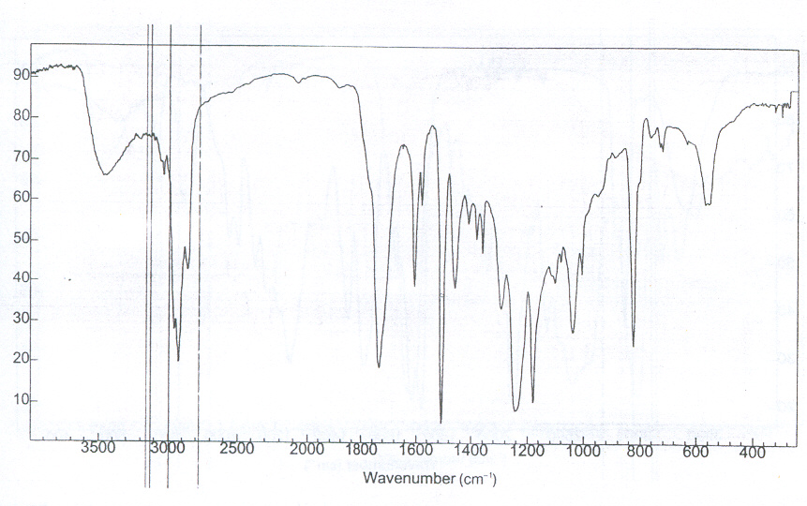
IR spectrum of an epoxy resin

Slide 35
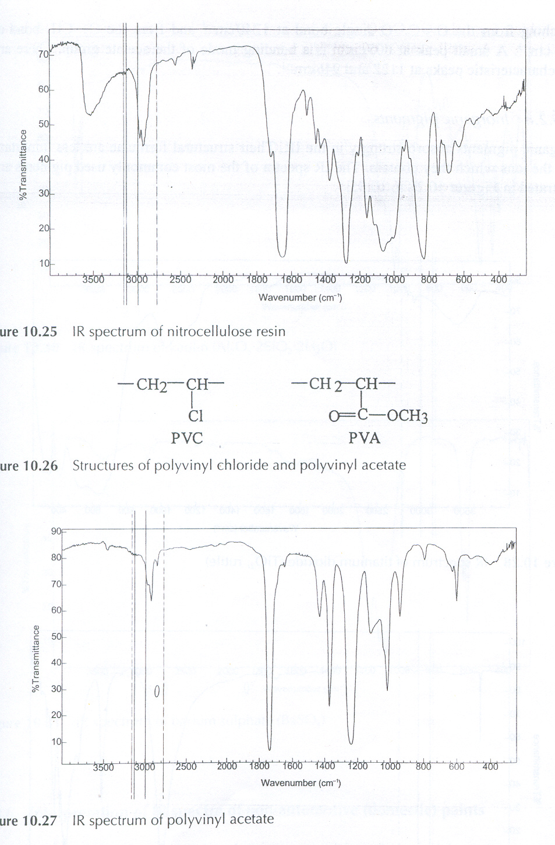
IR spectrum of nitrocellulose resin

Slide 36
IR spectrum of polyvinyl acetate

Slide 37
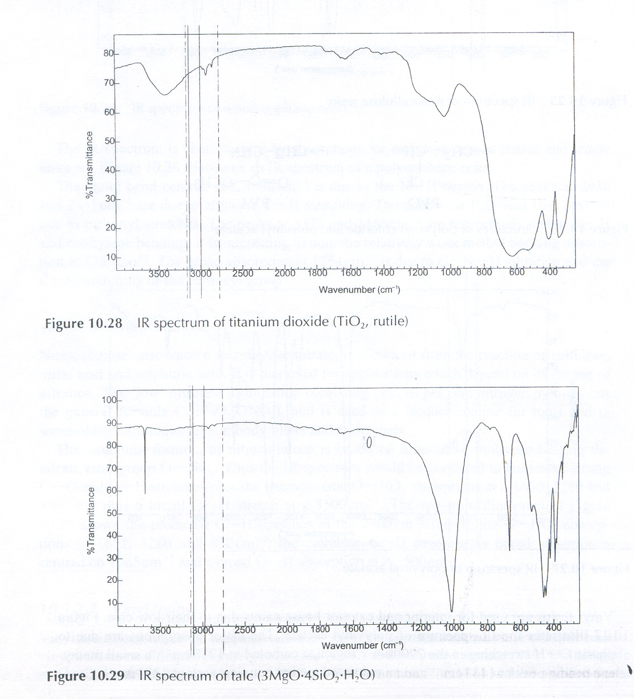
IR spectrum of titanium dioxide (TiO₂ rutile)

Slide 38
IR spectrum of talc (3MgO.4SiO₂.H₂O)

Slide 39
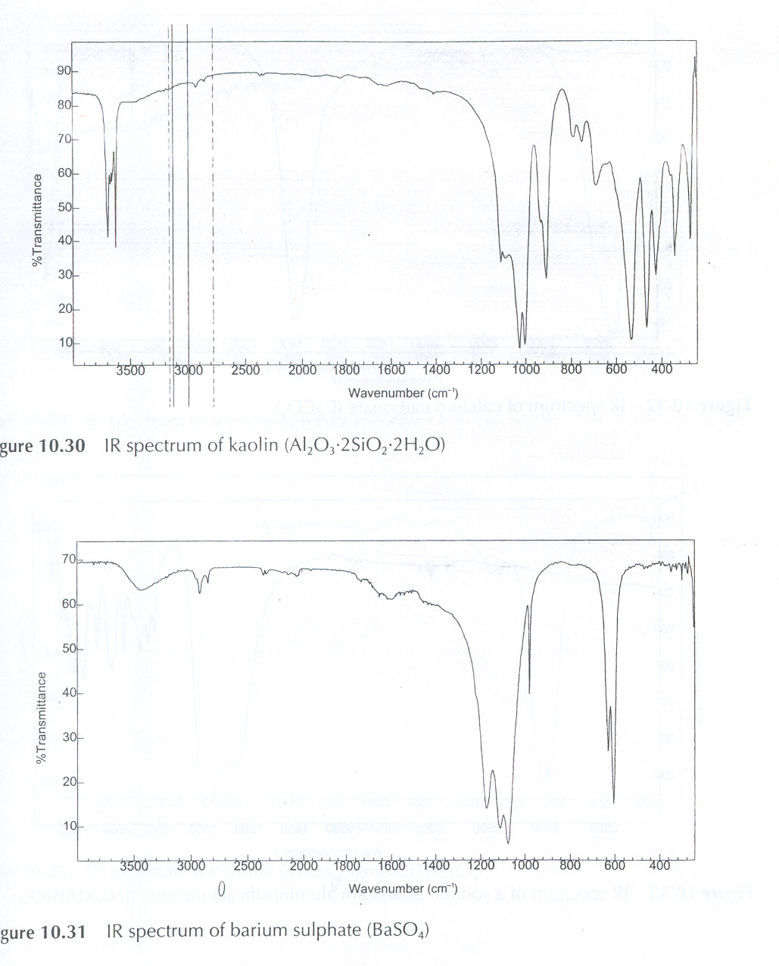
IR spectrum of kaolin (Al₂O₃.2SiO₂.2H₂O)

Slide 40
IR spectrum of barium sulphate (BaSO₄)

Slide 41
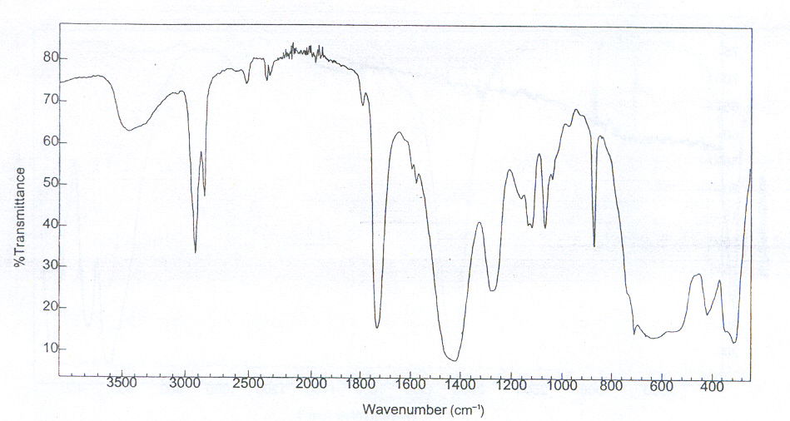
IR spectrum of unknown paint sample

Slide 42
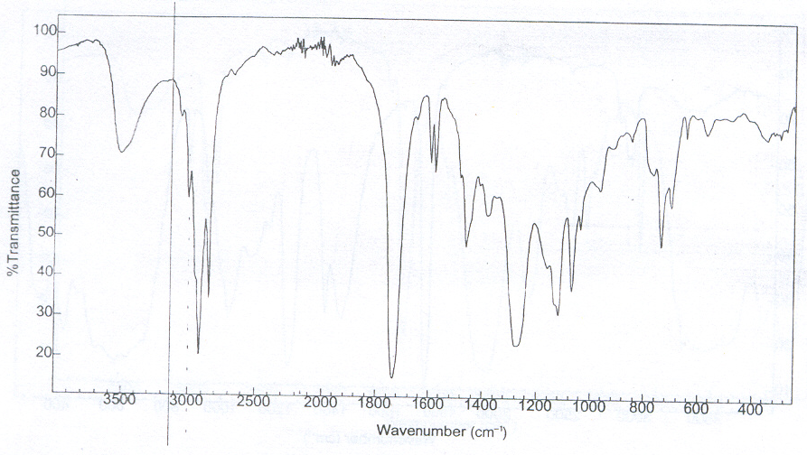
IR spectrum of the alkyd resin component of unknown paint sample
(in the previous projection)

Slide 43
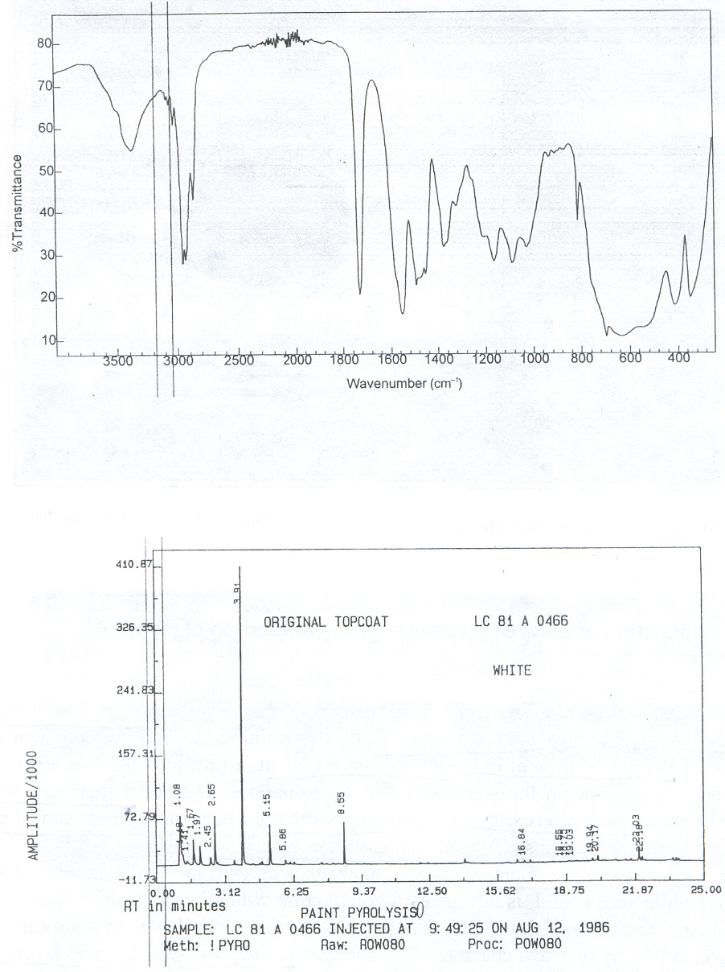
IR spectrum of a white acrylic melamine original automotive paint LC81AO466 (NBS)
Pyrolysis gas chromatogram of a white acrylic melamine original automotive paint LC81AO466 (NBS)
notice the presence of peak at retention time 8.55 minute

Slide 44
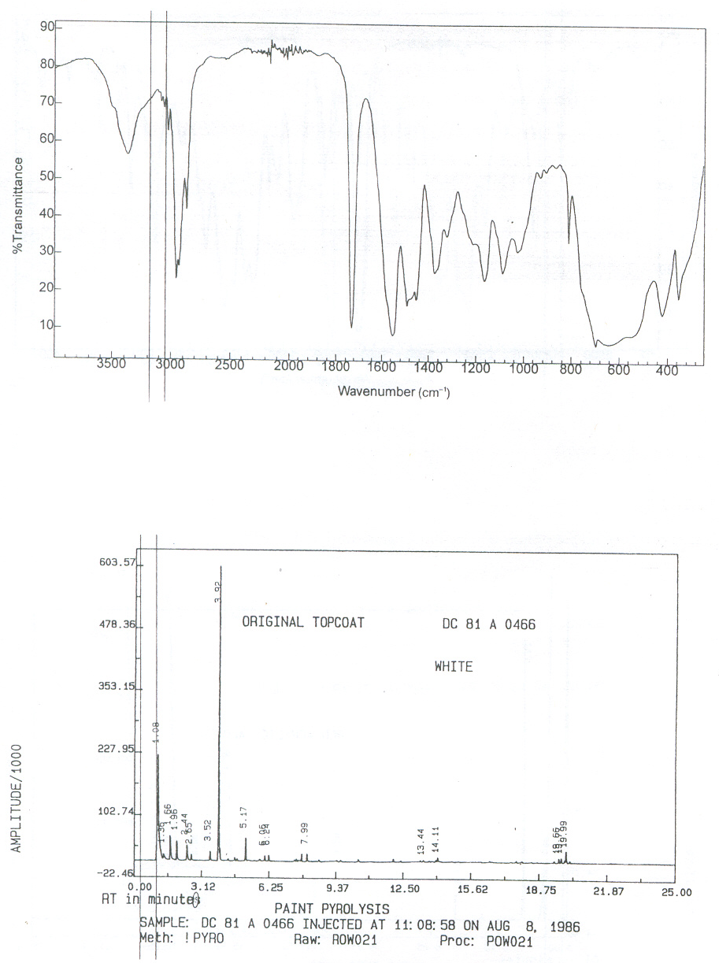
IR spectrum of a white acrylic melamine original automotive paint DC81AO466 (NBS)
Pyrolysis gas chromatogram of a white acrylic melamine original automotive paint DC81AO466 (NBS)
notice the absence of peak at retention time 8.55 minute

Slide 45
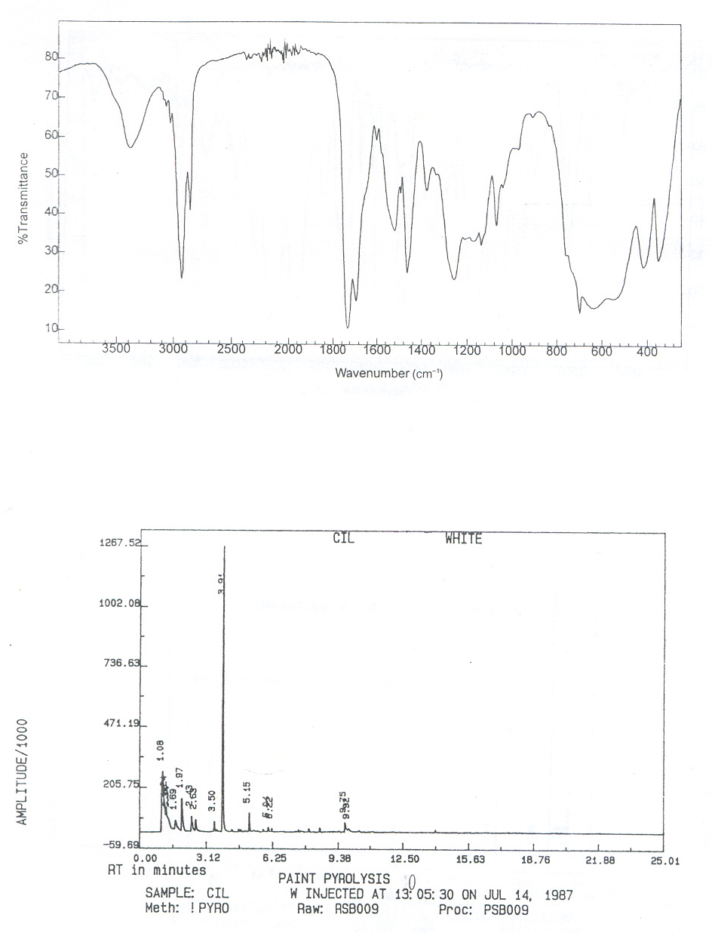
IR spectrum of a white alkyd automotive refinish paint (Canadian Industries Ltd.)
notice presence of urate absorptions at 1680 and 1520 cm⁻¹
Pyrolysis gas chromatogram of a white alkyd automotive refinish paint (Canadian Industries Ltd.)

Slide 46
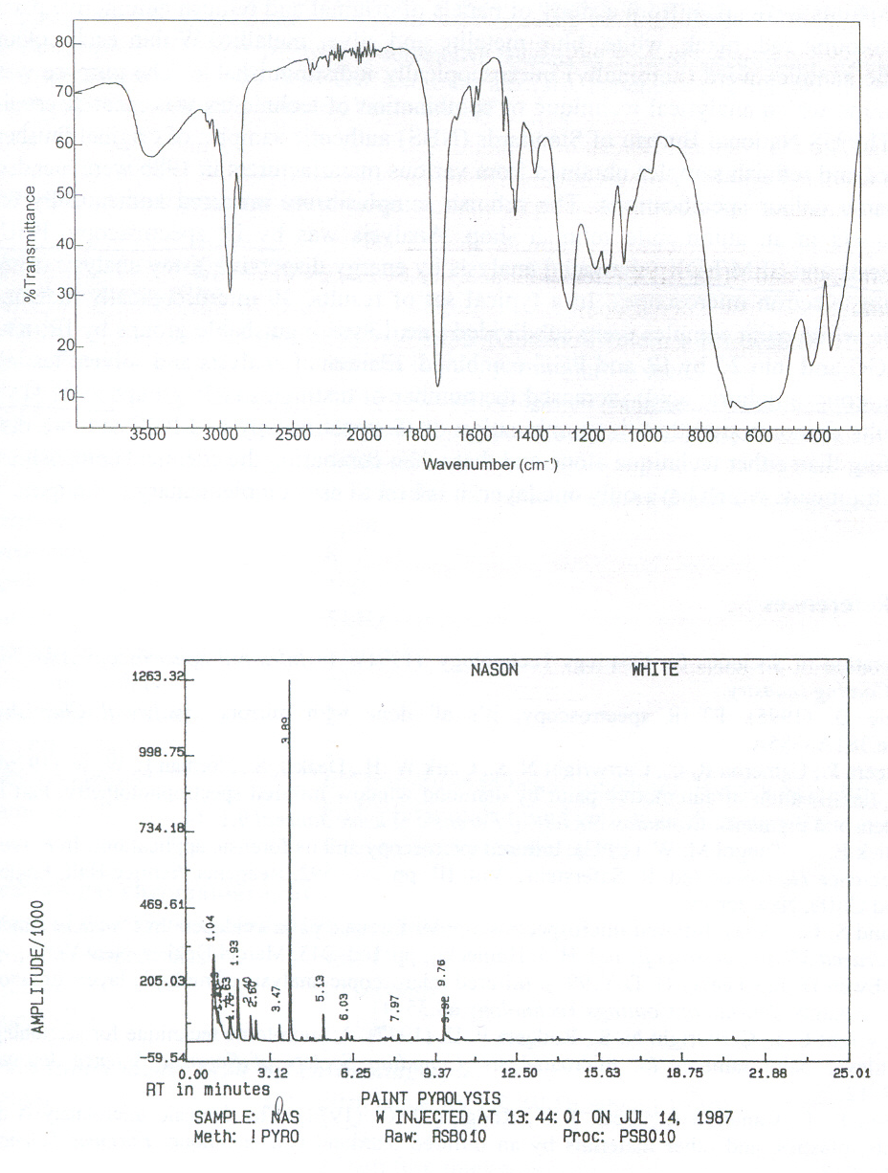
IR spectrum of a white alkyd automotive refinish paint (Nason)
notice absence of urate absorptions at 1680 and 1520 cm⁻¹
Pyrolysis gas chromatogram of a white alkyd automotive refinish paint (Nason)

Slide 47
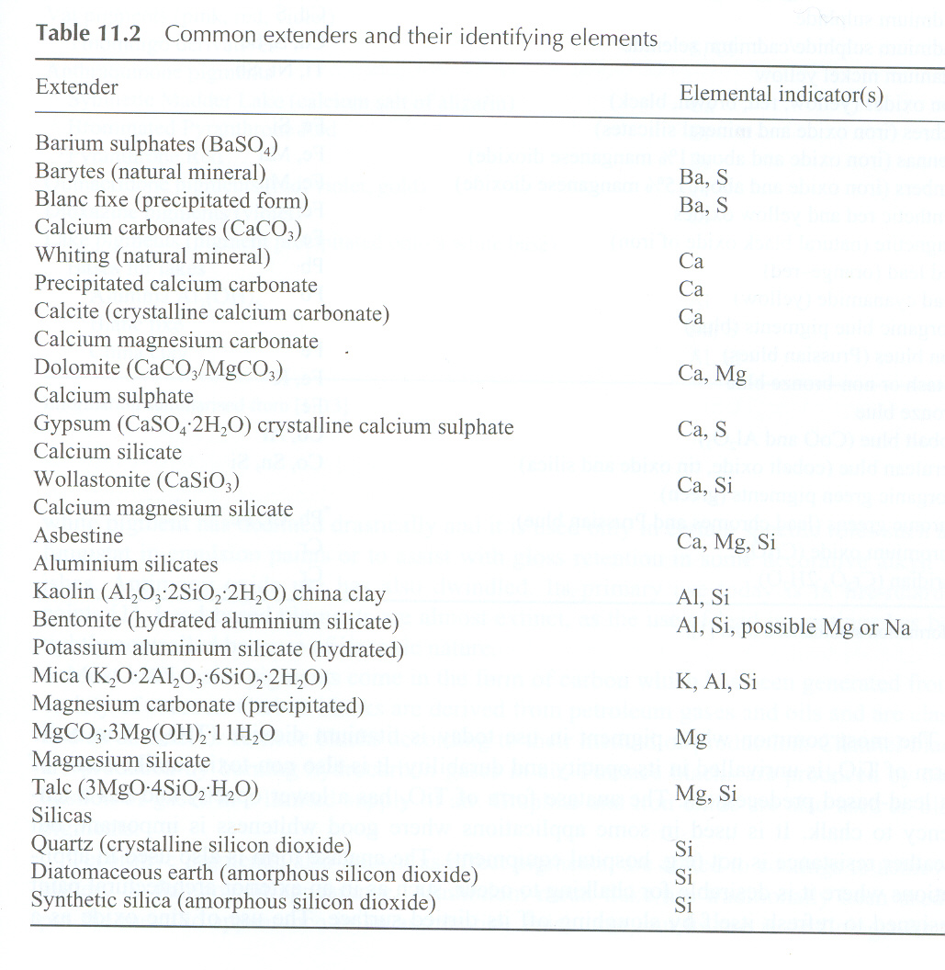

Slide 48
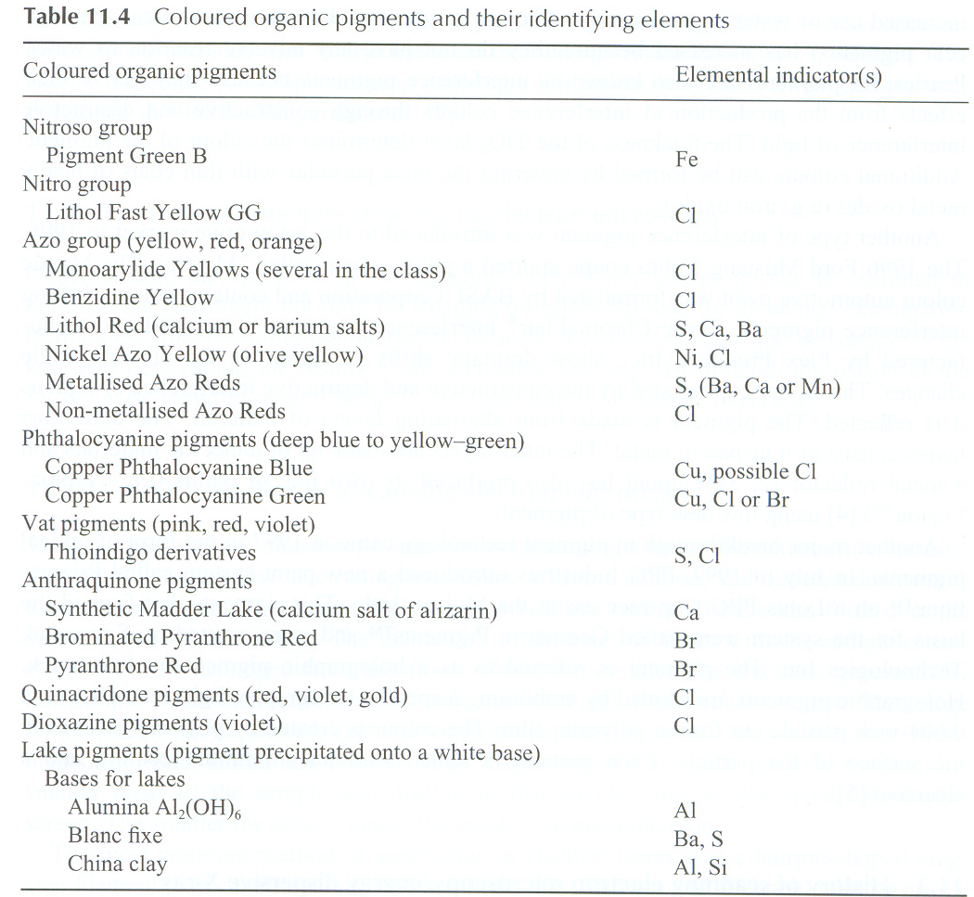

Slide 49
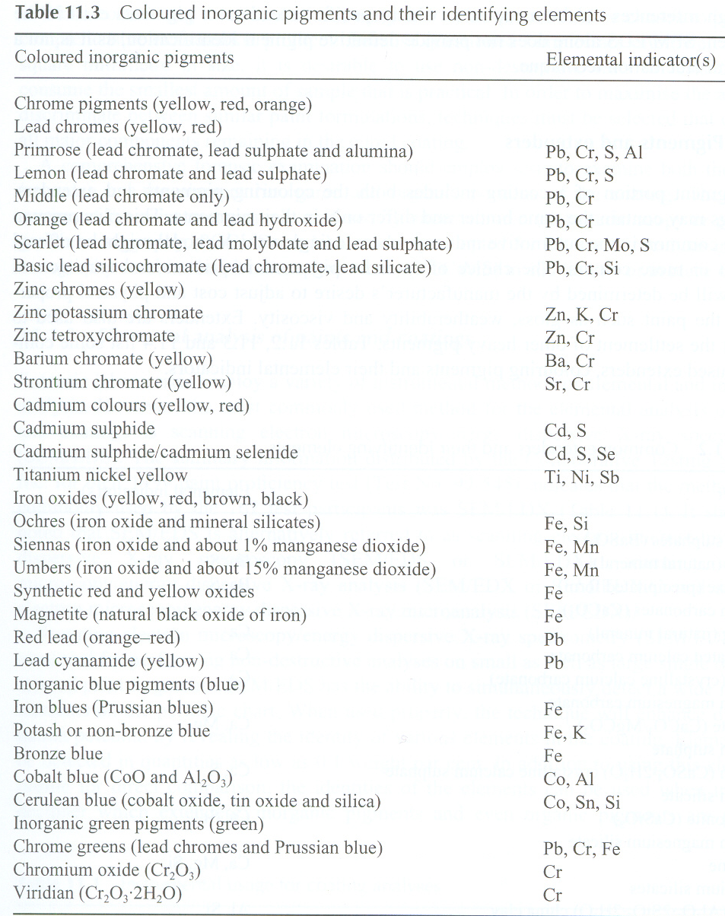

Slide 50
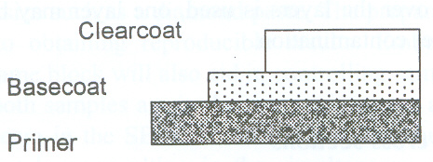
Stair-step carving of a three layer paint chip

Slide 51
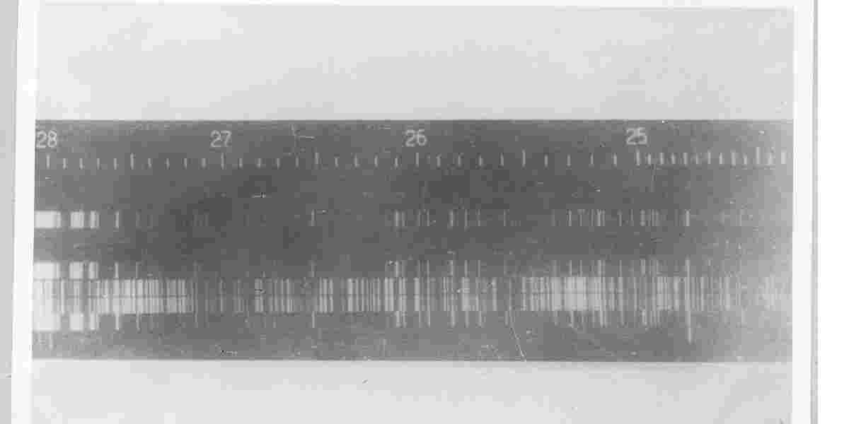
Spectrochemical analysis of paint samples
a
b
a-control; b-from the accident site
the two spectra match line by line, which shows that the sample a and
b have same elemental composition

Slide 52
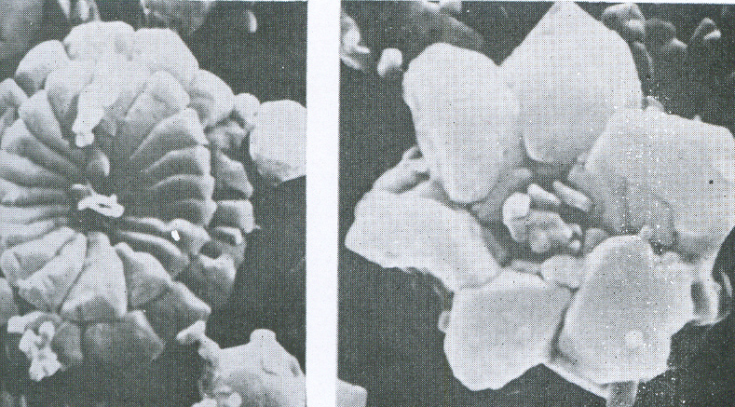
COCCOLITHS from PUTTYY
Coccoliths are the skeletons of micro-organisms which lived in the ancient seas from which chalk was deposited.
They differ in appearance according to the precise geological horizon from which the
chalk used in the putty was quarried

