Slide 1
Fractured Surface
Physical Matches
Mechanical Fit
ranbsingh

Slide 2
Fractured Surfaces
If any thing gets broken or torn into pieces during the commission of a crime, and if one of the pieces is found at the scene of crime and the other can be linked with the suspect, then the fitting together of the broken edges of these pieces may provide the most incontrovertible evidence to link criminal with the crime.
The uniqueness of the randomly generated irregular
contours of the broken edges can be inferred intuitively or
a statistical concept of random breaking to prove the
uniqueness of broken edges can be developed.
However, computer generated fractal surfaces, as models of evidence physical matches, have also been used to assess the degree of uniqueness of the broken edges in terms of the complexity of the fractal surfaces.
ranbsingh

Slide 3
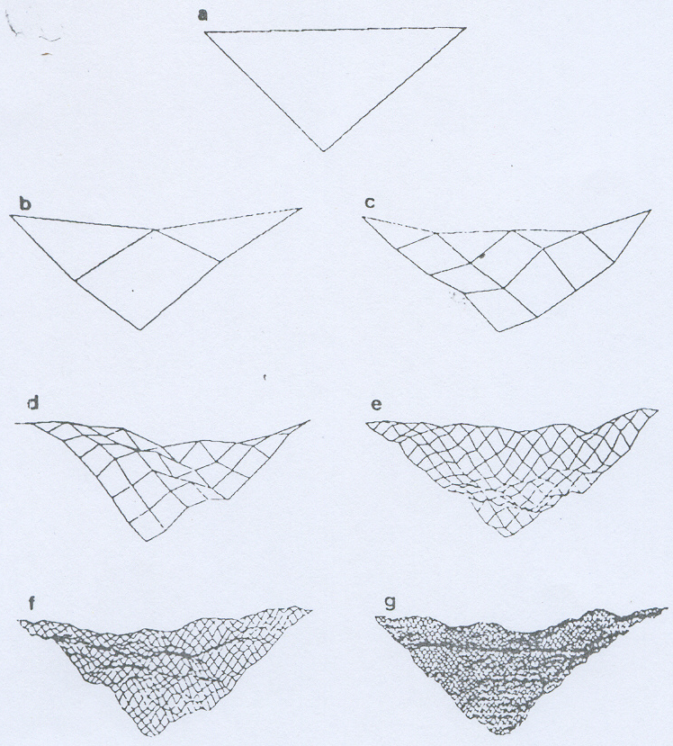
Computer generated fractal surfaces
The framing of the complexity of a fracture surface in terms of the time required for its generation,
represents a
means for the
concept– utilization
of the intricacy and uniqueness of an actual fracture.
Typical crack propagation velocity
in solids is of the
order of 2400 m/s.
A fracture surface of
1 in² (6.45 cm²)could be generated in
approx 10µs.
Are not subject to adventitious replications
(a) plane surface
(b) through (g)
fractal surfaces
time required for
Computation of
surface parameters
(b) 15 seconds
28 seconds
67 seconds
205 seconds
717 seconds
2740 seconds
Computer used
Apple II 500,000
operations/second
45 min 40 sec
incontrovertible evidence – taken for granted
ranbsingh

Slide 4
Direct Physical Match
Association of features of two corresponding facture surfaces like jigsaw fit
Indirect Physical Match
In case of
- Post fracture damage
- Intervening segment or section missing
direct physical match is not possible
The continuity of both surface and internal features are utilizes to evaluate the possibility of an association
ranbsingh

Slide 5
Direct Physical Match
Broken and severed parts of articles recovered from the
scene of occurrence and those from the person, house, or vehicle provide a definite type of evidence if hand in glove
fit is obtained. The variety of evidences in his type is in fact limitless.
In some cases where the article has appreciable projections and depressions at the cross section. They provide suitable material for comparison. The irregularities on one part are cast and compared with the irregularities on the other part. They match if they originally form one article.
ranbsingh

Slide 6
Indirect Physical Match
Culprits sometimes change the ends of the severed or broken parts intentionally or otherwise. The severed ends can still be connected with its counterpart.
The presence and continuity of the microscopic scratches on
the pieces prove useful. The scratches may be natural or due
to manufacturing defects.
A finger nail carries natural striation pattern. A piece of fingernail can be identified in respect of the finger from
which it has come even after years.
ranbsingh

Slide 7
Indirect Physical Matches
Fizeau fringes, ream/card marks in glass
Die marks/striations on wire surface
Matching of wood grains
Pigmentation pattern in plastic bags
Scratches on paint chips
under surface of automotive paint chips having
cast like replica of distinct random scratches on
the metal surface from which they have been
separated
etc. etc.
ranbsingh

Slide 8
Physical Matches
Contour match offers a different problem in elastic materials.
The broken or severed edges in the material often get deformed in the process. They do not show proper fit.
The manufacturing defects and wear and tear marks on the two parts should be searched for additional evidence. Striations on outer surfaces are also very strong points for comparison to establish source correspondence
In glass fragments, stone pieces, and other hard substances, mechanical fit even through a few millimeters is sufficient to constitute identity of the common source.
ranbsingh

Slide 9
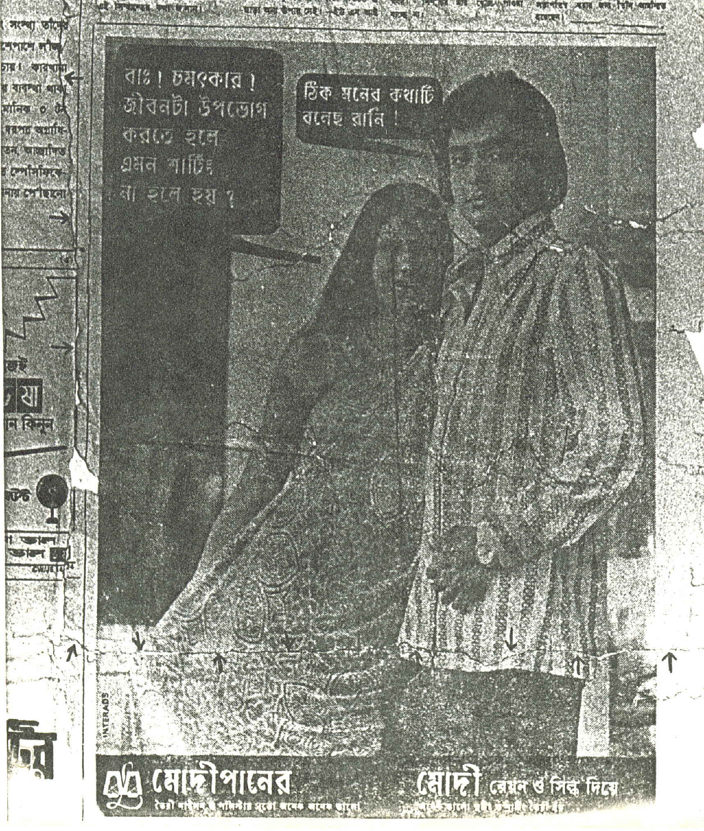
ranbsingh

Slide 10
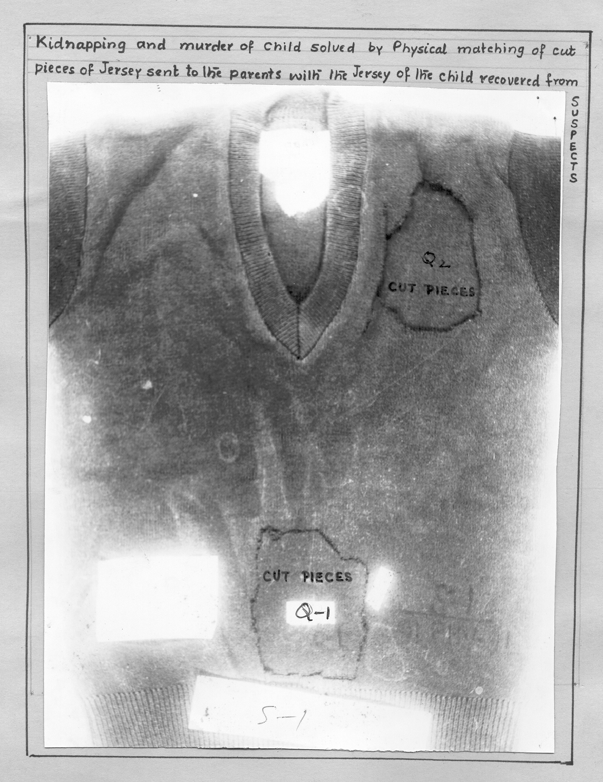
ranbsingh

Slide 11
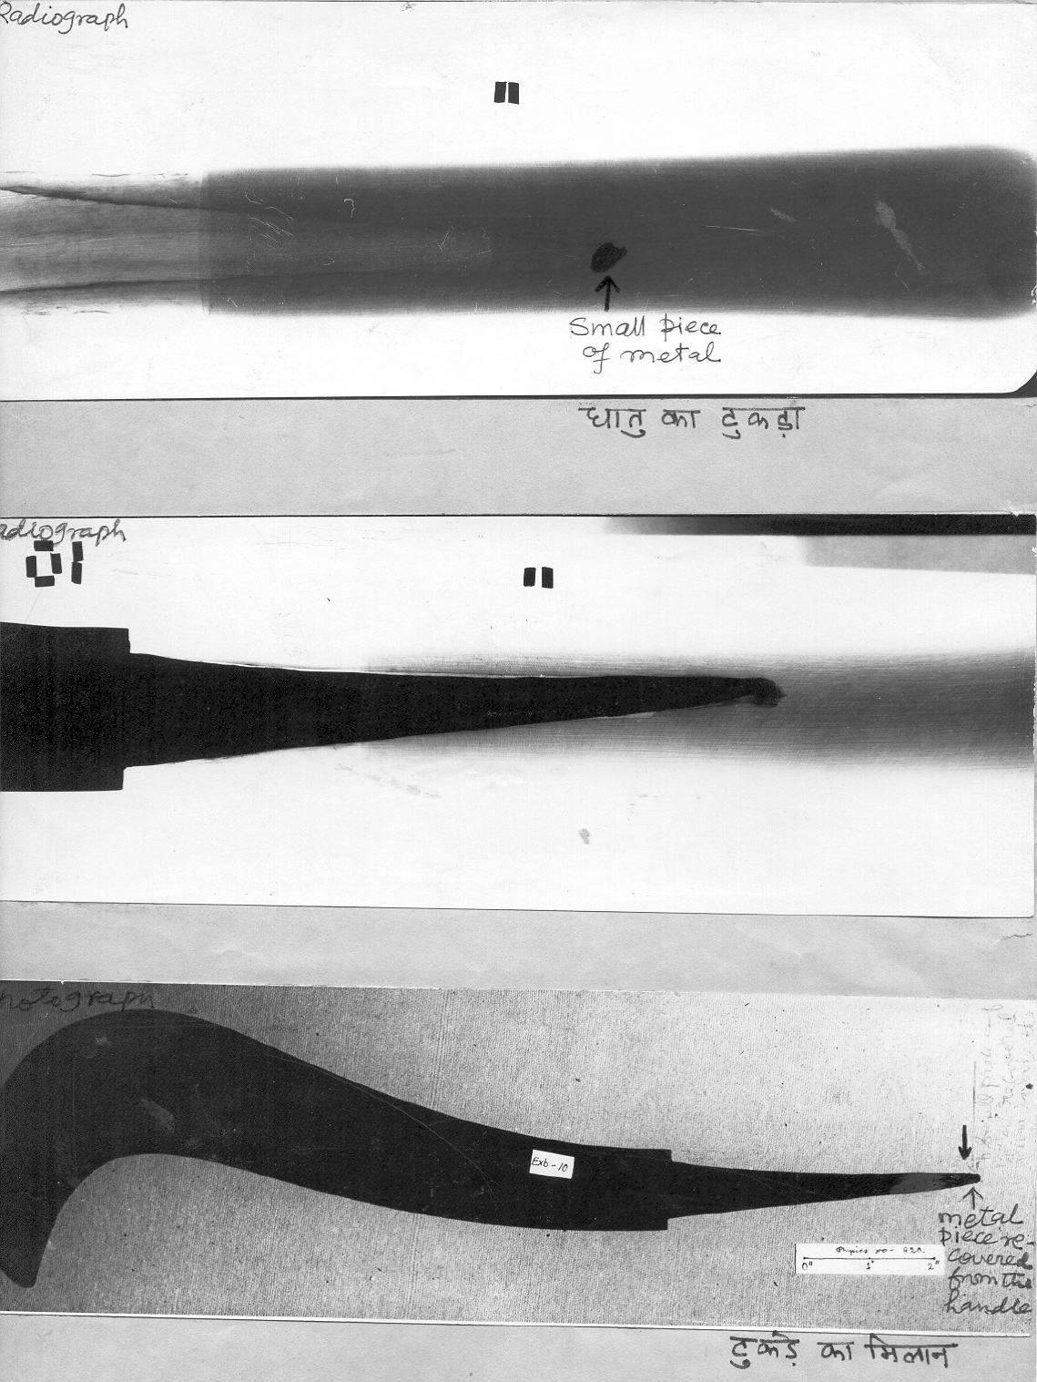
small piece of metal
piece recovered
from the handle
Physical match
ranbsingh

Slide 12
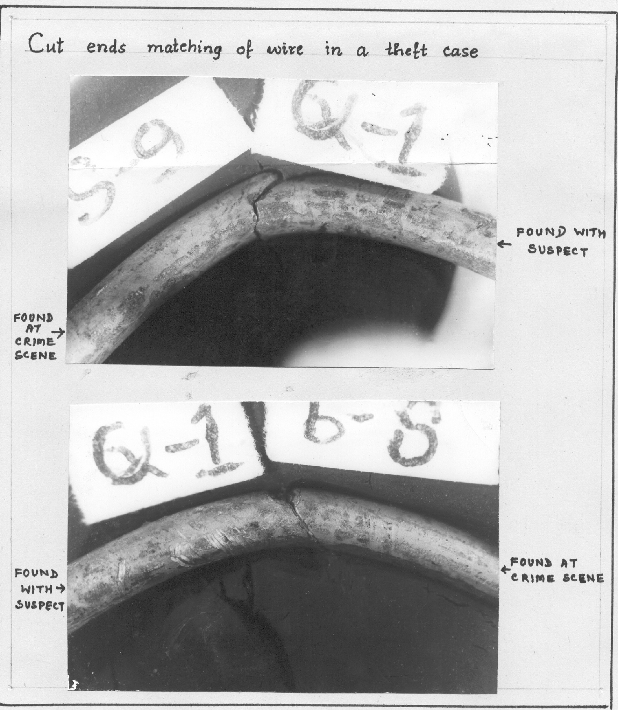
Theft of wire
found at the
scene of crime
recovered
from the suspect
physical match of cut ends
found at the
scene of crime
recovered
from the suspect
ranbsingh

Slide 13
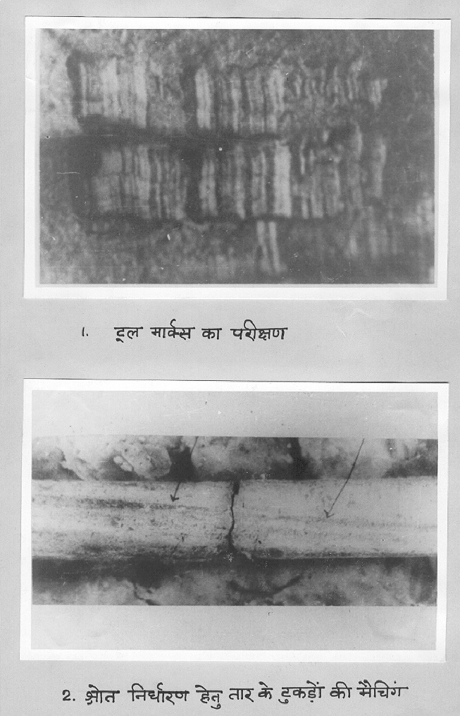
Comparison of striations (die marks) on the surface of wires
ranbsingh

Slide 14
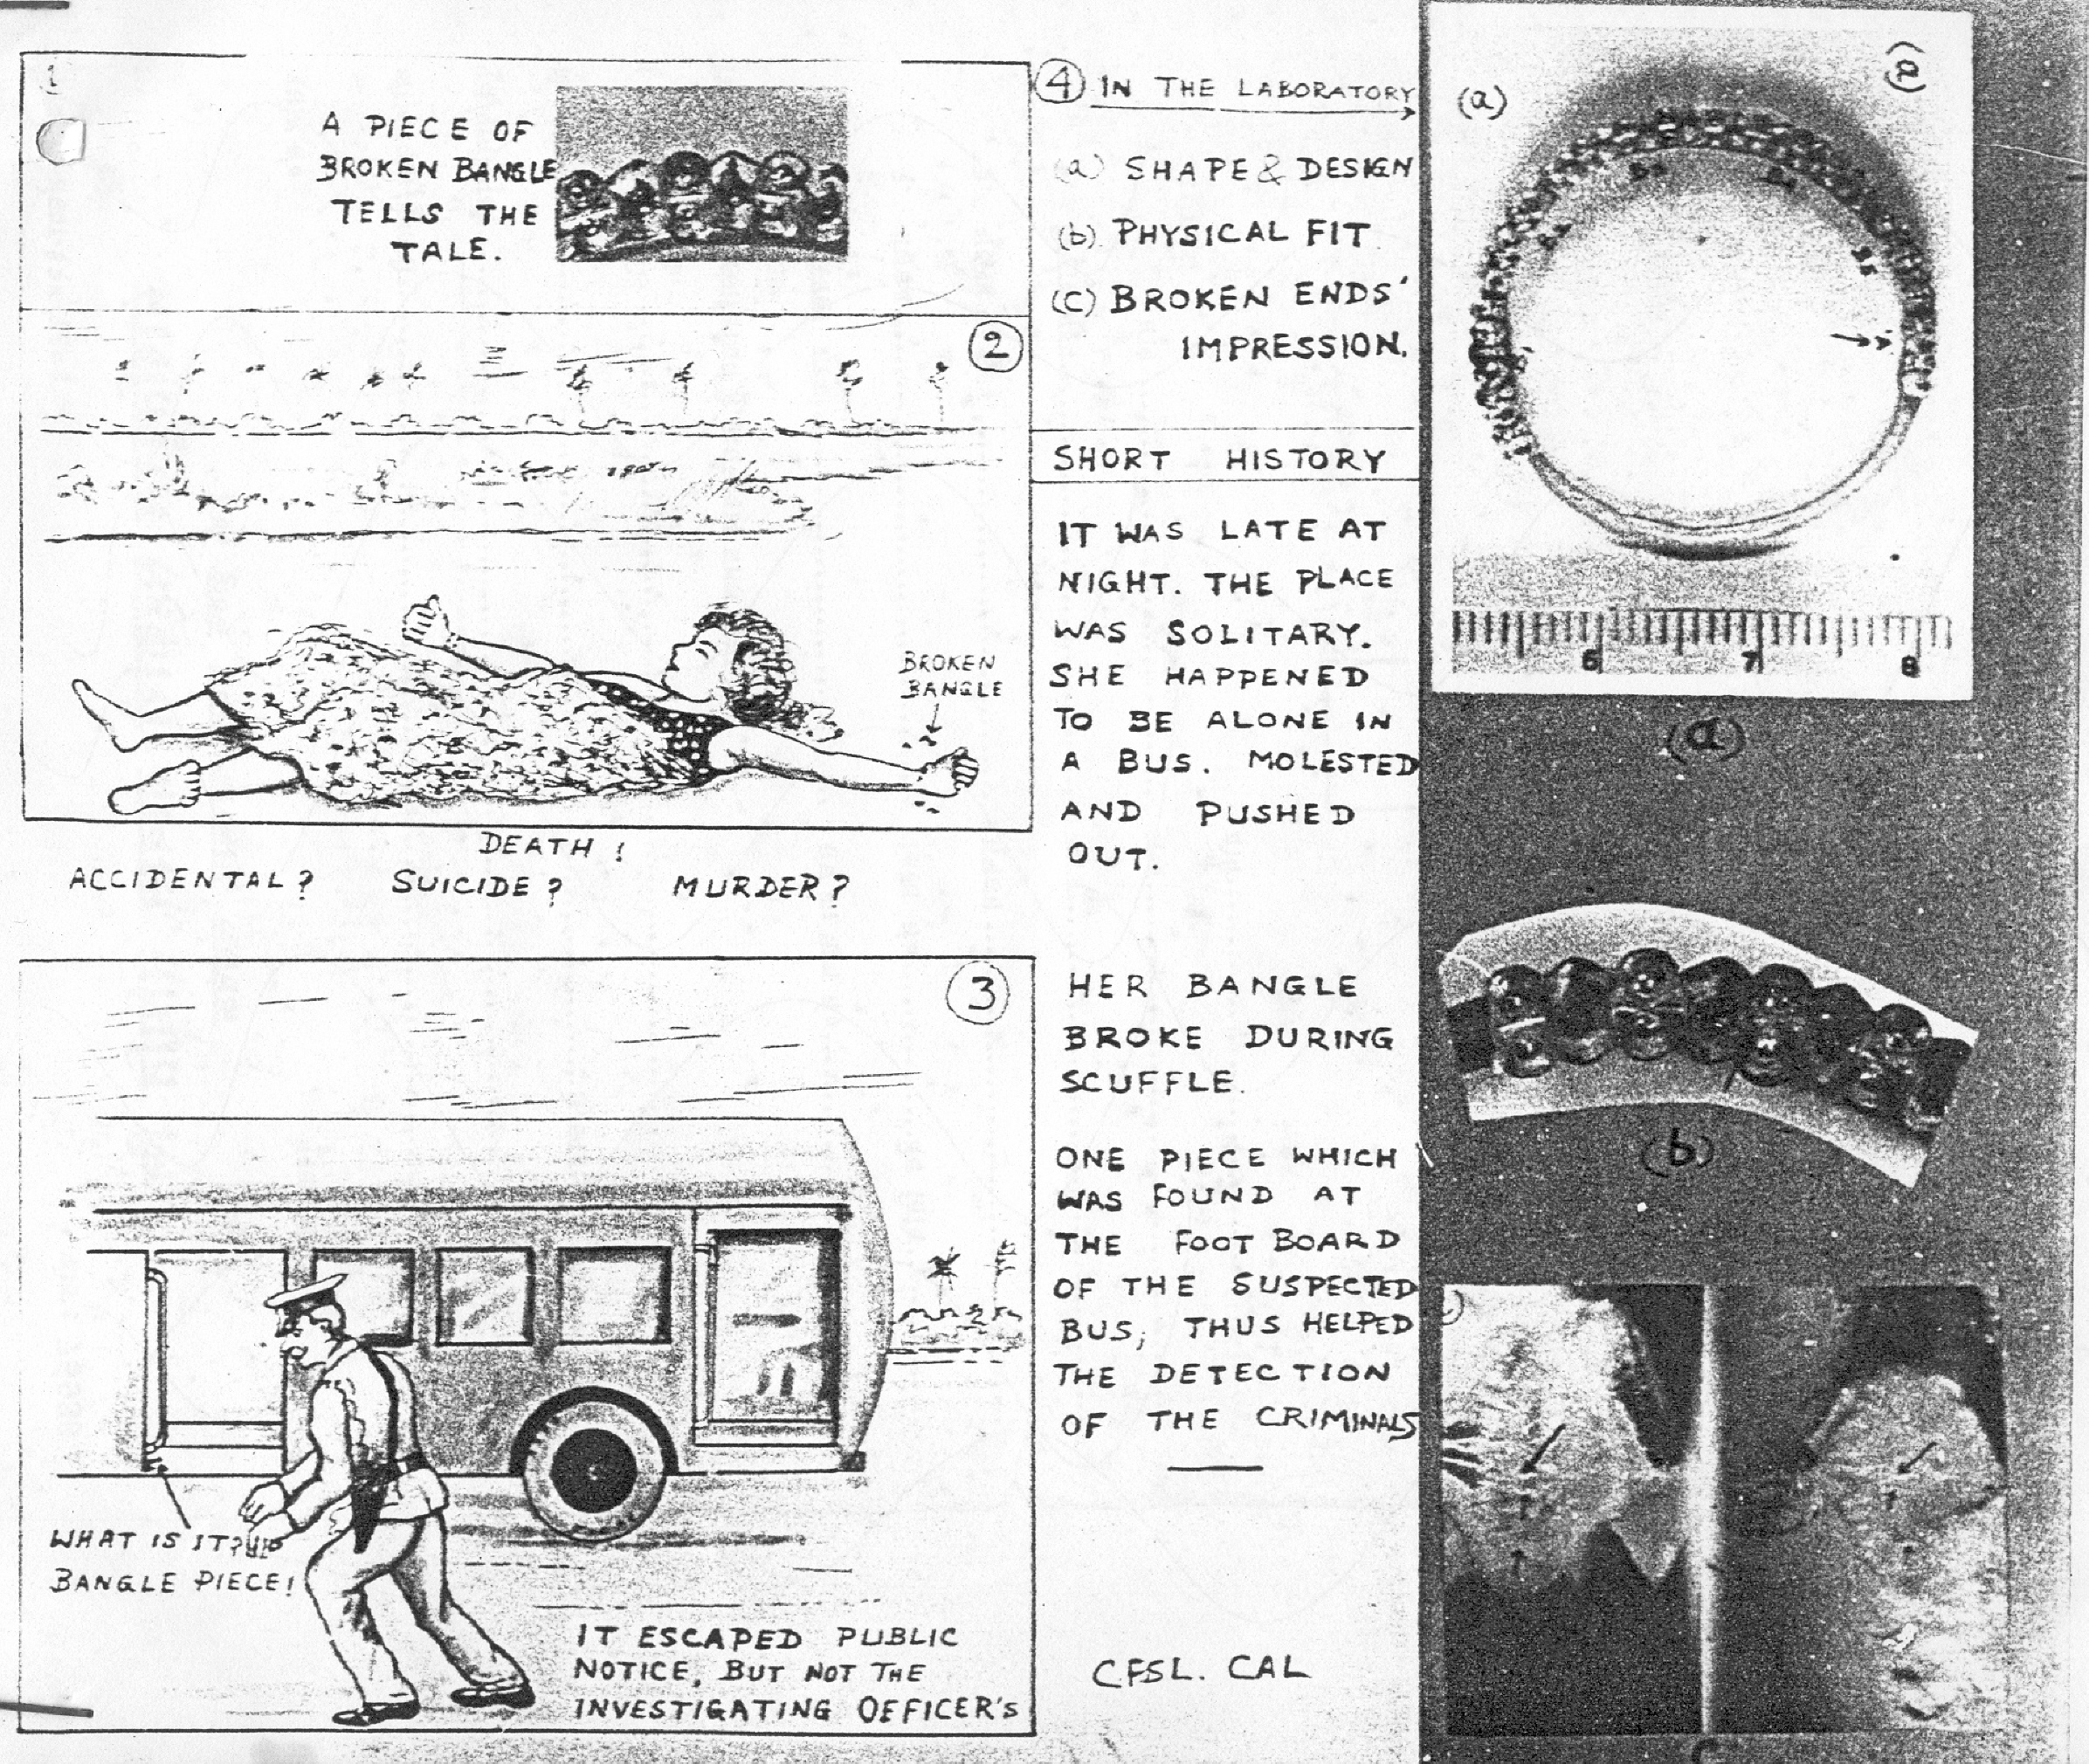
ranbsingh

Slide 15
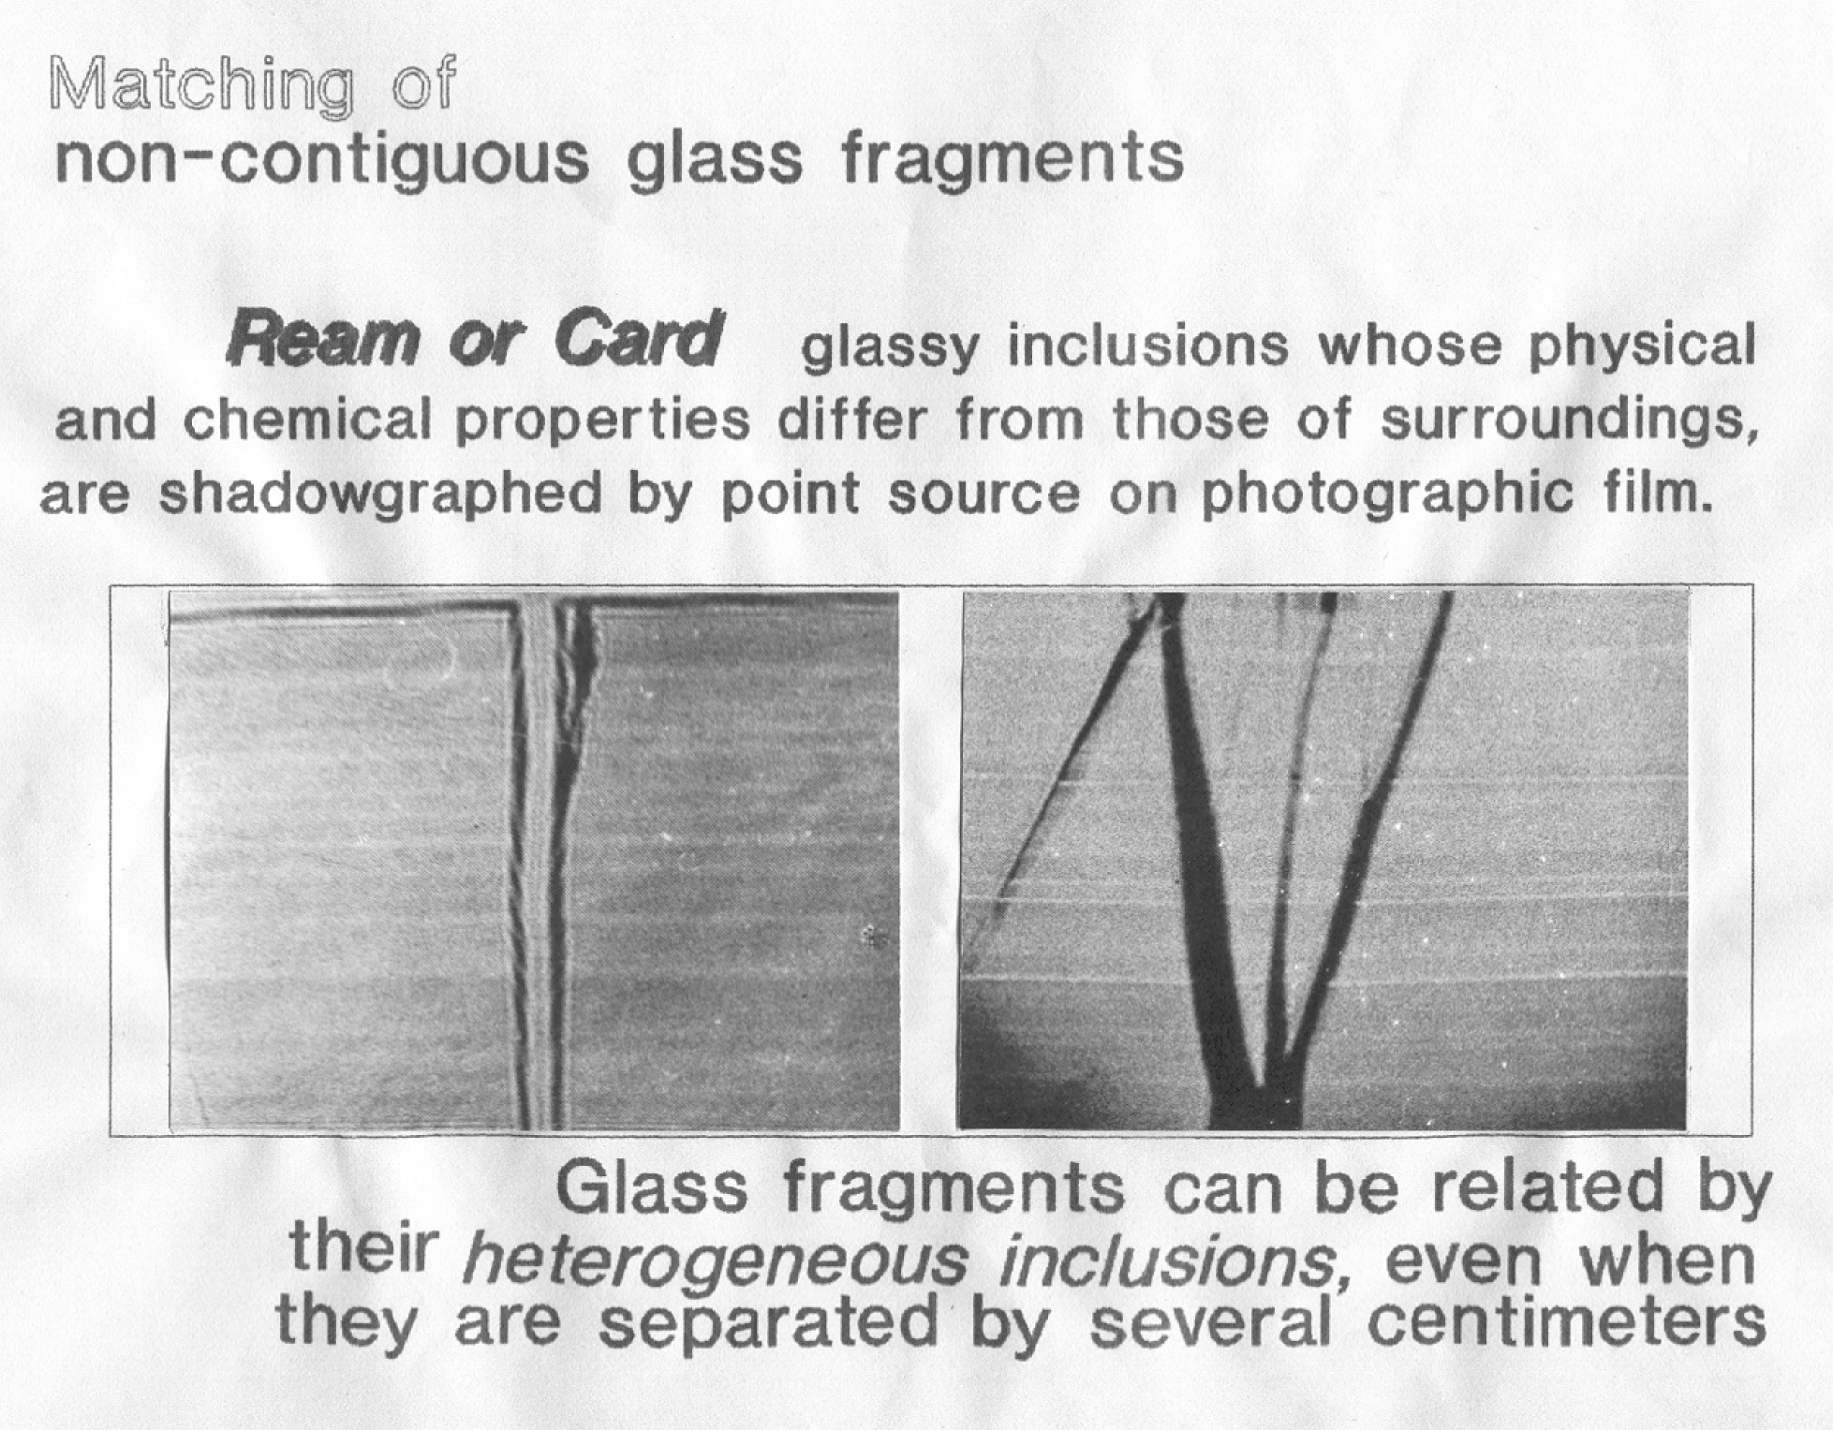
ranbsingh

Slide 16
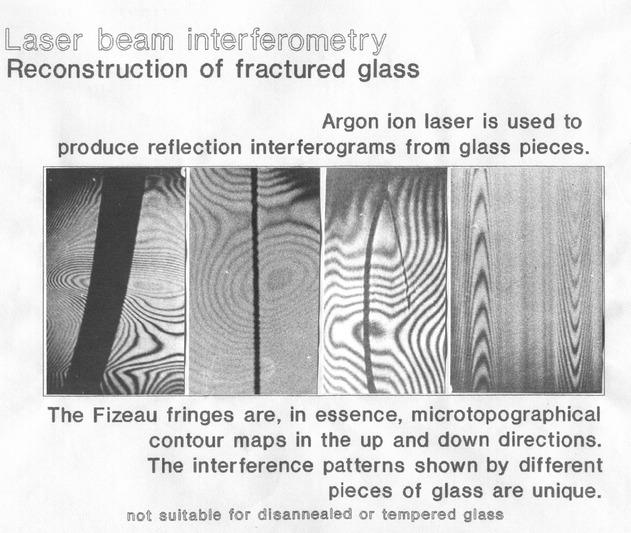
ranbsingh

Slide 17
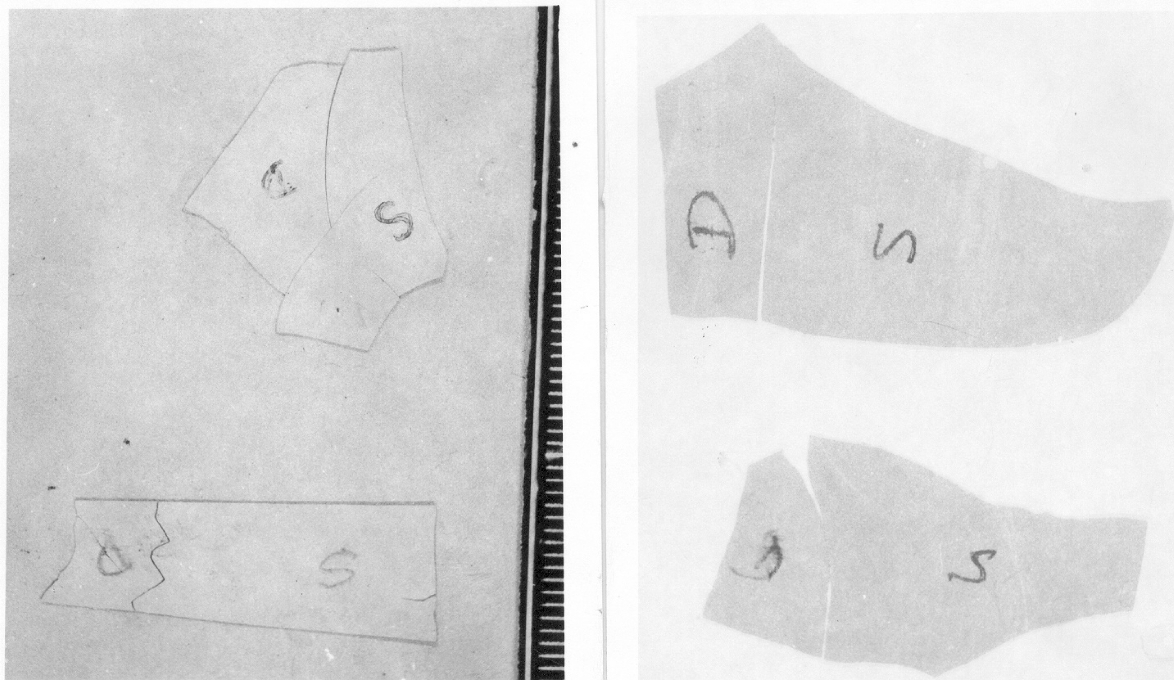
Contour matching of paint chips
ranbsingh

Slide 18
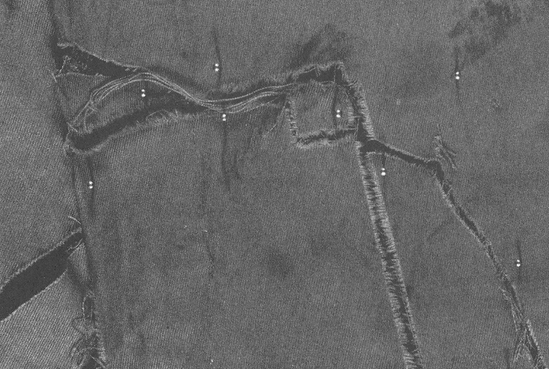
a
a – a piece of cloth recovered from suspect vehicle fits into the torn trousers of the victim
ranbsingh

Slide 19
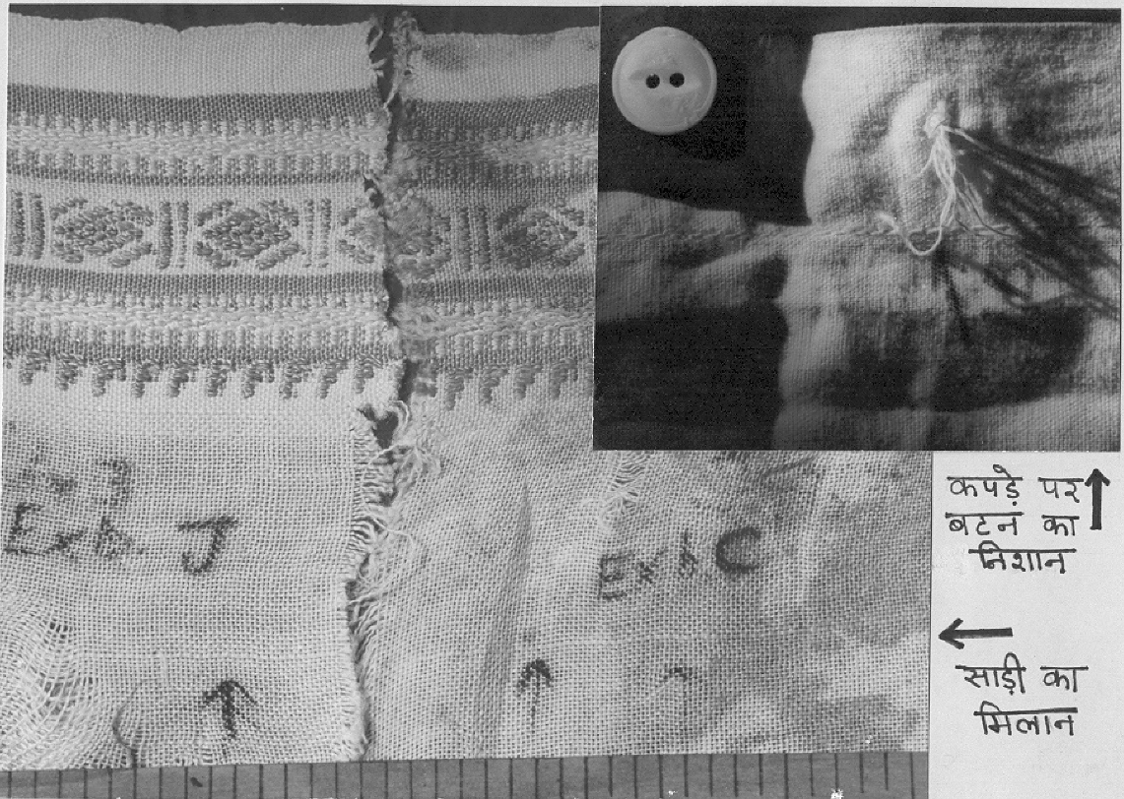
Button
impression
on shirt
Comparison
of saree
pieces
ranbsingh

