Slide 1
Cloth Examination
dimensions
colour
nature of material
pattern of weave
pattern of dyeing
thread count: warp and weft
direction of twist of threads
sewing threads
faults in the structure of the fabric
patches and other repairs, damages etc
ranbsingh

Slide 2
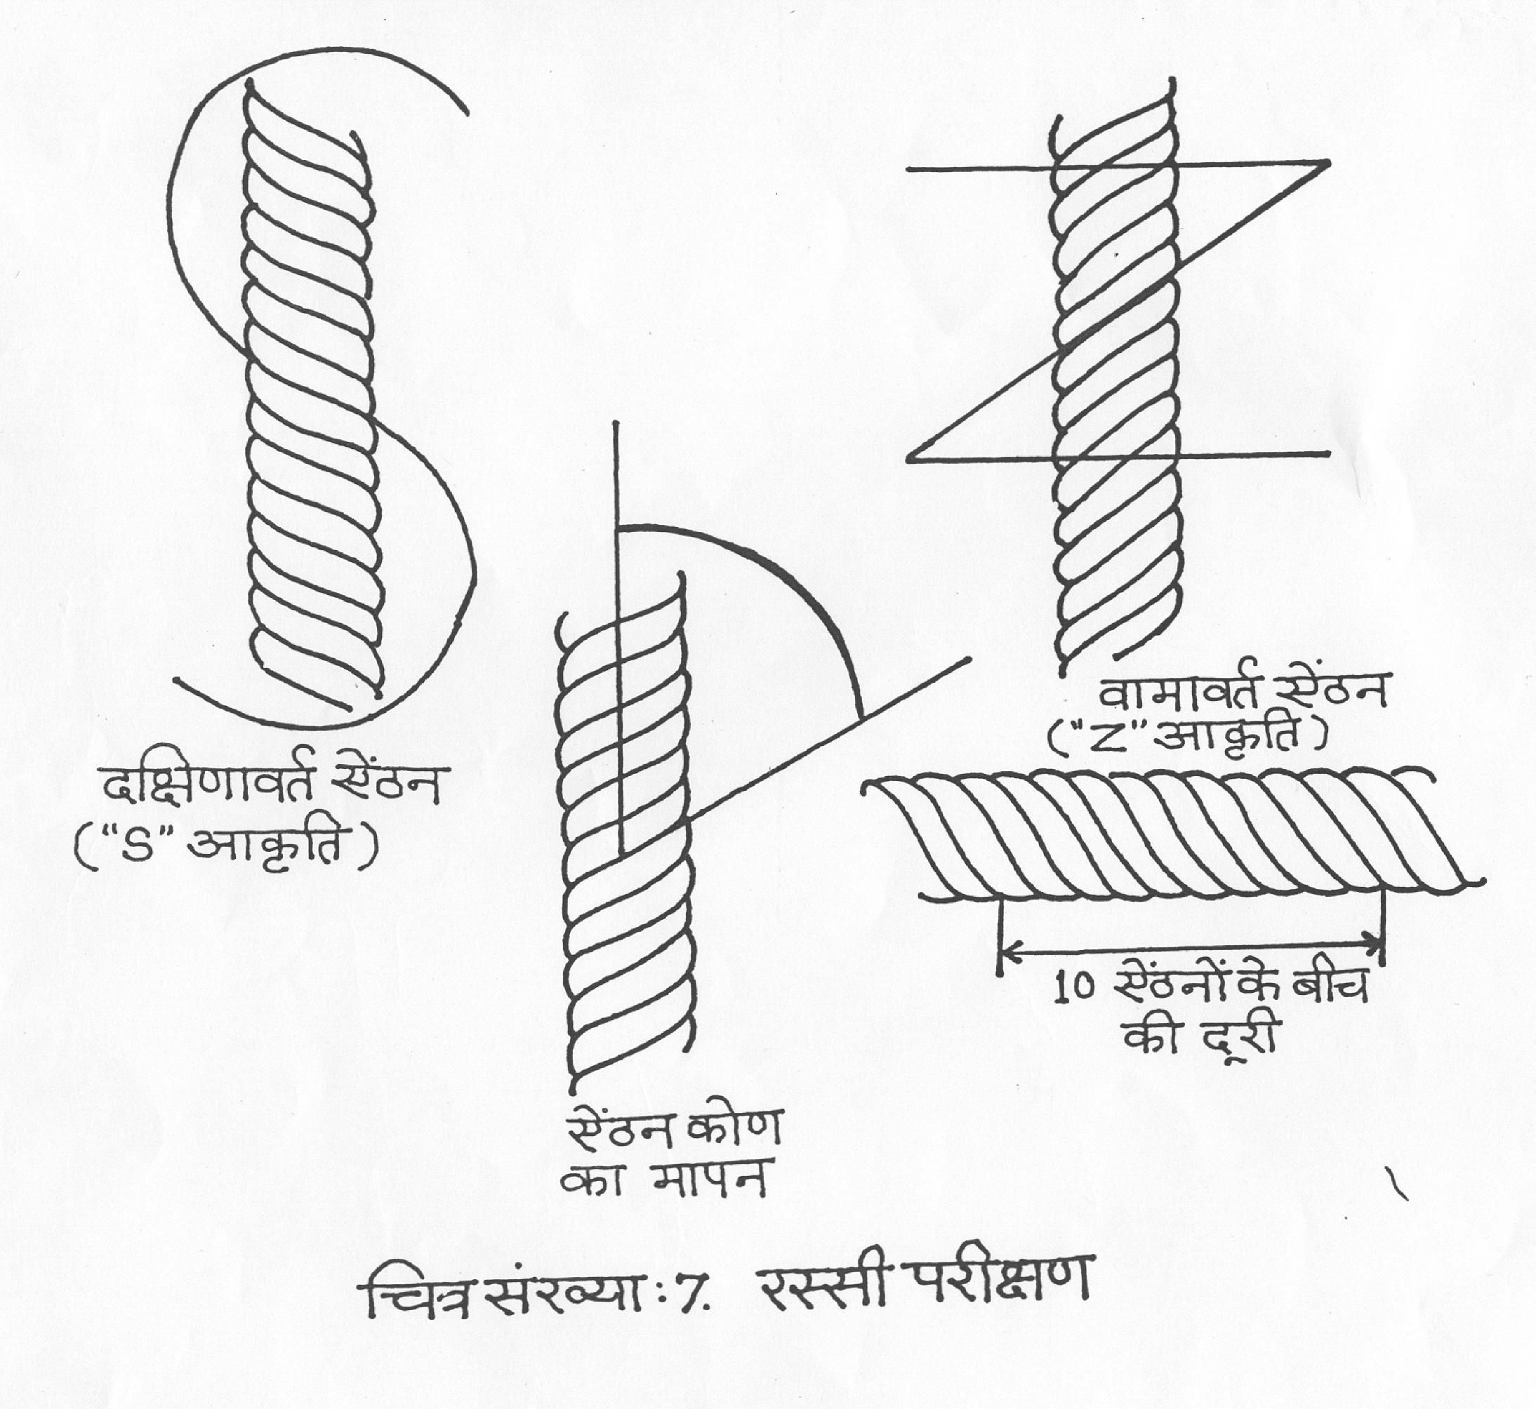

Slide 3
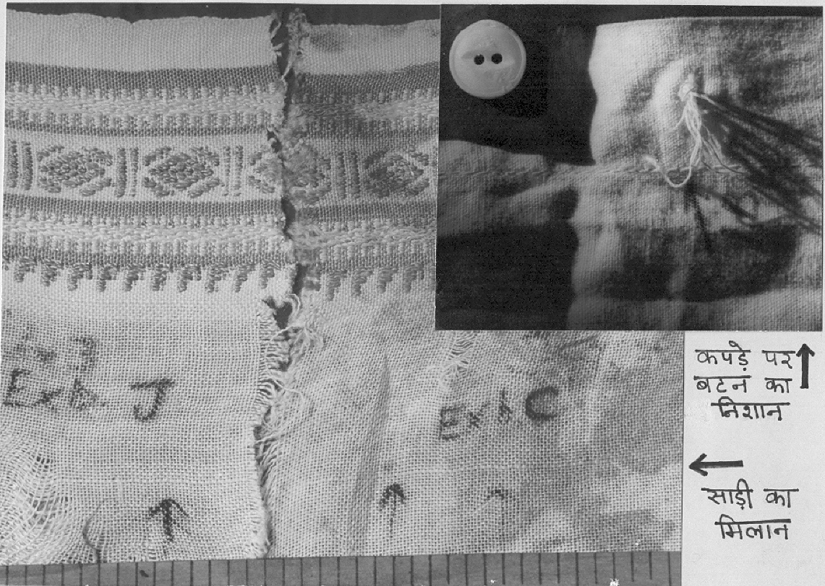
Button
impression
on shirt
Comparison
of saree
pieces
ranbsingh

Slide 4
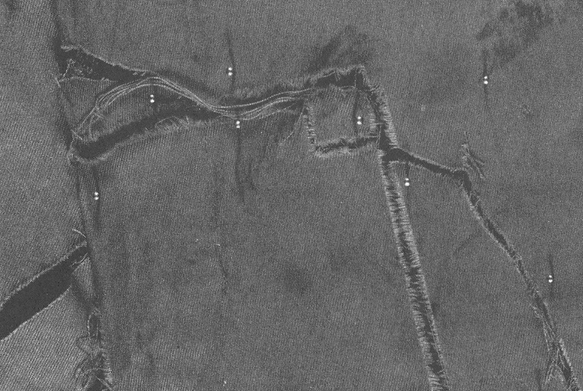
a
a – a piece of cloth recovered from suspect vehicle fits into the torn trousers of the victim

Slide 5
Fibers
Natural
- animal (wool, fur, etc. )
- plant (cotton, flax, hemp, etc.)
Manufactured
- regenerated fibers (from natural raw materials)
rayon, acetate, triacetate, etc.
- synthetic fibers (from synthetic chemicals, polymers)
nylons, polyesters, acrylics, etc.
(marketed under hundreds of different trademark names)

Slide 6
Methods of Examination
Physical examination (physical matching,size,shape,twist etc.)
Burning Test (infusible, melts and shrinks, melts and
chars, burns with bead, burns without bead, etc.)
Solubility Test (solvents: Acetone, Methylene dichloride, me-
tacresol, Sulphuric acid, conc. Hydrochloric acid, Caustic Soda etc.)
Microscopic appearance (colour, diameter, morphological
features, striations, cross-sectional view, etc.)
Birefringence
Visible Micro-spectrophotometer
Thin-Layer Chromatographic of Dyes
Infrared Micro-spectrophotometer

Slide 7
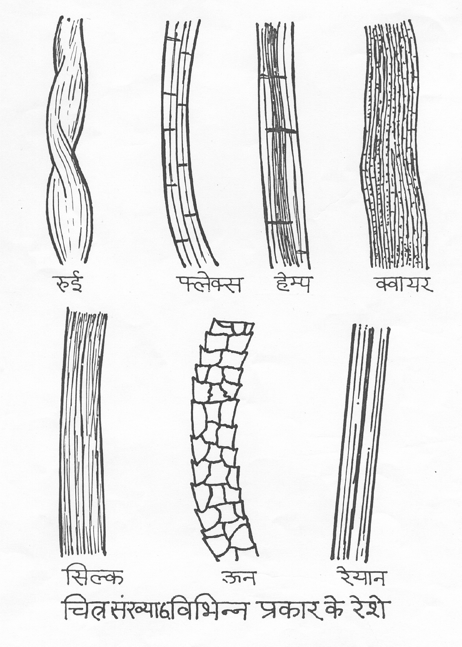

Slide 8
Birefringence
(regular arrangement of polymers produce crystallinity - double refraction)
The light passing through a synthetic fiber emerges polarized, perpendicular and parallel to the length of the fiber.
The value of the index of refraction is determined by observing the disappearance of Becke line under polarizing microscope
Refractive Index
Fiber parallel perpendicular Birefringence
Acetate 1.478 1.477 0.001
Triacetate 1.472 1.471 0.001
Acrylic 1.524 1.520 0.004
Nylon 1.568 1.515 0.053
Polyester 1.710 1.535 0.175
Modacrylic 1.536 1.531 0.005
Rayon 1.552 1.520 0.032

Slide 9
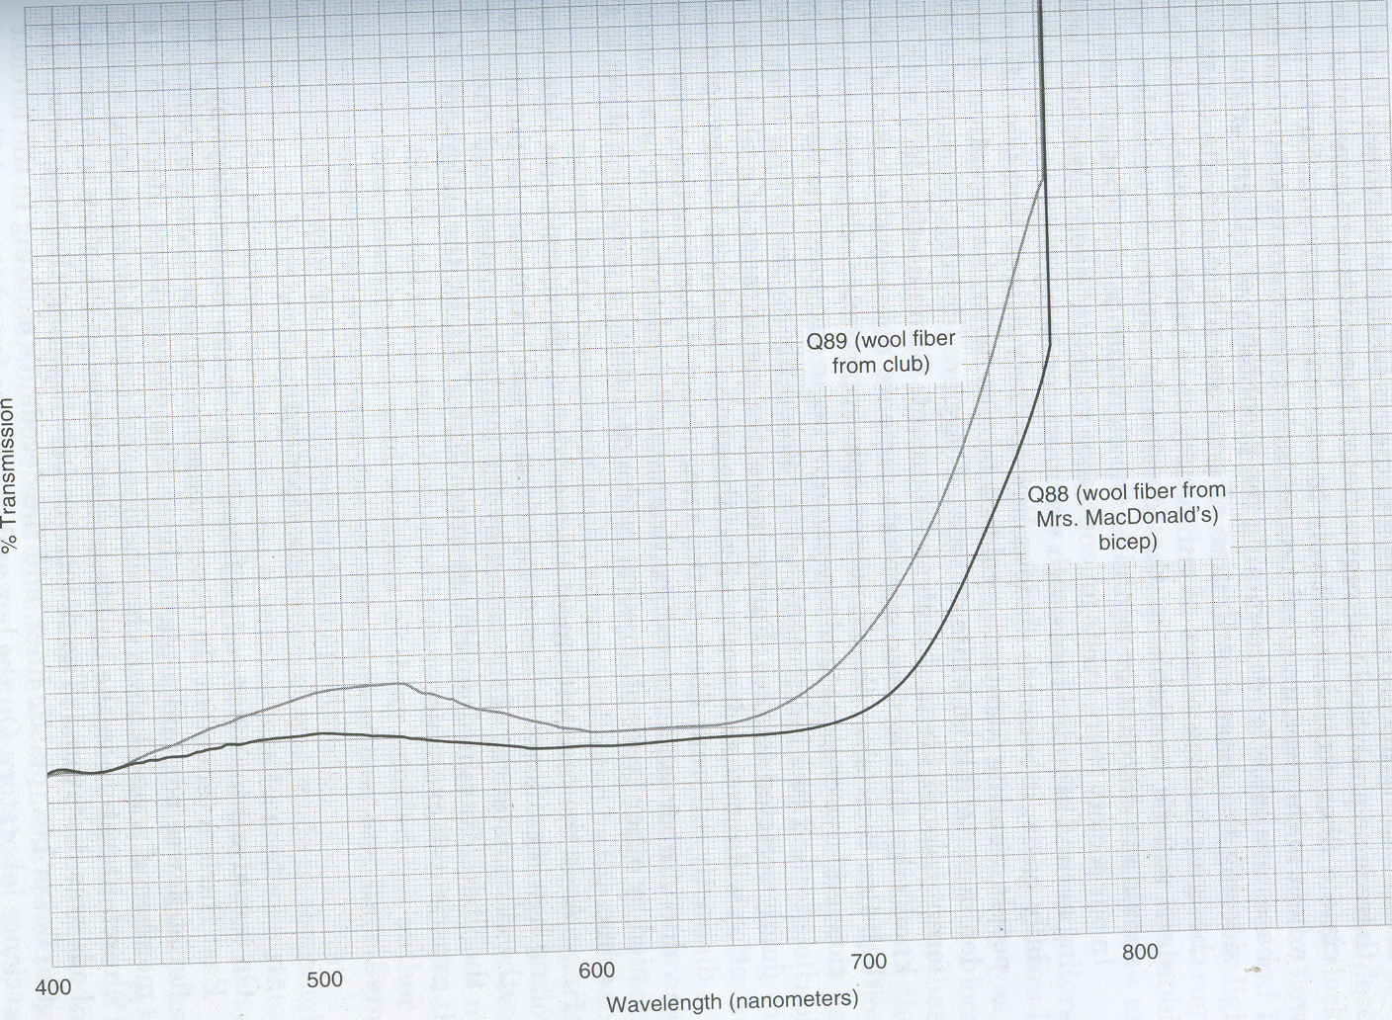
from the weapon
of offence
from the dead body
Visible spectrum of dyes from woolen fibers

Slide 10
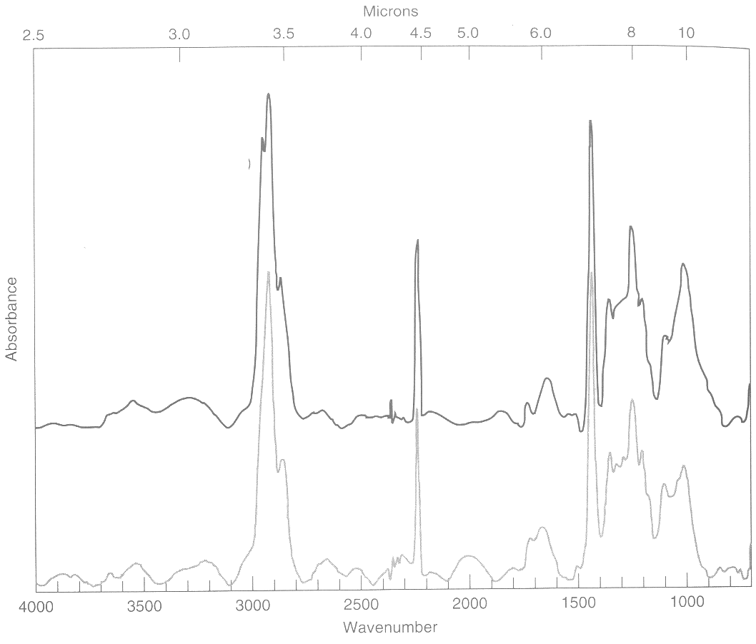
modacrylic fibers
Questioned fiber
Known fiber
Infrared spectrum of fibers

Slide 11
Examination of Seals
Physical Examination
- Shape, size, appearance, etc.
- Writings / design
Microscopic Examination
- Striations , fine markings, topography
Metallic seals
- Chemical composition of alloy
- Trace element profiling
Wax seals
- Softening temperature
- Fluorescence
- Differential thermal analysis
- Infrared spectrophotometry

Slide 12
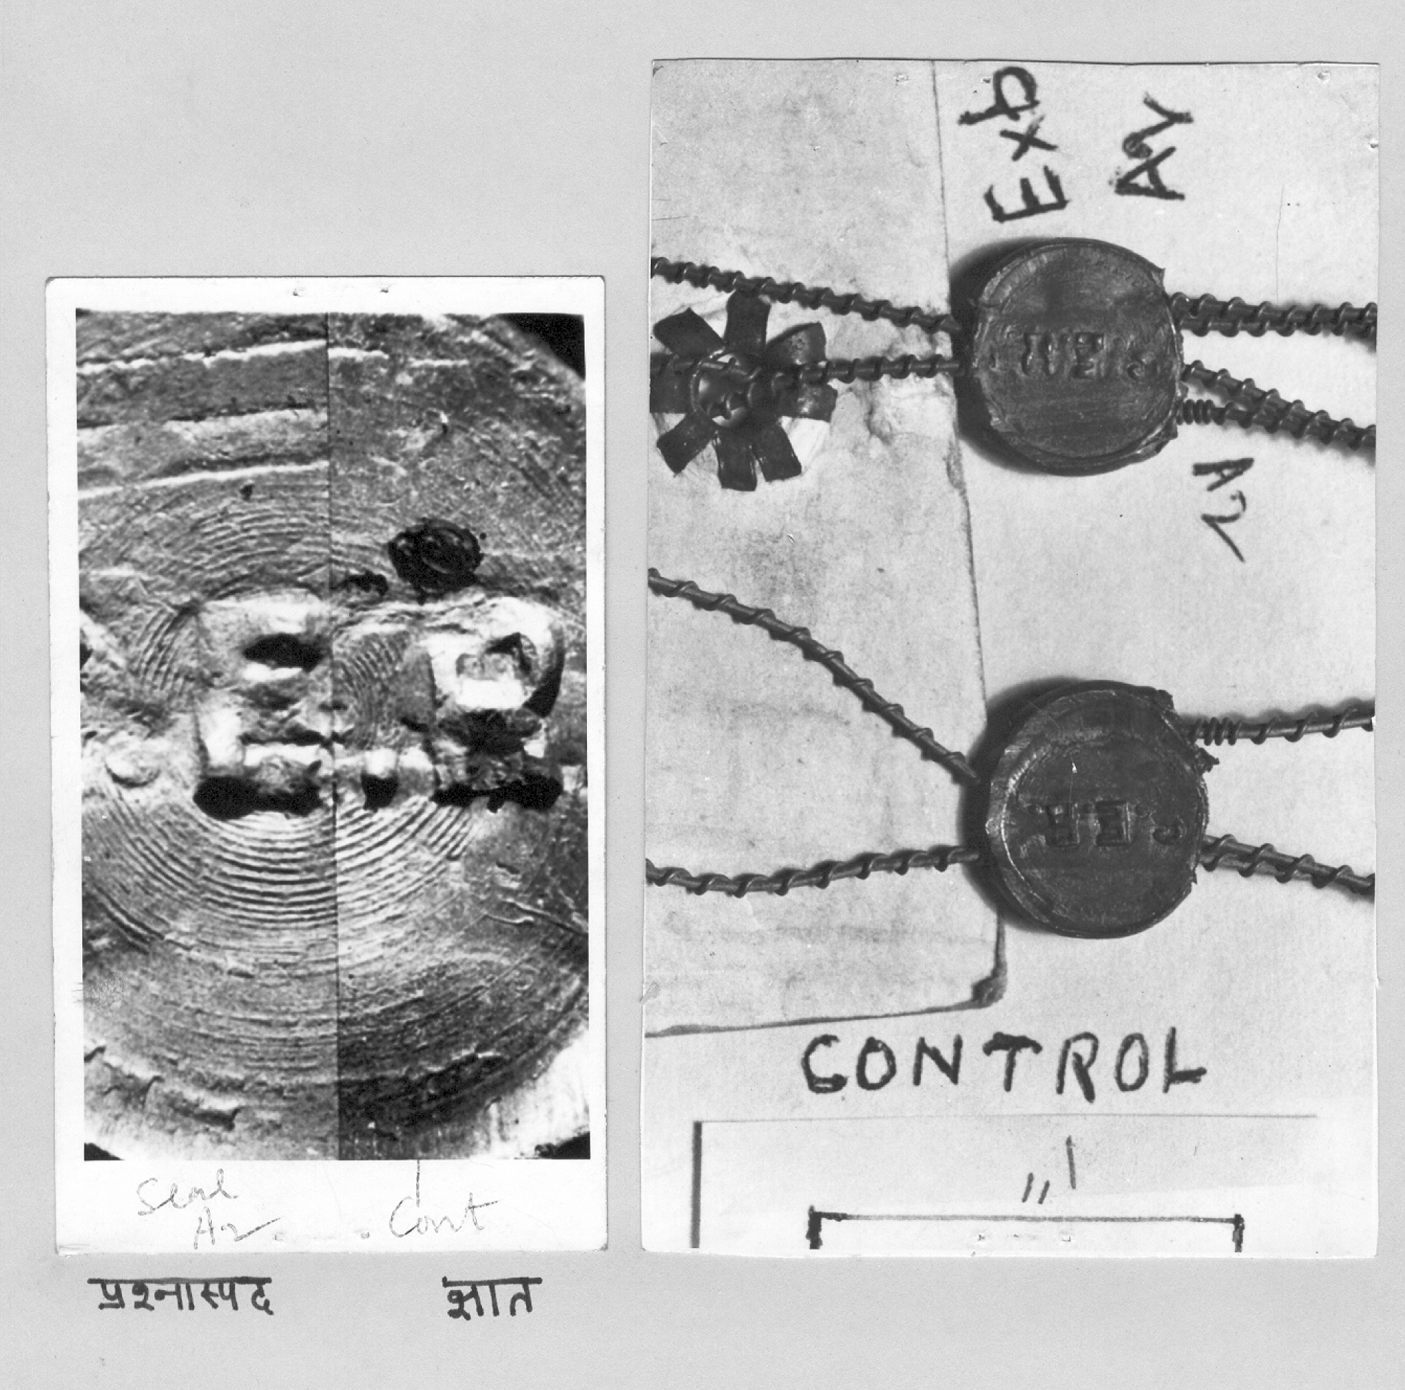
Questioned Known
Microscopic examination of metal seal
Physical examination of metal seal

Slide 13
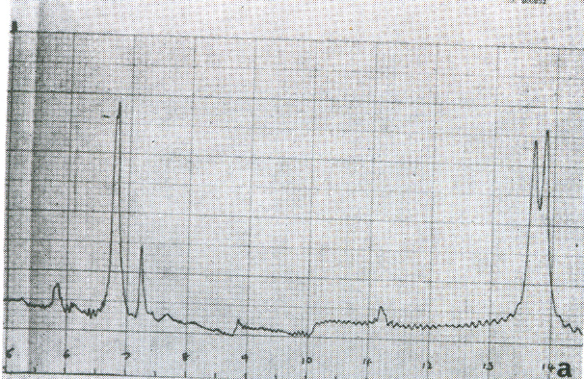
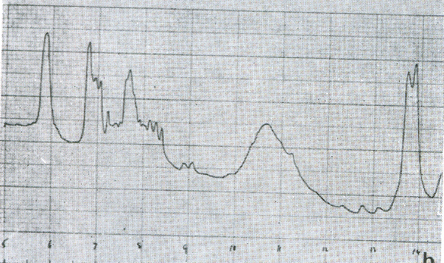
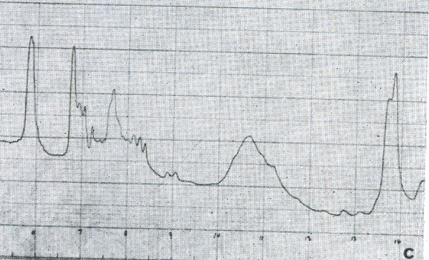
A
B
C
wax from
commercial candle
wax recovered from clothing of a suspect
Stearic acid
Inorganic filler
wax from the church candle

