Slide 1

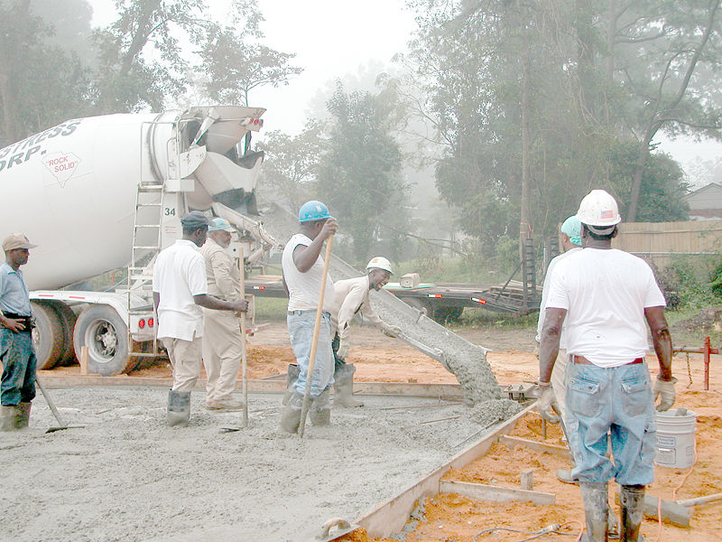
Concrete
A highway paved with concrete.
Pouring a concrete floor

Slide 2
Concrete
Concrete is a construction material that consists of cement (commonly Portland cement), aggregate (generally gravel and sand), water, and admixtures.
Concrete solidifies and hardens after mixing and placement due to a chemical process known as hydration.
The water reacts with the cement, which bonds the other components together, eventually creating a stone-like material.
It is used to make pavements, architectural structures, foundations, motorways/roads, overpasses, parking structures, brick/block walls and footings for gates, fences and poles etc.
Concrete is used more than any other manmade material on the planet.

Slide 3
Aggregates
Both fine and coarse aggregates are utilised to make up the bulk of the concrete mixture.
Sand, natural gravel and crushed stone are mainly used for this purpose. Recycled aggregates (from construction, demolition and excavation waste) may also be used as partial replacements of natural aggregates.
A number of manufactured aggregates, including air-cooled blast furnace slag and bottom ash are also permitted.
Decorative stones such as quartzite, small river stones or crushed glass are sometimes added to the surface of concrete for a decorative "exposed aggregate" finish, popular among landscape designers.

Slide 4
Chemical admixtures
Chemical admixtures are materials in the form of powder or fluids that are added to the concrete to give it certain characteristics not obtainable with plain concrete mixes.
In normal use, admixture dosages are less than 5% by mass of cement, and are added to the concrete at the time of batching/mixing.
The most common types of admixtures are:
Accelerators speed up the hydration (hardening) of the concrete.
Retarders slow the hydration of concrete
Air-entrainers add and distribute tiny air bubbles in the concrete, which will reduce damage during freeze-thaw cycles

Slide 5
Chemical admixtures (contd.)
Plasticizers (water-reducing admixtures) increase the workability of "fresh" concrete
Pigments can be used to change the color of concrete, for aesthetics.
Corrosion inhibitors are used to minimize the corrosion of steel and steel bars in concrete.
Bonding agents are used to create a bond between old and new concrete.
Pumping aids improve pumpability, thicken the paste, and reduce dewatering of the paste.

Slide 6
Chemical admixtures (contd.)
Mineral admixtures and blended cements
There are inorganic materials that also have pozzolanic or latent hydraulic properties. These very fine-grained materials are added to the concrete mix to improve the properties of concrete, or as a replacement for Portland cement (blended cements).
Fly ash: A by product of coal fired electric generating plants,
Ground granulated blast furnace slag (GGBFS or GGBS): A by product of steel production,
Silica fume: A byproduct of the production of silicon and ferrosilicon alloys. Silica fume is similar to fly ash, but has a particle size 100 times smaller.
High Reactivity Metakaolin (HRM): Metakaolin produces concrete with strength and durability similar to concrete made with silica fume.

Slide 7
Examination of concrete
To find out the cement content in concrete (mixture of cement, sand, and aggregate) i.e. the ratio of cement, sand, and aggregate in concrete.
Sample preparation
Collect about 1 Kg sample of concrete used, from several separate portions.
Break down these portions to 2-3 inch (50-75)mm) size pieces with hammer and dry about 500 g of composite sample at 105ºC to a constant weight.
Place the fragment in small stainless steel open top boxes and heat the boxes containing the sample in a furnace at 550ºC
for 3 hours.

Slide 8
Examination of concrete; Sample preparation (contd.)
After heat treatment (which destroys the strength of the concrete); combine and weigh the sample.
The weight of the material at this point is considered as the weight of the sample and represents the weight of the cement, and aggregates (Wi).
Work the dehydrated sample by hand over a No.6 (3.35mm) sieve with a pan below, being careful not to loose any sample.
Individually, hand clean all aggregates larger than the No.6 sieve size by removing any adhering particles of cement and fine aggregates with a spatula or knife.
Brush the aggregates on the sieve such that no material is lost.

Slide 9
Examination of concrete; Sample preparation (contd.)
Weigh the total fraction retained on the No.6 sieve and place in a beaker.
Wash with HCl (1:9) (which dissolves any cement that might be adhering) followed by several water wash, and carefully decant after each wash.
Dry the washed aggregate in the beaker on a hot plate.
Reweigh and find out the difference in weight (W_{L}) which is considered as a part of cement content of the concrete.
If the aggregate is relatively insoluble in the acid, the wash should be continued until no gas is observed from the solution.
If the aggregate is relatively soluble in the acid, the acid wash is terminated quickly as soon as the aggregate is observed to be clean.

Slide 10
Examination of concrete; Sample preparation (contd.)
Weigh the material passing the No.6 (W_{f}). Take a sample of approximately 100 g and pulverise to pass a No. 200
(75 micron size) sieve.
Take 2 g of sample and determine the SiO₂ or CaO (S_{f}) using the procedure as described earlier in the case of cement analysis.
Collect remainder of material passing No.6 sieve which was not used to prepare the fine aggregate cement sample.
Screen a small portion over No.50 (300 micron) sieve.
Wash the retained material thoroughly in HCl (1:9) and dry it in order to obtain a sample of fine aggregate which was used in the concrete mixture.

Slide 11
Examination of concrete; Sample preparation (contd.)
Care must be taken to be sure that the pieces of aggregate are completely free of particles of cement that tend to adhere.
pulverise the material to pass No. 200 (75 μm size) sieve.
Collect 2 g of sample and determine the SiO₂ or CaO (S_{a}) using the procedure as described in the case of cement analysis
Calculations:
Total weight of the exhibit (building material) = W_{i}
On the mechanical separation through sieve No.6 ASTM
Weight of the fine aggregate (mortar) = W_{f}
Weight of the coarse aggregate (grit) = W_{c}

Slide 12
Examination of concrete; Calculations (contd.)
Percentage of soluble constituent (SiO₂ /CaO)
present in the fraction passing the No.6 sieve
(fine aggregate) = S_{f}
Decimal fraction of cement present in the fraction
passing the No.6 sieve (fine aggregate) = C_{f}
Percentage of soluble constituent (SiO₂ /CaO)
in cement which is used in concrete = S_{c}
Percentage of soluble constituent (SiO₂ /CaO)
present in aggregate in the fraction passing the = S_{a}
No.6 sieve

Slide 13
Examination of concrete; Calculations (contd.)
If the cement used for the concrete is not available i.e. soluble constituents of cement are unknown, SiO₂ may be assumed to be 21.0% and CaO may be assumed to be 63.5%.
Whenever it is possible, the known values should be used in calculation
Using the following equations:
S_{f} = (C_{f}.S_{c} )+ (A_{f}. S_{a})
since C_{f} + A_{f} = 1 we have,
C_{f} = (S_{f}-S_{a})/(S_{c}-S_{a})
where, A_{f} = decimal fraction of aggregate present
in the fraction passing the no. 6 sieve.

Slide 14
Examination of concrete; Calculations (contd.)
Percentage of cement weight in the sample of dehydrated concrete Ct is given as
C_{t} = [(C_{f}W_{f} + W_{L})*100]/W_{i}
Where: W_{L} is the difference in weight of aggregate after washing with HCl (1:9) Similarly, percentage of sand weight in the sample of dehydrated concrete St is given as:
S_{t} = [(1-C_{f}) W_{f}*100]/W_{i}
And, percentage of coarse aggregate present in the sample (building material) is given as:
A_{t} = [W_{c}/W_{i}]*100
Thus, the ratio of cement, sand, and stone in the sample of concrete (building material) by weight is given as:
C_{t} : S _{t}: A_{t}
The ratio of cement, sand and stone in the sample of concrete (building material) by volume:
= C_{t}. α : S_{t}. β: A_{t} γ
α, β and γ are correction factors and they can be calculated as mentioned earlier in the case of mortar analysis

