Slide 1
Counterfeit Coins
Counterfeit : A person is said to “counterfeit”
who causes one thing to resemble another thing, intending by means of that resemblance to practice deception, or knowing it to be likely that deception will thereby be practiced (Indian Penal Code chapter II, section 28)
Coin : Coin is metal used for the time being as money, and stamped and issued by the authority of some state or sovereign power in order to be so used (Indian Penal Code chapter XII, section 230)
Sections 230 to 254 in the chapter XII of the Indian Penal Code are about the offences relating to coin, counterfeiting, possession, instruments , or material, etc.
ranbsingh

Slide 2
Genuine Coins
Govt. Mints: Bombay, Hyderabad, Kolkata, Noida
Metal and alloys: prescribed from time to time
Magnesium-aluminum alloy, Stainless steel, Cupro-nickel, etc.
Minting Genuine Coin
Metal weighed, melted and made into
rectangular bars
Bars are rolled into sheets of requisite gauge
Coin blanks are punched out
Coin blanks of correct weight selected
ranbsingh

Slide 3
Minting Genuine Coin (contd.)
Blanks are annealed
Washed in dilute sulphuric acid
Fed to minting machine to stamp them
For milled edges, pressed between two dies
with milled collar
Security groove, dots and milling on either side,
are made before minting
After minting, all the coins are examined, defective
coins are removed
Dispatched to RBI for issue to treasuries
ranbsingh

Slide 4
Counterfeit Coins
Cast process,
or
Struck process
Cast Counterfeit Process
Moulds: powder moulds or metal moulds
Powder moulds
Fine powder of any material like: brick, glass, porcelain, clay,
cement, plaster of Paris made into paste using honey, jaggery,
oil, ghee, coal-tar, resin, gum, juice of plants, white of an egg, etc.
Collar is made of metal, wood, or clay in two segments
Paste is pressed in the segments
ranbsingh

Slide 5
Cast Counterfeit Process (Contd.)
Genuine coin, smeared with oil, is placed on the paste in one of
the segments and pressed into it
A tissue paper of the size of the coin with hole in the center is
placed over it (so that the two halves of the mould do not fuse
together, when baked)
The second segment of the collar (similarly filled) is fixed over
the first with guide pins
The whole mould is then baked in an oven to harden it
After it is cooled the two halves are separated and the coin and
paper are removed
A small passage (gate) is made within two halves to allow the
molten metallic alloy to run into the mould
ranbsingh

Slide 6
Cast Counterfeit Process (Contd.)
The two segments are clamped together
Molten alloy is poured through the gate
When the alloy cools and solidifies, the counterfeit
coin is removed by separating the two halves
Metal Moulds
The impression of the coin is engraved on two
metal plates (one for each side)
The two halves are fixed together in a collar with
a hole at the top of on side
Multiple metal moulds : to make a large number of coins at a time
Moulds containing impressions of several coins with
common channel for pouring metal, are made
ranbsingh

Slide 7
Finishing the products
Coins are fixed in a vice
Superfluous metal projections at the rim of the coin
are cut and filed
Edge is milled by file or special milling machine
Detection of cast counterfeit coins
Questioned coins are compared with one or more similar
genuine coins of the same denomination
Thickness: not uniform, thicker at one side, often slightly
bent, lie unevenly between two other coins
Color: brassy or leaded appearance, Counterfeit Nickel coins often have yellowish appearance
ranbsingh

Slide 8
Weight: differs from that of genuine coins, often lighter
Sound: do not, generally, ring well
Milling: at the spot of ‘gate’ serrations are non existent: serrations are made by hand obliquely or irregular interval using saw or file: security grooves – metal ring is inserted
Pit marks: pit marks or pin holes on the surface of the coin ( because of the coarse grains of the powder used for mould )
Letters
and Figures: rounded appearance instead of having sharp edges
Beading: minute beads of metal around letters and numbers due to defects in the mould caused at the time two halves are taken apart to extract the genuine coin
ranbsingh

Slide 9
Composition: do not conform to that of genuine coin
Finish: the finish is crude
Struck Counterfeit Coins
Metal dies
made in a press or with several heavy blows
with a hammer
A pair of steel (or other hard metal) dies are made
A iron collar is made to hold both halves of the
dies in position
Coin blanks are cut from plates of metal alloy
ranbsingh

Slide 10
Blanks are placed between the two dies
Pressed or hammered to cause the impression
Milled edges are made later with milling machine
Struck coins are better than cast coins
Detection of struck counterfeit coins
Weight: does not conform to that of the genuine coin
Ringing
Sound: do not ring well
ranbsingh

Slide 11
Design: lettering are sometimes irregularly spaced and not symmetrical; the enclosed spaces of letters and figures are sometimes filled with metal
Milling: Invariably defective, oblique millings, spaces between groves are often irregular and broken (compared by keeping the suspected coin between two similar genuine coins of the same denomination)
Table of
the coin: may not be smooth and even; die impression may be uneven or doubly impressed
Thickness: uneven, coin may be slightly bent or distorted
ranbsingh

Slide 12
Composition: do not conform to that of genuine coin
Finish: generally satisfactory
Search for evidences
Counterfeit coins,
Metal, and metal sheets,
Moulds, broken moulds,
Pieces of metals used for making moulds
Powders, adhesive material,
Tools (files, pincers, vices, anvils, chisels, etc.) etcetera
ranbsingh

Slide 13
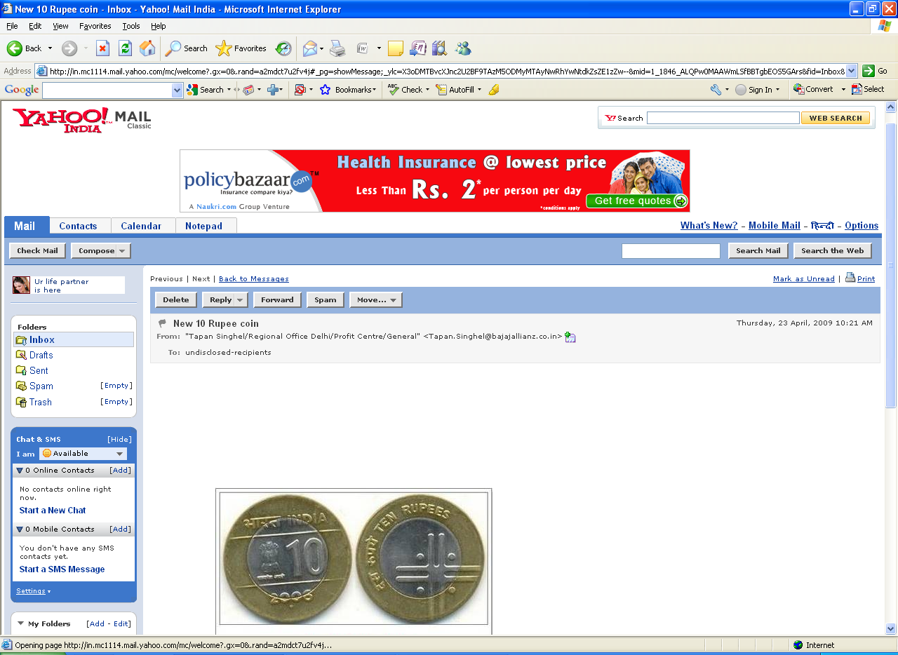
New 10 Rupee coin
a new bimetallic 10 Rupee coin for circulation
The look
The obverse side has the lion capitol with numeral 10 and year of manufacture.
On reverse side, a double line cross with a dot in each pellet of cross and denomination written in Hindi and English around.
The outer side metal is Nickel-Bronze and the inner side metal is Ferrous Steel.
The weight of the coin would be 8 grams and the diameter would be 28 mm.

Slide 14
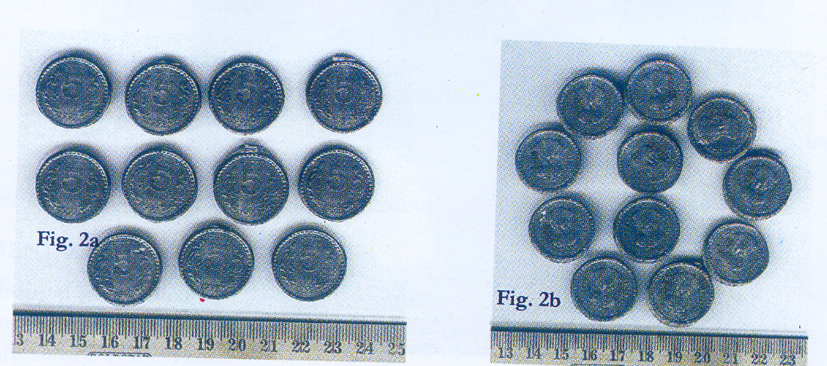
A Case Study – Forensic Science Laboratory, Tripura
J Indian Academy Forensic Science 2007; 41(2) 34-39
head and tail views of seized counterfeit coins

Slide 15
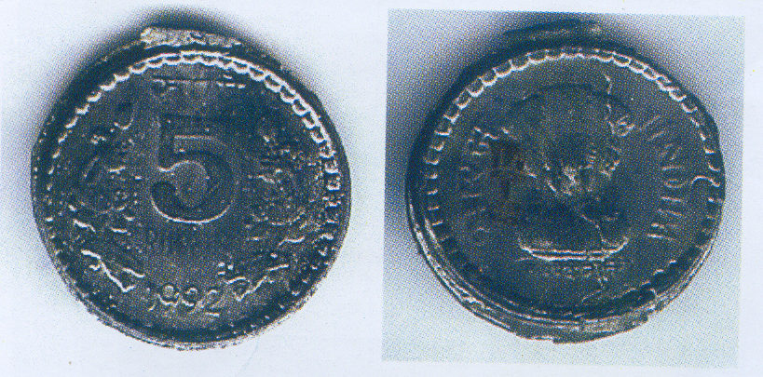
J Indian Academy Forensic Science 2007; 41(2) 34-39
Close up photograph of a counterfeit coin

Slide 16
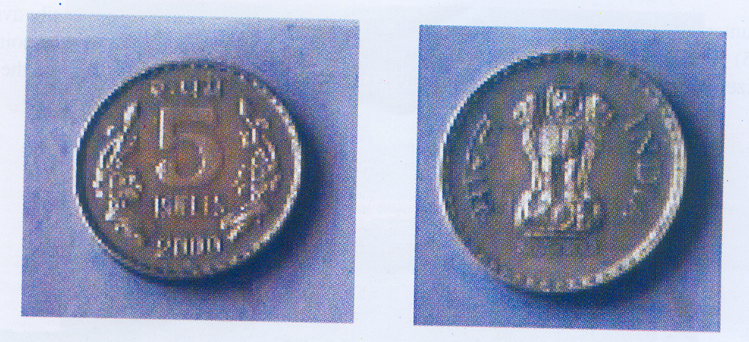
J Indian Academy Forensic Science 2007; 41(2) 34-39
Close up photograph of a genuine coin

Slide 17
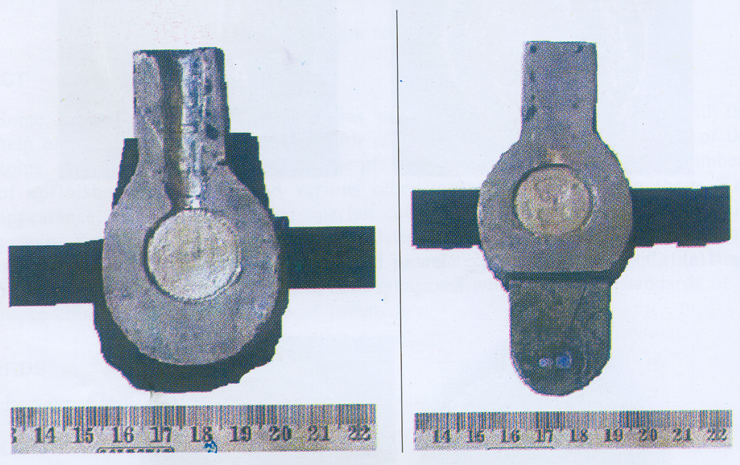
J Indian Academy Forensic Science 2007; 41(2) 34-39
Dies used for making counterfeit coins

Slide 18
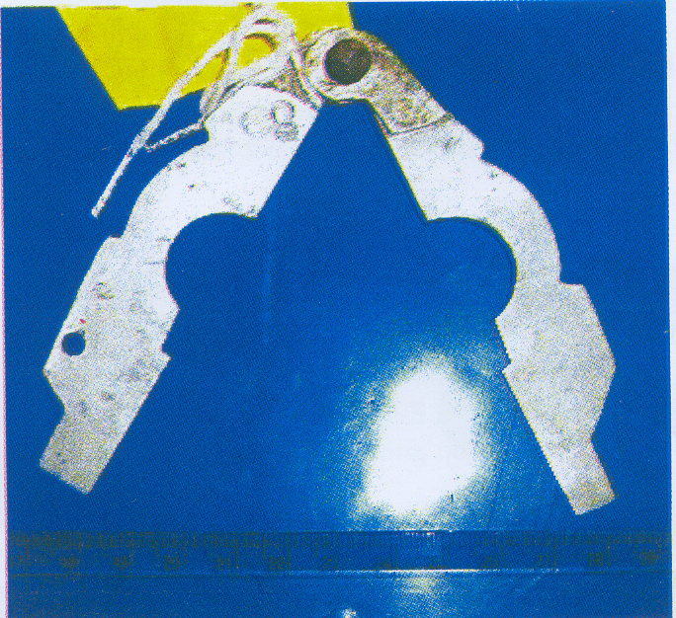
J Indian Academy Forensic Science 2007; 41(2) 34-39
Cutter used for shaping edges of counterfeit coins

Slide 19
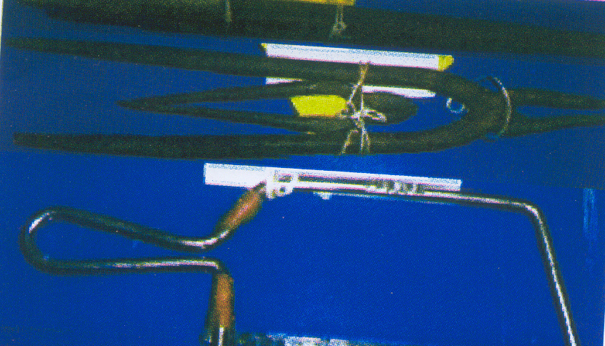
J Indian Academy Forensic Science 2007; 41(2) 34-39
Tools for counterfeiting coins

Slide 20
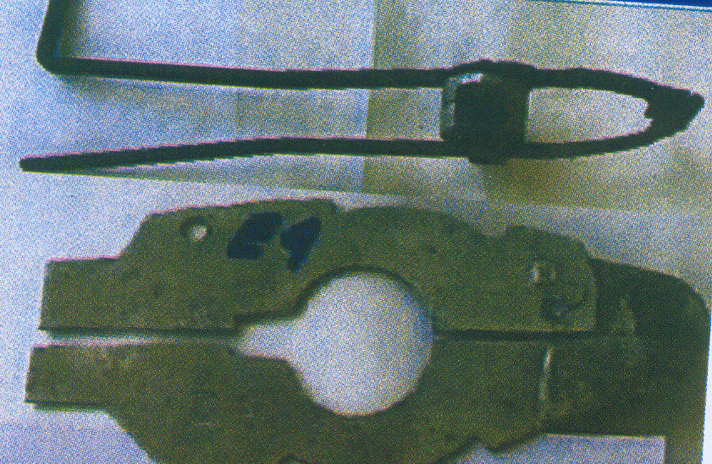
J Indian Academy Forensic Science 2007; 41(2) 34-39
Tools for counterfeiting coins

Slide 21
Comparison of
genuine and questioned coins
Parameter standard (RBI) questioned coins
Weight 9.00 gm average 10.78 gm
range 9.67 gm – 11.51 gm
Diameter 23 mm some of the coins were not in proper shape, their maximum diameter varied between 24.66 to 26.06 mm
range of minimum diameter
22.99mm – 23.97 mm
average minimum diameter
23.57 mm

Slide 22
Comparison of
genuine and questioned coins (Contd.)
Parameter standard questioned coins
Edge thickness 2.75 mm average 2.91 mm
range 2.61 – 3.05 mm
Shape circular distorted milled edges
Elemental Cu 75 % Pb 61.72 %
Composition Ni 25 % Sb 30.07 %

