Slide 1
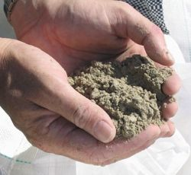
Cement

Slide 2
Cement
- a binder, a substance which sets and hardens independently, and can bind other materials together
The name "cement" goes back to the Romans who used the term "opus caementitium" to describe masonry which resembled concrete and was made from crushed rock with burnt lime as binder
The volcanic ash and pulverized brick additives which were added to the burnt lime to obtain a hydraulic binder were later referred to as
cementum, cimentum, cäment and cement

Slide 3
Cements used in construction are characterized as
hydraulic
non-hydraulic
Hydraulic cements
are materials which set and harden after combining with water, as a result of chemical reactions with the mixing water and, after hardening, retain strength and stability even under water.
The key requirement for this is that the hydrates formed on immediate reaction with water are essentially insoluble in water

Slide 4
Non-hydraulic cements
include such materials as (non-hydraulic) lime and gypsum plasters, which must be kept dry in order to gain strength, and oxychloride cements which have liquid components.
Lime mortars, for example, "set" only by drying out, and gain strength only very slowly by absorption of carbon dioxide from the atmosphere to re-form calcium carbonate.
The earliest construction cements are as old as construction and were non-hydraulic. Wherever primitive mud bricks were used, they were bedded together with a thin layer of clay slurry.
Mud-based materials were also used for rendering on the walls. Lime was probably used for the first time as an additive in these renders, and for stabilizing mud floors. A "daub" consisting of mud, cow dung and lime produces a tough and water-proof coating, due to coagulation, by the lime, of proteins in the cow dung.

Slide 5
Pozzolana
Pozzolana, also known as pozzolanic ash, is a fine, sandy volcanic ash, originally discovered and dug in Italy at Pozzuoli.
It is found in all the volcanic areas of Italy in various colours: black, white, grey and red.
Pozzolana is a siliceous and aluminous material which reacts with calcium hydroxide in the presence of water to form compounds possessing cementitious properties at room temperature.
Finely ground and mixed with lime it creates a hydraulic cement and can be used to make a strong mortar that will also set under water.
It transformed the possibilities for making concrete structures. Typically it was mixed two-to-one with lime just prior to mixing with water.
ranbsingh

Slide 6
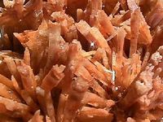
Gypsum is a very soft mineral composed of calcium sulfate dihydrate, with the chemical formula CaSO₄·2H₂O
Plaster of Paris, or simply plaster, is a type of building material based on calcium sulfate hemihydrate. It is created by heating gypsum to about 150 °C.
2CaSO₄ · 4H₂O → 2CaSO₄ · H₂O + 3H₂O (released as steam)
A large gypsum deposit at Montmartre in Paris is the source of the name.
When the dry plaster powder is mixed with water, it re-forms into gypsum. Unlike mortar and cement, plaster remains quite soft after drying, and can be easily manipulated with metal tools or even sandpaper.
These characteristics make plaster suitable for a finishing, rather than a load-bearing material.
ranbsingh

Slide 7
Fly ash
Fly ash is the finely divided mineral residue resulting from the combustion of coal in electric generating plants.
Fly ash consists of inorganic, incombustible matter present in the coal that has been fused during combustion into a glassy, amorphous structure.
Fly ash material solidifies while suspended in the exhaust gases and hence, the fly ash particles are generally spherical in shape and range in size from 0.5 µm to 100 µm.
They consist mostly of silicon dioxide (SiO₂), aluminium oxide (Al₂O₃) and iron oxide (Fe₂O₃).
They are also pozzolanic in nature and react with calcium hydroxide and alkali to form calcium silicate hydrates (cementitious compounds).
ranbsingh

Slide 8
There aretwo classes of fly ash ;Class F fly ash and Class C fly ash. The chief difference between these classes is the amount of calcium, silica, alumina, and iron content in the ash.
Class F fly ash
The burning of harder, older anthracite and bituminous coal typically produces Class F fly ash.
This fly ash is pozzolanic in nature, and contains less than 10% lime (CaO).
Possessing pozzolanic properties, the glassy silica and alumina of Class F fly ash requires a cementing agent, such as Portland cement, quicklime, or hydrated lime, with the presence of water in order to react and produce cementitious compounds.
ranbsingh

Slide 9
Class C fly ash
Fly ash produced from the burning of younger lignite or subbituminous coal.
In addition to having pozzolanic properties, also has some self-cementing properties.
In the presence of water, Class C fly ash will harden and gain strength over time.
Class C fly ash generally contains more than 20% lime (CaO).
Unlike Class F, self-cementing Class C fly ash does not require an activator.
Alkali and sulfate (SO₄) contents are generally higher in Class C fly ashes.
ranbsingh

Slide 10
Fly ash - Chemical composition and classification
Component | Bituminous | Sub-bituminous |  |  |  | Lignite
SiO₂ (%) | 20-60 |  | 40-60 | 15-45
Al₂O₃ (%) | 5-35 |  | 20-30 |  | 20-25
Fe₂O₃ (%) | 10-40 |  | 4-10 |  | 4-15
CaO (%) | 1-12 |  | 5-30 |  | 15-40
LOI (%) | 0-15 |  | 0-3 | 0-5
ranbsingh

Slide 11
Cement chemist notation
Cement chemist notation (CCN) was developed to simplify the formulas which cement chemists use on a daily basis. It is a sort of "short hand" way of writing the chemical formula of oxides of calcium, silicon, and various metals. Below is a list of all of the abbreviations used:
CCN
Actual Formula
CCN
Actual Formula
C
CaO
M
MgO
S
SiO₂
K
K₂O
A
Al₂O₃
N
Na₂O
F
Fe₂O₃
H
H₂O
T
TiO₂
CO₂
SO₃
ranbsingh

Slide 12
The oxides are used to build complex molecules such as
C₃S
3 CaO • SiO₂
Tricalcium silicate
C₂S
2 CaO • SiO₂
Dicalcium silicate
C₃A
3 CaO • Al₂O₃
Tricalcium aluminate
C₄AF
4 CaO • Al₂O₃•Fe₂O₃
Tetracalcium alumino ferrite
ranbsingh

Slide 13
Hydration products are more complicated
many of the products have nearly the same formula
some are solid-solutions with overlapping formula
Some examples are below:
CSH
2(CaO) • SiO₂ • 0.9-1.25(H₂O) and/or
CaO • SiO₂ • 1.1(H₂O) and/or
0.8-1.5(CaO) • SiO₂ • 1.0-2.5(H₂O) and more!
CAH
This is even more complex than CSH
AFt
₃H₃₀₋₃₂
C₃A
AFm
H₁₂
C₂A
ranbsingh

Slide 14
Modern hydraulic cements
It is uncertain where it was first discovered that a combination of hydrated non-hydraulic lime and a pozzolan produces a hydraulic mixture, but concrete made from such mixtures was first used on a large scale by the Romans
Modern hydraulic cements began to be developed from the start of the Industrial Revolution (around 1700), when good quality building stone became ever more expensive, and it became a common practice to construct prestige buildings from the new industrial bricks, and to finish them with a stucco to imitate stone
Hydraulic limes were favored for this, but the need for a fast set time encouraged the development of new cements.

Slide 15
‘New Cement’ was developed by James Parker in the 1780s, and finally patented in 1796.
It was, in fact, nothing like any material used by the Romans, but was a "Natural cement" made by burning septaria - nodules that are found in certain clay deposits, and that contain both clay minerals and calcium carbonate.
Louis Vicat went on to devise a method of combining chalk and clay into an intimate mixture, and, burning this, produced an "artificial cement" in 1817
In 1824, Joseph Aspdin patented a similar material, which he called Portland cement, because the render made from it was in color similar to the prestigious Portland stone.

Slide 16
Setting and hardening
When water is mixed with Portland cement, the product sets in a few hours and hardens over a period of weeks.
In principle, the strength continues to rise slowly as long as water is available for continued hydration, but concrete is usually allowed to dry out after a few weeks, and this causes strength growth to stop.
Setting and hardening of Portland cement is caused by the formation of water-containing compounds, forming as a result of reactions between cement components and water. The reaction and the reaction products are referred to as hydration and hydrates or hydrate phases, respectively.
Stiffening, setting and hardening are caused by the formation of a microstructure of hydration products of varying rigidity which fills the water-filled interstitial spaces between the solid particles of the cement paste, mortar or concrete.

Slide 17
During the hydration of Portland cement clinker minerals react with water, yielding a complex microstructure consisting mainly of
amorphous calcium silicate hydrate gel
(approx. 1.7CaO.SiO₂.1.5H₂O;
C-S-H in cement chemistry notation),
ettringite (3CaO.Al₂O₃.3CaSO₄.32H₂O),
portlandite (Ca(OH)₂),
carbonated phases, and calcite (CaCO₃).
When limestone is present in Portland cement, the rate and degree of hydration change, as does the composition of the hydrated cement paste.

Slide 18
There are three fundamental stages in
the production of Portland cement
Preparation of the raw mixture
Production of the clinker
Preparation of the cement

Slide 19
Rawmix Preparation
The raw materials for Portland cement production are a mixture of minerals containing calcium oxide, silicon oxide, aluminium oxide, ferric oxide, and magnesium oxide
If the local rocks do not have the desired composition, it may require the addition of clay and limestone, as well as iron ore, bauxite or recycled materials
The raw materials are ground together in a rawmill
- fineness of rawmix is usually controlled so that there are less than 5-15% by mass of particles exceeding 90 μm in diameter

Slide 20
Rawmix blending
A blending system homogenizes the rawmix
The rawmix is formulated to a very tight chemical specification.
Typically, the content of individual components in the rawmix must be controlled within 0.1% or better
Calcium and silicon are present in order to form the strength-producing calcium silicates.
Insufficient aluminium and iron lead to difficult burning of the clinker
In practice, the rawmix is controlled by frequent chemical analysis (hourly by X-Ray fluorescence analysis, or every 3 minutes by prompt gamma
neutron activation analysis)

Slide 21
Formation of clinker
The raw mixture is heated in a cement kiln
- a slowly rotating and sloped cylinder, with temperatures increasing over the length of the cylinder up to a peak temperature of 1400-1450 °C
A complex succession of chemical reactions take place as the temperature rises. The peak temperature is regulated so that the product contains sintered but not fused lumps
Sintering consists of the melting of 25-30% of the mass of the material. The resulting liquid draws the remaining solid particles together by surface tension, and acts as a solvent for the final chemical reactions
The resulting material is clinker.
Some effort is usually made to blend the clinker
(the kiln process may introduce new sources of
chemical variability)

Slide 22
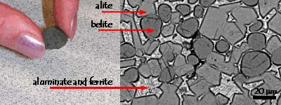
Clinker nodule and image of the main clinker
Phases:
alite, belite, aluminate and ferrite
Portland
Cement Clinker
Portland cement clinker consists of four phases
Alite, Ca₃SiO₅ Belite, Ca₂SiO₄
Aluminate, Ca₃Al₂O₆ Ferrite,Ca₂(Al_{x}Fe_{1-x})₂O₅

Slide 23
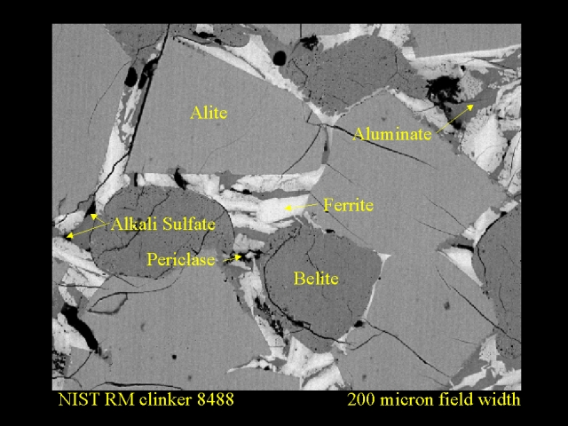

Slide 24
The four clinker phases react in different ways when
the cement is mixed with water.
Aluminate and ferrite reacts fast but gives little strength development.
Alite and belite reacts slower but gives high strength.
By combining the raw materials carefully it is possible to get different amounts of the four phases and thereby design cement with special properties for different types of constructions.
In general, Ordinary Portland cement (OPC)
consists of approximately
67 wt% alite, 15 wt% belite,
9 wt% aluminate and 9 wt% ferrite.

Slide 25
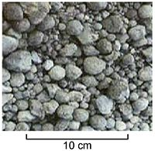
clinker
Cement Grinding
In order to achieve the desired setting qualities in the finished product, a quantity
(2-8%, but typically 5%) of calcium sulfate (usually gypsum or anhydrite) is added to the clinker and the mixture is finely ground, to form the finished cement powder
The grinding process is controlled to obtain a powder with a broad particle size range, in which typically 15%
by mass consists of particles below 5 μm diameter, and
5% of particles above 45 μm
The measure of fineness usually used is the "specific surface", which is the total particle surface area of a unit mass of cement.
Typical values of "specific surface" are 320-380 m².kg-1 for general purpose cements, and 450-650 m².kg-1 for "rapid hardening" cements

Slide 26
Typical constituents of Portland clinker
and Portland cement
Cement industry style notation in italics
Clinker
Mass%
Cement
Mass%
Tricalcium silicate (CaO)₃.SiO₂, C₃S
45-75%
Calcium oxide, CaO, C
61-67%
Dicalcium silicate (CaO)₂.SiO₂, C₂S
7-32%
Silicon oxide, SiO₂, S
19-23%
Tricalcium aluminate (CaO)₃.Al₂O₃, C₃A
0-13%
Aluminium oxide, Al₂O₃, A
2.5-6%
Tetracalcium aluminoferrite (CaO)₄.Al₂O₃.Fe₂O₃, C₄AF
0-18%
Ferric oxide, Fe₂O₃, F
0-6%
Gypsum CaSO₄
2-10%
Sulfate

Slide 27
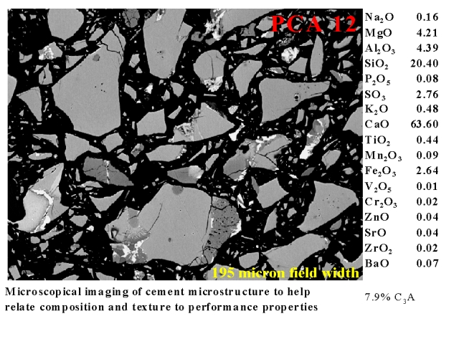

Slide 28
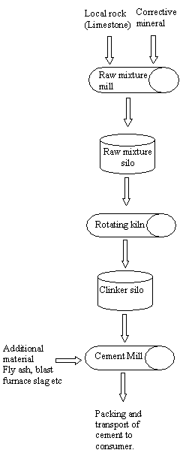
Schematic explanation of
Portland cement production

Slide 29
Types of modern cement
Portland cement
Portland cement is the most common type of cement in general usage Portland cement may be gray or white.
There are different standards for classification of Portland cement, which may vary from country to country.
As defined by the European Standard EN197.1, "Portland cement clinker is a hydraulic material which shall consist of at least two-thirds by mass of calcium silicates (3CaO.SiO₂ and 2CaO.SiO₂), the remainder consisting of aluminium- and iron-containing clinker phases and other compounds. The ratio of CaO to SiO₂ shall not be less than 2.0. The magnesium content (MgO) shall not exceed 5.0% by mass."

Slide 30
Composition of cement
2CaO Si0₂
Dicalsium silicate, (C₂S)
and 80%
3CaO Si0₂
Tricalsium silicate (C₃S)
3CaO Al₂O₃ 15%
Tricalsium aluminate (C₃A)
4CaO Al₂0₃ Fe₂0₃ (C₄AF) 5%
Tetra calsium alumino ferrite
The following compounds are also present in free state
MgO, K₂O, Na₂O, CaO (0.3 to 1.3%)

Slide 31
Portland cement blends
These are often available as inter-ground mixtures from cement manufacturers, but similar formulations are often also mixed from the ground components at the concrete mixing plant.
Portland Blastfurnace Cement
Contains up to 70% ground granulated blast furnace slag, with the rest Portland clinker and a little gypsum.
All compositions produce high ultimate strength, but as slag content is increased, early strength is reduced, while sulfate resistance increases and heat evolution diminishes.
Used as an economic alternative to Portland sulfate-resisting and low-heat cements.

Slide 32
Portland cement blends (contd)
Portland Flyash Cement
Contains up to 30% fly ash.
The flyash is pozzolanic, so that ultimate strength is maintained.
Because flyash addition allows a lower concrete water content, early strength can also be maintained.
Where good quality cheap flyash is available, this can be an economic alternative to ordinary Portland cement.

Slide 33
Portland cement blends (contd)
Portland Pozzolan Cement
Includes fly ash cement, since fly ash is a pozzolan, but also includes cements made from other natural or artificial pozzolans.
In countries where volcanic ashes are available (e.g. Italy, Chile, Mexico, the Philippines) these cements are often the most common form in use.
Portland Silica Fume cement.
Addition of silica fume can yield exceptionally high strengths, and cements containing 5-20% silica fume are occasionally produced.
However, silica fume is more usually added to Portland cement at the concrete mixer.

Slide 34
Portland cement blends (contd)
Masonry Cements
are used for preparing bricklaying mortars and stuccos, and must not be used in concrete.
They are usually complex proprietary formulations containing Portland clinker and a number of other ingredients that may include limestone, hydrated lime, air entrainers, retarders, waterproofers and coloring agents.
They are formulated to yield workable mortars that allow rapid and consistent masonry work.

Slide 35
Portland cement blends (contd)
Expansive Cements
Contain, in addition to Portland clinker, expansive clinkers (usually sulfoaluminate clinkers), and are designed to offset the effects of drying shrinkage that is normally encountered with hydraulic cements.
This allows large floor slabs (up to 60 m square) to be prepared without contraction joints.

Slide 36
Portland cement blends (contd)
White blended cements
may be made using white clinker and white supplementary materials such as high-purity metakaolin.
Colored cements
are used for decorative purposes. In some standards, the addition of pigments to produce "colored Portland cement" is allowed.
In other standards (e.g. ASTM), pigments are not allowed constituents of Portland cement, and colored cements are sold as "blended hydraulic cements".

Slide 37
Non-Portland hydraulic cements
Pozzolan-lime cements. Mixtures of ground pozzolan and lime are the cements used by the Romans, and are to be found in Roman structures still standing (e.g. the Pantheon in Rome). They develop strength slowly, but their ultimate strength can be very high. The hydration products that produce strength are essentially the same as those produced by Portland cement.
Slag-lime cements. Ground granulated blast furnace slag is not hydraulic on its own, but is “activated” by addition of alkalis, most economically using lime. They are similar to pozzolan lime cements in their properties. Only granulated slag (i.e. water-quenched, glassy slag) is effective as a cement component.

Slide 38
Supersulfated cements. These contain about 80% ground granulated blast furnace slag, 15% gypsum or anhydrite and a little Portland clinker or lime as an activator. They produce strength by formation of ettringite, with strength growth similar to a slow Portland cement. They exhibit good resistance to aggressive agents, including sulfate.
Calcium aluminate cements are hydraulic cements made primarily from limestone and bauxite. The active ingredients are monocalcium aluminate CaAl₂O₄ (CA in Cement chemist notation) and Mayenite Ca₁₂Al₁₄O₃₃ (C₁₂A₇ in CCN). Strength forms by hydration to calcium aluminate hydrates. They are well-adapted for use in refractory (high-temperature resistant) concretes, e.g. for furnace linings.

Slide 39
Calcium sulfoaluminate cements
are made from clinkers that include ye’elimite (Ca₄(AlO₂)₆SO₄
or C₄A₃ in Cement chemist’s notation) as a primary phase.
They are used in expansive cements, in ultra-high early strength cements, and in "low-energy" cements.
Energy requirements are lower because of the lower kiln temperatures required for reaction, and the lower amount of limestone (which must be endothermically decarbonated) in the mix.
In addition, the lower limestone content and lower fuel consumption leads to a CO₂ emission around half that associated with Portland clinker.
However, SO₂ emissions are usually significantly higher.

Slide 40
“Natural” Cements
correspond to certain cements of the pre-Portland era, produced by burning argillaceous limestones at moderate temperatures. The level of clay components in the limestone (around 30-35%) is such that large amounts of belite (the low-early strength, high-late strength mineral in Portland cement) are formed without the formation of excessive amounts free lime. As with any natural material, such cements have very variable properties.
Geopolymer cements
are made from mixtures of water-soluble alkali metal silicates and aluminosilicate mineral powders such as fly ash and metakaolin

Slide 41
EXAMINATION OF CEMENT SAMPLES
Sampling
Mix the sample of cement thoroughly and collect about 100 gm in porcelain dish/ watch glass.
Dry for 30 minute in oven at 105ºC and cool it to room temperature. Mark the sample and place it in a desiccator.
If any solid lumps of cement, which are usually formed due to absorption of moisture, are observed in sample, note it, prior to any testing because the presence of lumps affects the results of testing. This type of cement is known as ‘Expired Cement’.
All exhibits/samples containing cement should be kept in a dry (moisture free) atmosphere

Slide 42
Physical tests for Hydraulic cement

Slide 43
Bromoform Test
Take 200-300 mg of the each of representative cement samples into separate test tubes/ gradient tubes containing 5 ml of bromoform (sp. Gr.= 2.89).
Shake the tube vigorously and keep it for settling for
about an hour.
Observe and note the distribution of cement particles in the bromoform, whether:
the cement is completely settled in bromoform at the bottom; or
-floating on the top layer; or
-the sample is partially settled at bottom and partially floating on the top.
The particles lighter than cement usually float in bromoform and indicate adulteration in cement.

Slide 44
Fineness Test
Collect about 50 g of the cement sample and weigh accurately to the nearest 0.01 g. Place it on a clean and dry 90μm IS sieve with the pan attached.
Hold the sieve in both hands. Sieve the sample with a gentle wrist motion. The continuous rotation of sieve should be carried out through out sieving. Washers, slots and slugs etc. should not be used on the sieve. The underside of the sieve should be slightly brushed using a nylon or pure bristle brush after every five minutes of sieving.
Weigh the mass of cement sample retained on 90μm IS sieve.
Calculate the percentage of cement sample passed through 90μm, and compare the value with the standards for the cement in question

Slide 45
Ignition Test
Take an exactly weighed quantity (one gm) of sample in a platinum crucible and keep it in a muffle furnace.
Ignite it at temperature between 900-1000 ºC for one hour and then cool it to room temperature.
Weigh accurately and record the loss in weight on ignition and calculate the percentage of loss on ignition to the nearest 0.1.
Observe the colour on ignition and compare it with the initial colour (prior to ignition of the sample).
High ignition loss with change of colour generally indicates adulteration in cement but high ignition loss alone may be observed in some cases (compare with the standards for the cement in question)

Slide 46
Compressive Strength Test
This test is carried out in three steps given as below:
Determination of Standard Consistency
Before determining compressive strength of cement, standard consistency of cement sample i.e. amount of
water required to prepare the paste for cube is determined.
The standard consistency of a cement paste is defined as that consistency which will permit the Vicat plunger to penetrate to a point 5 to 7 mm from the bottom of the Vicat mould when the cement is tested.

Slide 47
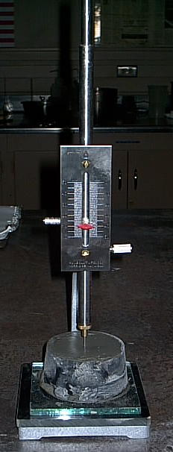
Vicat Apparatus

Slide 48
Determination of Standard Consistency (contd.)
Take 400g of cement sample (representative sample) in a wide metallic pot or on a metallic sheet where gauging is easily possible.
Add measured amount of water into it and prepare paste by gauging it within 3 to 5 minutes. (The gauging shall be completed before any sign of setting occurs. The gauging time shall be counted from the time of adding water to dry cement until commencing to fill the mould).
Apply petroleum jelly to the inner surface of
Vicat mould and base plate.
Fill the Vicat mould resting upon a non-porous plate with the paste after completely filling the mould, smooth the surface of paste using gauging trowel blade.

Slide 49
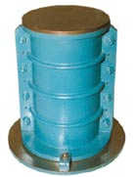
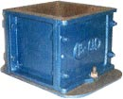
Cylindrical moulds
Cube moulds
Specifications : These are available in different sizes and are made according to Indian and British standards.
For the metric size cube moulds, the faces are machined flat to 0.02mm accuracy and finished to within 0.02mm.
For the inch size moulds, the faces are machined flat to 0.01 inches and finished to within 0.01 in.
All moulds are supplied complete with base plate.
For testing concrete cylinders for compressive strength tests.
Salient Features
Specifications : The moulds is split vertically into two parts.
The mean internal diameter is within 0.2mm and height is within 1mm. The ends are machined to 0.05.
The base plate and top plate are machined flat to 0.03mm

Slide 50
Determination of Standard Consistency (contd.)
The mould may be slightly shaken to expel the air.
Place the whole assembly (test block) on the base of
Vicat apparatus.
Slowly bring down the plunger attached to the bearing rod to touch the surface of the cement paste (rest block) and quickly release
This operation shall be carried out immediately after filling the mould
Observe the plunger point reading.
Prepare trial pastes with varying percentages of water and test as described above until the plunger penetrate to a point 5 to 7 mm from the bottom of the Vicat mould.
The value of standard consistency P
= [(water used to prepare paste (ml)/(mass of dry cement]*100

Slide 51
Preparation of Cube
Set the vibration machine.
Remove the hopper and cube mould.
Apply grease lightly to all the four inside faces of mould and base plate.
Mount with base plate on the top of vibrator under the hopper.
Tightly fit the mould and hopper with nut and side screws for mould.
Hopper should not be removed until the completion of the vibration period.

Slide 52
Preparation of Cube (contd.)
For each cube, take weighed quantity of cement, sand and water separately; say
Cement sample = 200 g
Standard sand* = 600 g
Water = (P/4+3.0) *% weight of cement and sand
where: ‘P’ is standard consistency i.e. the percentage of water required to prepare a paste of standard consistency.
(*Standard sand (IS: 650-1966)
Mix thoroughly as above weighed quantity of cement and sand with a trowel for one minute.
Then, add the calculated quantity of water and mix these three ingredients thoroughly until uniform colour of the mixture is obtained.

Slide 53
Preparation of Cube (contd.)
If uniform colour is not obtained within four minutes, reject the mixture and prepare another mixture. Gauging time is very important, it should not exceed 3 minutes at 20 ºC.
Transfer the paste through hopper into the assembled mould placed in the position on the table of the vibration machine.
Prod the mortar with poking rod 20 times in about 8 seconds to ensure elimination of entrained air and honey combing.
Place the remaining quantity of mortar in the hopper of the cube mould and prod again as specified for the first layer and then compact the mortar by vibration.
Start vibration machine and vibrate for two minutes.

Slide 54
Preparation of Cube (contd.)
Remove the mould with the base plate from the machine and finish the top surface of the cube in the mould by smoothing the surface with the blade of trowel.
Keep the mould in humid atmosphere (moist closet or moist room) for 24 hours.
After that remove the cube from mould and submerge in clean and fresh water.
Keep there for 7 (or 28 days as required ). Change the water every 7 days and maintained at a temperature of 27ºC ± 2ºC.

Slide 55
Determination of Compressive Strength
After 7 (or 28 days as required), take out the cube from water.
Place it on the base of compressive strength testing machine.
Break it with the help of compressive strength testing machine and note the total load applied at which cube is broken.
Calculate the compressive strength as below:
Compressive Strength
= [Total load (strength) applied)/(face area of cube) ] (Kg)/(cm²)

Slide 56
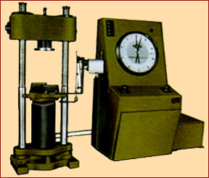
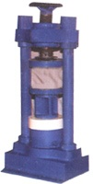
compressive strength testing machine

Slide 57
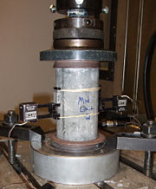
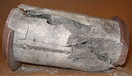
Compression testing of a concrete cylinder
Same cylinder after failure

Slide 58
Determination of Setting Times
Preparation of Test Block
First, determine the amount of water required to give a paste of standard consistency as described earlier
Prepare a neat cement paste by gauging the cement with 0.85 times the water required for standard consistency.
Start a stop watch at the time when water is added to the cement.
Fill the Vicat mould positioned in the glass plate with cement paste and smooth off the surface of the paste making it level with the top of the mould.

Slide 59
Determination of Setting Times: Preparation of Test Block (contd.)
The cement block thus prepared in the mould is the test block.
After moulding place the test block in the moist closet or moist room and allow it to remain there except when determinations of time of setting are being made
Determination of Initial Setting Time
Attach a initial needle to the movable bearing rod of
the Vicat apparatus.
Place the mould with test block on glass plate on the base
of the Vicat apparatus.
Slowly bring down the needle to the surface of the cement paste and quickly release.

Slide 60
Determination of Setting Times: Preparation of Test Block (contd.)
In beginning, the needle will completely pierce the test block.
Repeat the procedure and note down the reading on the scale at a regular interval of 10 minutes.
Every time, clean the needle from the stretching cement paste soon after it is withdrawn.
Note the time when the needle rests about a point 5±0.5 mm from the bottom of the mould.
This gives the initial setting time.

Slide 61
Determination of Final Setting Time
Remove the initial needle and fit the final needle with hollowed out metallic attachment to the bearing rod.
Lower down the needle slowly to contact with the surface of the paste and apply the needle gently to the surface.
Repeat the same operation at regular intervals of time until the needle makes a mark on the surface of the test block while metallic attachment fails to do so.
Note down the time.
The period elapsing between the time when water is added to the cement and the time at which the needle makes an impression on the surface while the attachment fail to do so, gives the final setting time.

Slide 62
Chemical Analysis fore Hydraulic cement

Slide 63
Analysis of Chemical Constituents
(Gravimetric method)
There are a number of chemical ingredients such as silica (SiO₂), alumina (Al₂ O₃),ferric oxide (Fe₂ O₃), lime (CaO), magnesia (MgO), sodium oxide (Na₂ O), potassium oxide (K₂O) etc. in cement which can be analysed, but in the forensic context only the insoluble residue, silica and lime are analyzed.
Sample Preparation
Collect 25 gm of representative sample, and sieve it through 90μm sieve. If some residue is left in the sieve, crush/grind it and pass it repeatedly till all the sample is passed through the sieve..

Slide 64
Preparation of Reagent and solutions
The following reagents are required for the above analysis:
Hydrochloric acid (sp. gr. 1.16)- 1:1, 1:3 and 1:9 (by volume)
(b) Nitric acid (sp. gr. 1.42) – concentrated
(c) Ammonium Hydroxide (sp. gr. 0.90)- 1:1 (by volume)
(d) Sodium Hydroxide Solution -Dissolve 10 g of sodium
hydroxide in one litre volumetric flask and make up to the
mark with distilled water.
(e) Ammonium Oxalate solution- Dissolve 50 g of ammonium
oxalate [(NH₄)₂C₂O₄) H₂O] in one litre of water.
(f) Bromine water
Distilled water shall be used where the use of water as a reagent is intended. Whatman filter paper No. 40, No.41 and No.42 or equivalent shall be used.

Slide 65
Analysis of Insoluble Residue
Take about 0.5 g of the sample and weigh accurately into a 250 ml beaker
Moisten with water and add 100 ml HCl (1:3) to it, heat to boil to ensure complete decomposition.
Now, filter through ash less filter paper (Whatman No. 40 or equivalent) and wash with hot distilled water.
Mark the Filtrate as A, and the Residue as I
Dissolve residue-I with filter paper in 75 ml of
sodium hydroxide (NaOH 10g per litre) and warm it,
filter it into filtrate-A. Wash with hot distilled water.

Slide 66
Analysis of Insoluble Residue (contd.)
Mark above Filtrate as B, and the Residue as II
Keep residue II with filter paper in alumina/platinum crucible (weight of the empty crucible should be recorded); and ignite it at 1000ºC for one hour in muffle furnace. Cool to room temperature and weigh the crucible with the residue.
Percentage of insoluble residue
= (weight of the insoluble residue/ initial weight of cement)* 100
If insoluble residue is more with respect to pure cement, sample is considered adulterated

Slide 67
Analysis of SiO₂
Take filtrate marked B and add 10 ml of conc. HCl to acidify.
Keep it on hot plate at 90-100ºC and heat the filtrate to dryness till yellow mass.
Bake it at 120 ºC in oven for 30 minute and moisten
with conc. HCl.
Dry again and bake for 30 minute.
Dissolve in 75 ml of HCl (1:3) and filter through ash less filter paper (Whatman No.42). Wash with 50 ml of HCl (1:9) and again wash with hot distilled water.
Mark this Filtrate as C, and the Precipitate as III

Slide 68
Analysis of SiO₂ (contd.)
Collect the precipitate of SiO₂ on filter paper and place it along with filter paper in alumina/ platinum crucible (weight of the empty crucible should be recorded).
Ignite the precipitate with filter paper at 1000 ºC for one hour in muffle furnace and then, cool it to room temperature.
Weigh crucible with the precipitate
Percentage of SiO₂ content in the sample
= (weight of the SiO₂ precipitate / initial weight of cement) * 100
In routine experiment, dissolution of residue-1 in NaOH is usually omitted and then, to acidify the filtrate- A is not necessary. Filtrate-A can directly be used for dryness and residue-I is treated as insoluble residue.

Slide 69
Analysis of combined Alumina and Ferric Oxide
Take filtrate-C; after filtering SiO₂ precipitate) and
evaporate to 100ml.
Add few drop of conc. HNO₃ or bromine water to hot solution in order to oxidise any ferrous ions to ferric ions (blue litmus paper will be red).
Then, add immediately NH₄OH till solution becomes alkaline (red litmus paper will be blue). Reddish precipitate will appear.
Boil for 5 min and allow the precipitate to settle.
Filter the precipitate through an ash less filter paper (Whatman No.41 or equivalent and wash with hot distilled water.

Slide 70
Analysis of combined Alumina and Ferric Oxide (contd.)
Mark the above Filtrate as D, and the Precipitate as IV
Ignite the precipitate with filter paper at 1000ºC for one hour
Weigh crucible with the precipitate
Percentage content of combined ferric oxide and alumina in the sample
= (weight of the Fe₂O₃ and Al₂O₃ precipitate / initial weight of cement) * 100
In routine examination, combined precipitate of ferric oxide and alumina are rejected but their precipitation is essential for analysis of CaO.

Slide 71
Analysis of CaO
Take filtrate-D, after filtering the combined precipitate of Fe₂O₃ and Al₂O₃, and acidify with HCl.
Dilute and make solution to about 200ml.
Boil and add 30-40 ml saturated solution of ammonium oxalate to hot solution.
Then, add ammonium hydroxide (1:1) drop by drop till solution become alkaline i.e. white precipitate of calcium oxalate appears, allow the precipitate to settle.
Filter the precipitate through ash less filter paper (Whatman No. 42 or equivalent) and wash with distilled water.

Slide 72
Analysis of CaO (contd.)
Ignite the precipitate with filter paper at 1000ºC for 1 hour
in muffle furnace and then cool to room temperature.
On ignition calcium oxalate is converted into CaO.
Weigh the precipitate with crucible
Percentage of lime content in cement sample
= (weight of the CaO precipitate / initial weight of cement) * 100

Slide 73
Analysis of Chemical Constituents
(EDTA Method)
By this method, content of any chemical constituents of cement except SiO₂, can be calculated directly i.e. content of CaO can be calculated directly without precipitation of Fe₂O₃ & Al₂O₃.
Preparation of solution
Take total filtrate-C i.e. after filtering the SiO₂, and makeup the volume in a 250ml volumetric flask.

Slide 74
EDTA Method (contd.)
Preparation of reagents and solution
Acetic acid-glacial.
Hydrochloric acid (sp.gr.1.16)- 1:1 (by volume).
Nitric acid (sp.gr.1.42)-concentrated.
Sulphuric acid- 1:3 (by volume)
Phosphoric acid- 1:3 (by volume)
Sulphosalicylic acid-solid.
Ammonium Hydroxide (sp. gr. 0.90)- 1:1 (by volume)

Slide 75
EDTA Method :Preparation of reagents and solution (contd.)
Sodium Hydroxide Solution -4N (approximately). Dissolve 80g of sodium hydroxide in 500 ml volumetric flask and make up to the mark with distilled water.
Sodium Chloride-solid
Sodium or potassium Sulphate-solid
Potassium Periodate-solid
Glycerol- 1:1 (by volume).
Diethylamine-liquid.
Ammonium Acetate-50% solution. Weigh 50 g of ammonium acetate and make up the volume to 100 ml with distilled water.

Slide 76
EDTA Method :Preparation of reagents and solution (contd.)
Thymol blue-0.1% solution in ethyl alcohol.
Bismuth Nitrate Solution- Weight about 5 g of bismuth nitrate pentahydrate [Bi(NO₃)3.5 H2O] in 500-ml beaker, Add 25 ml acetic acid. Stir and dilute with about 40 ml water. Filter and transfer the solution to one litre volumetric flask and make up the volume to the mark with distilled water.
Buffer Solution-pH 10. Dissolve 70 g ammonium chloride in 570 ml of ammonium hydroxide (sp.gr. 0.92) and make up to one litre with distilled water.
Standard Zinc Solution- 0.01 M. Weigh accurately 0.6537 g analytical reagent grade granulated zinc and dissolve it in the minimum quantity of dilute hydrochloric acid (1:1). Make up to the mark with distilled water in one litre flask.

Slide 77
EDTA Method :Preparation of reagents and solution (contd.)
Standard EDTA Solution -0.01M.
Dissolve 3.7224 g of disodium ethylenediamine tetra acetate dihydrate in 400 ml hot water and make up the volume in one litre flask. Take 10 ml of standard zinc solution in an Erlenmeyer flask. Add buffer solution of pH 10 and warm to 50 to 60ºC. Add 50 mg Erichrome Black- T indicator and titrate with EDTA till colour changes from wine red to clear blue.
Note the volume (V) of EDTA used
Molarity of EDTA = 0.01*10/V
Adjust the molarity to 0.01M if required

Slide 78
EDTA Method :Preparation of reagents and solution (contd.)
Erichrome Black-T: Grind 100 mg of indicator with 10 g of sodium chloride.
Store in an airtight polythene bottle.
Xylenol Orange: Grind 1 g of indicator with 100 g of potassium nitrate and store in an airtight bottle.
Patton and Reeder Indicator: Grind 100 mg of the indicator with 10g of sodium or potassium sulphate until a homogeneous mixture is obtained.
Store in an airtight bottle.
Distilled water shall be used where the use of water as a reagent is intended.

Slide 79
Analysis of Ferric Oxide
Take 25 ml of solution (of filtrate C) and add
dil NH₄OH (1:6) till turbidity appears.
Clear the turbidity with a minimum amount of dil HCl (1:3) and add a few drops in excess to adjust the pH to 1.15.
Shake well and then, add 100ml of sulphosalicylic acid. Titrate with 0.01 M EDTA solution and calculate the percentage of Fe₂O₃ as bellow:
Calculations
1ml of 0.01M EDTA = 0.7985 mg of Fe₂O₃
Percent Iron Oxide (Fe₂O₃) = 0.7985*V/X₀
Where, V is the volume of EDTA used in titration, and X₀ is the initial weight of cement sample in gm.

Slide 80
Analysis of Al₂O₃
Take 25 ml of solution (of filtrate C), and first titrate it as above for iron at pH=1.5 with EDTA using sulphosalicylic acid as indicator.
Add 15 ml standard EDTA solution, 1 ml of phosphoric acid (1:3), 5 ml of sulphuric acid(1:3) and one drop of thymol blue into the titration flask.
Add ammonium acetate solution by stirring until the colour change from red to yellow. Add 25 ml of ammonium acetate in excess to attain a pH of about 6.
Heat the solution to boiling for one minute and then, cool. Add 0.5 g solid xylenol orange indicator and bismuth nitrate solution slowly with stirring until the colour of the solution changes from yellow to red.

Slide 81
Analysis of Al₂O₃ (contd.)
Add 2 to 3 ml of bismuth nitrate solution in excess and titrate with 0.01M EDTA to a sharp yellow end point.
Calculations
1 ml of 0.01M EDTA = 0.05098mg of Al₂O₃
Percent Al₂O₃ = 0.5098*V/x₀
where:
X₀ = initial weight of sample taken in gm
V = volume of EDTA used for Alumina in ml
V = V1- V2- V3E
V1 = total volume of EDTA used in the titration in ml
V2 = volume of EDTA used earlier for iron in ml.
V3 = total volume of bismuth nitrate solution used in ml, and E = equivalence of 1 ml of bismuth nitrate solution.

Slide 82
Analysis of Al₂O₃ (contd.)
Equivalence of bismuth nitrate solution is obtained as follows:
Take 100 ml of bismuth nitrate solution to a 500 ml flask and dilute with about 100ml distilled water.
Add few drop of thymol blue solution and ammonium acetate solution until the colour changes from red to yellow.
Add 0.05 g of xylenol orange indicator and titrate with 0.01 M EDTA until the colour changes from red to yellow.
The equivalence E (ml of 0.01M EDTA) of 1 ml of bismuth nitrate solution is calculated as :
E= V4/100 where V4= volume of EDTA solution in ml.

Slide 83
Analysis of CaO
Take 10 ml of silica free acid solution of the sample (filtrate C),
in a 250 ml conical flask.
Add 5 ml of 1:1 glycerol with constant stirring and then, add 5 ml of diethylamine.
To this, add 10ml of NaOH-4N solution and shake well to adjust pH about 12 (to highly alkaline range).
Add about 50 ml of distilled water and 50 mg of solid Patton-Reeder’s indicator. Titrate with 0.01M EDTA solution to a sharp change in colour from wine red to clear blue.

Slide 84
Analysis of CaO (contd.)
Calculations
1ml of 0.01mEDTA = 0.5608 mg 0f CaO
Percent CaO = 0.05608*25*V/X₀
where:
V = volume of EDTA used in ml, and’
X₀ = initial weight of sample taken in gm
In presence of high magnese (Mn₂O₃), which interferes with the estimation of CaO, the above procedure is slightly modified as below:
Take 10ml silica free solution of the sample (filtrate C)
in a 250ml conical flask.
Add 2-3 drop nitric (HNO₃) acid followed by 50 mg
of potassium periodate.

Slide 85
Analysis of CaO: Calculations (contd.)
Keep the flask on water bath till a pink colour develops.
Shake and allow to cool to room temperature.
Add 5 ml of 1:1 glycerol with constant stirring and then, 5 ml of diethylamine.
Add 3-4 pellets of NaOH and shake well to adjust the pH to 12 or slightly more.
Add 50 ml of distilled water and 100 mg of solid Patton- Reeder’s indicator.
Titrate with 0.01 M EDTA solution to a sharp change in colour from violet to blue and calculate percent CaO as similar to the above.

Slide 86
Requirements for ordinary Portland cement
acid soluble
silica 21.32 % (19-25%)
CaO 63.36 %, (60-67%)
MgO 4.20 %, (0.5-5% )
A_{l2}O₃ 5.65 % (3-8%)
Fe₂O₃ 2.23 % (0.3-6%)
SO₃ 1.61 % (1-3%)

Slide 87
Loss on ignition
Max
GRADE 33 5%
GRADE 43 5%
GRADE 53 1%
Insoluble residue
Max
GRADE 33 4%
GRADE 43 2%
GRADE 53 2%

Slide 88
Examination of Cement by
X-Ray Diffraction Technique
As is well known, cement is made by mixing together calcareous and argillaceous materials at high temperature and its properties depend on various phase compositions of clinker and on the structure of individual crystal phases.
Cement has, thus, an unique structural/phase characteristics and any changes in its structure clearly reveals the alteration of its quality.
Keeping in view, x-ray diffraction technique- ‘a tool of structure determination’ can be used in forensic context to analyse the quality of cement sample.

Slide 89
X-Ray Diffraction Technique (contd.)
In some cases,
when a specific or two more adulterants are blended in such way that the values of the basic constituents remain within the limits of prescribed in the specifications, conventional physical and chemical methods are not of much help;
and in addition,
- identification of nature of adulterant is also very difficult by conventional methods since both the cement and adulterant usually have same ingredient,
X-ray diffraction method is more useful.
The method is rapid and conclusive

Slide 90
X-Ray Diffraction Technique (contd.)
Procedure:
The x-ray diffractometer is set with the following operating conditions:
Source : CuKα
Voltage : 40KV
Current : 30mA
Scanning rate : 0.125 deg/min
Integrating time : 4sec.
Sample holder size : rectangular, 2 x 1x 0.5 cm

Slide 91
X-Ray Diffraction Technique (contd.)
Take 2-3 g of representative sample and make fine powder.
Fill the sample tightly in specimen holder of XRD and fix them with adhesive tape or quick fix paste.
Put specimen holder at its stage and start to record x-ray diffraction patterns from the Bragg angle, 2θ =10 deg.
to 2θ = 45 deg. on paper chart.
Now a days, computerised x-ray diffractometer in which
d-spacing as well as intensity corresponding to peak are calculated simultaneously, are available.
If this type of facility is not available then,
First, observe XRD patterns.
Measure the distance in mm of each pattern/peak from initial/origin point.

Slide 92
X-Ray Diffraction Technique (contd.)
This directly corresponds to 2θ i.e. the Bragg angle.
Calculate d- spacing using the Bragg equation:
2 d Sin θ = λ
Where: λ =wave length of characteristic x-ray radiation depend on material of target ( for example λ = 1.5418 A⁰
for Cu Kα line)
Make a table of XRD pattern in descending order in a table
with the following columns
Sample no., 2d-spacing, Intensity, Relative Intensity I/Io
Relative intensity of each peak is obtained by dividing the
intensity of peak having highest intensity

Slide 93
Identification of Adulterated Cement
Compare the XRD patterns so observed for the questioned sample with XRD patterns of pure/standard cement carefully and on the basis of comparison only, adulteration in cement can be detected easily.
Presence of any extra new XRD peak/line in XRD patterns of sample clearly reveals the adulterated or poor quality cement.
Identification of Adulterant:
In the case of adulterated cement sample, as mentioned above, some extra/new XRD lines/ peaks will be observed in the XRD patterns of sample.
Note these extra/new XRD lines/peaks with d-spacing and their corresponding intensity.

Slide 94
Identification of Adulterant (contd.)
Match the d- spacing sequentially with d-spacing of known compound using ASTM file.
Two compounds/samples must be identical, if their XRD patterns match; and on the basis of this any unknown compound (adulterant) can be identified easily.
Now a days, in modern X-ray Diffractometers, ASTM files are also available as library and the procedure becomes more easy to identify the adulterants

Slide 95
X-Ray Diffraction Analysis for Phase Abundances
Analysis of portland cement is difficult as the large number of
phases results in substantial peak overlap
Diffraction pattern for each phase is unique
The patterns are produces independently of others, and
In a mixture, their intensities are proportional to phase concentration
Amorphous phases may be identified through use of an internal standard
These problems are being addressed using the Rietveld method and the General Structure Analysis System (GSAS)

Slide 96
The Rietveld method allows standardization of powder diffraction analysis through use of calculated reference diffraction patterns based upon crystal structure models
Whole pattern –fitting utilizes all diffraction pattern data,
Reference models optimized for each material representing the best-fit for each phase,
Compositional and structural variations may be accounted for relative to the idealized structure models in the database,
Pattern scales are used in calculation of phase abundances

Slide 97
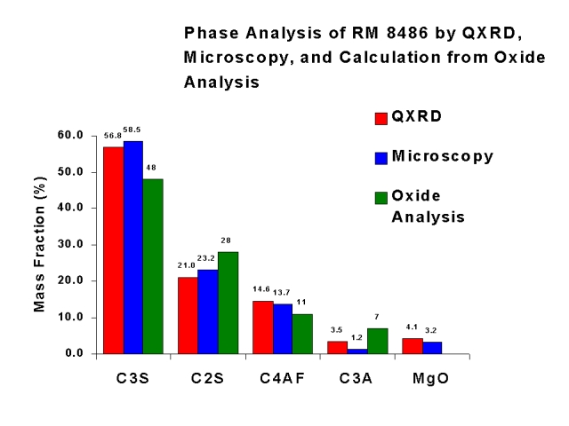

Slide 98
Thermal analysis
Thermal analysis is useful in both quantitative and qualitative compositional analyses of multicomponent materials.
Samples may be identified and characterized by investigations of their thermal behavior.
The fields in which DT A has been applied to the chemistry of cements can be summarized as follows
(a) Analysis of the raw materials prior to calcination e.g. to determine the amounts of calcium carbonate and magnesium carbonate present.

Slide 99
Thermal analysis (contd.)
(b) A study of the physical and chemical processes which occur as the finely ground raw materials are heated progressively up to about 1500 °C, to form cement clinker.
(c) To study the composition and rate of growth of the hydration products at various periods after setting of the cement.
(d) The effect of accelerators and retarders on the setting characteristics of cements has been studied by DT A.
(e) Differential thermal analysis has now become a standard method for determining the degree of conversion (and consequent loss of strength) in high alumina cements.

Slide 100
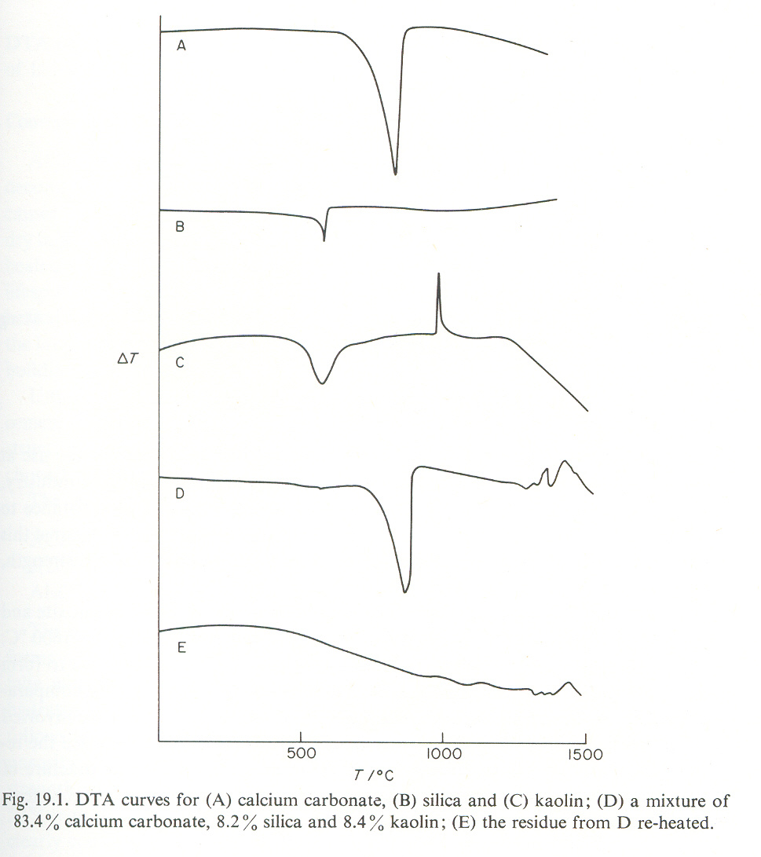
A typical DT A curve for a mixture of cement raw materials

Slide 101
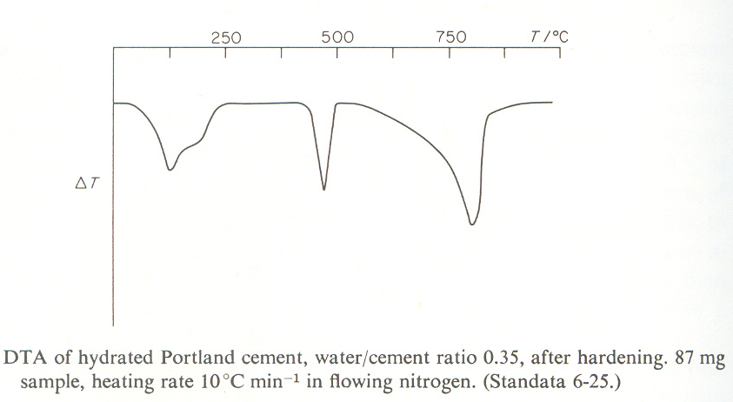
A typical DTA curve for hydrated Portland cement

Slide 102
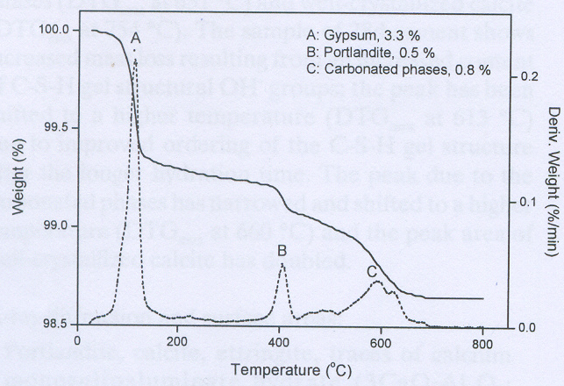
TG/DTG curve of anhydrous cement

Slide 103
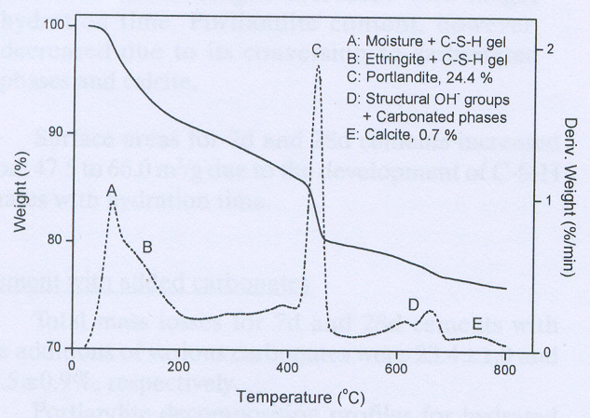
TG/DTG curve of cement
hydrated for 28 days at 60⁰C

