Slide 1
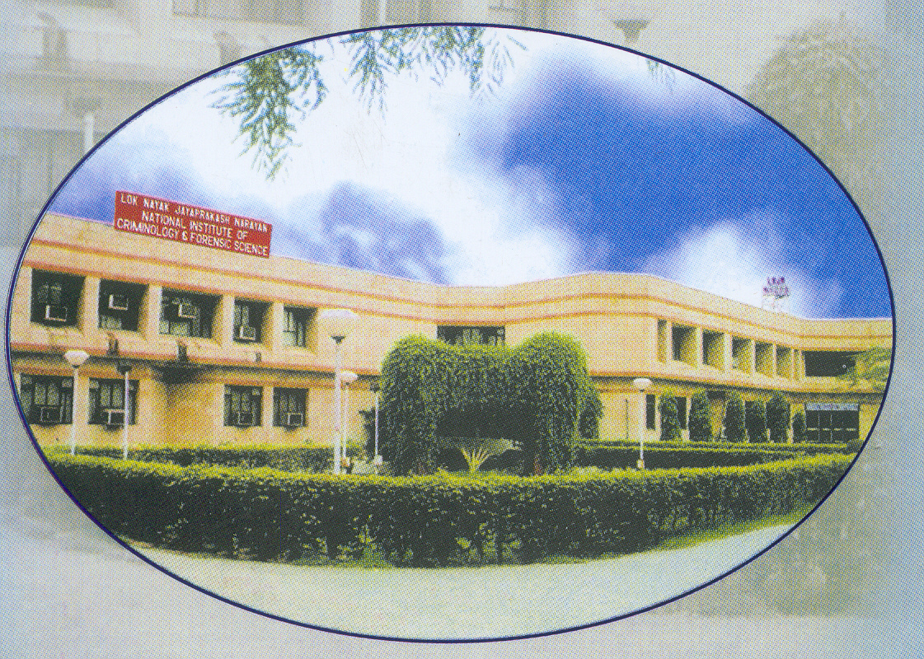
Building Material
and
Road Material
Cement
Mortar _
Concrete
Brick
Bitumen
Stones _
Sand
ranbsingh

