Slide 1
Equipments for the examination of Questioned Documents
Professor Ran B. Singh
Visiting faculty NICFS, Delhi

Slide 2
for Questioned Document Examinations
one may need
Measuring instruments
Magnifiers
Light Sources
Equipments for chemical examinations
Special application devices

Slide 3
Measuring instruments
Linear scales
Special scales
Micrometers
Screw gauge
Paper gauge (dial type)

Slide 4
Magnifiers
Eye pieces
Binocular magnifiers
(tied to forehead with headband)
Illuminated magnifiers
(with or without scales)
Microscopes (stereo)

Slide 5
Light sources
(filters for selection of band width)
visible
- reflected, co-axial, retro,
- transmitted,
- oblique
ultraviolet
Infrared
X-rays
Laser

Slide 6
Equipments for chemical examinations
Chromatographic Apparatus
Fume Chamber
Humid Chamber
Heating Chamber (oven, IR lamp)
Spectrophotometers

Slide 7
Special application devices
Electrostatic Developers
Digital Image Processing
Special Devices developed for the
examination of questioned documents
(with combined facilities like different
light sources, filters, split windows for
comparisons, image processing, etc.)

Slide 8
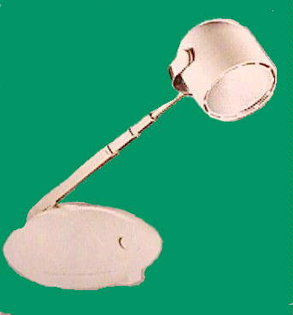
Desk lamp
with a swivel head,
a gooseneck arm, and a weighted base

Slide 9
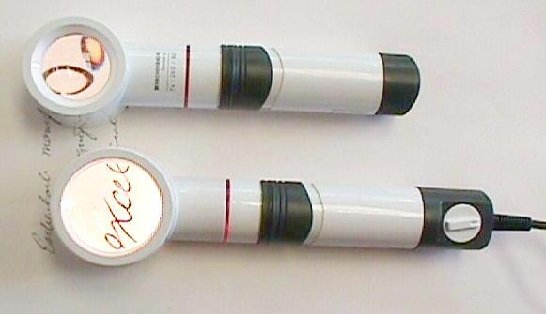
illuminated
Magnifiers
an incandescent battery halogen handle with
a 7x head
a halogen pulg-in handle with
a 4.2x head
Notice the wider field and less distorted image through the 4.2x head

Slide 10
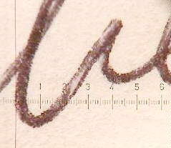
Distortion free measurements
Precision Scale Magnifier (say x7 or x10)
a linear scale

Slide 11
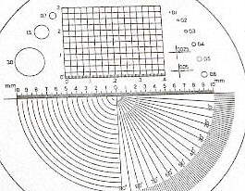
a combination scale with useful measurement options
as magnification increases,
the field of view decreases

Slide 12
In case alignment of lines, vertical or horizontal,
is to be checked; transparent sheets with parallel lines or grid may be prepared.
It can be prepared by making Xerox copies on transparent sheets of graph paper or other chart papers as per need.
Alternatively, lines, grids etc of required spacing and dimensions may made with computer.
Computer generated lines and grid

Slide 13
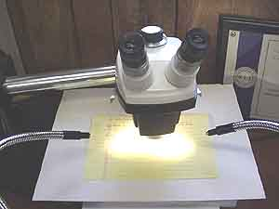
Stereo-zoom microscope
with lenses and eyepieces
providing a range of magnification from 8-160x
to identify the process that produced a document, or to look at a "line sequence" problem, a higher magnification allows a closer look at the "dots" of ink or toner that are on the document

Slide 14
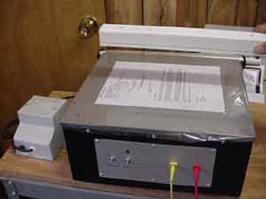
an electrostatic detection device
An electrostatic detection
device is used to detect
indented writing. It
consists of a metal
box with a porous
metal plate at the top.
The document is positioned on the plate and covered with a clear protective sheet. A vacuum is drawn, holding the document tightly to the metal plate, and an electrostatic charge is transferred to the document.

Slide 15
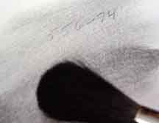
Powder method
Toner powder is sprinkled
over the document, the
toner is drawn into the
indentations on the
document, making them visible. If indentations are revealed the results can be photographed, and the document is usually not harmed.
Electronography

Slide 16
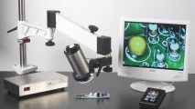
A digital microscope
combining optics, with
digital technology
for image display
and capture.
The examiner can see the big picture on the monitor in addition to, or instead of, seeing it through the eyepiece. These devices supplement, but do not replace, conventional optical microscopes

Slide 17
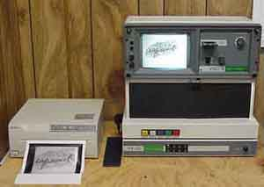
A special instrument
for document examination
makes use of electromagnetic
wavelengths and various filters
to differentiate inks and reveal
hidden material on documents.
It has a full compliment of visible, UV and IR sources, source and camera filters, coaxial light, transmitted light, oblique light and other features that allow the document examiner to see beyond what the human eye can see in order to learn what has happened to a document

Slide 18
Thank You

